Slide 1

Digital Products Project
Status Report
Presented by Staff to the Digital Products Work Group
February 19, 2026

Slide 2
Where We Started
April 2021 –
Washington gave a presentation contrasting different approaches states use to include digital products in the sales tax base –
  Broad definitions (with exemptions)—similar to the longstanding approach to tangible property.
  Narrow, specific definitions—more like excise taxes and Streamlined’s approach.

Slide 3
Where We Started
June 2021 –
The Standing Subcommittee recommended tp the Uniformity Committee that it draft a white paper on the broad approach:
  What it is,
  The issues that approach may raise, and
  Whether it’s workable.

Slide 4
Where We Started
July 2021 to April 2022 –
The Uniformity Committee directed MTC staff to do research and hold stakeholder interviews to create a detailed outline of issues for the white paper.
Staff conducted research and held dozens of interviews to identify issues raised, summarizing them in the form of an outline.

Slide 5

Where We Started
August 2022 –
The Uniformity Committee reviewed the outline of the white paper, gave approval to continue with the project, and formed a work group to review the issues and give more detailed input.

Slide 6
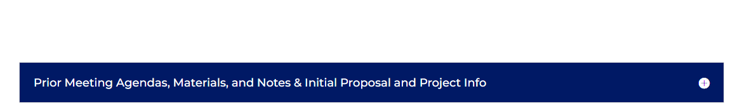
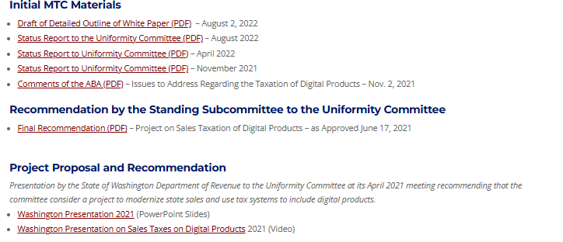
The Initial Itinerary
. . .

Slide 7
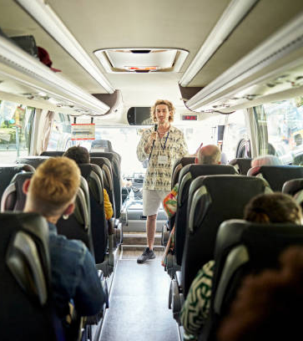
Travel
Companions
Stakeholders –
  Dozens of interviews with practitioners, taxpayers, academics, and states.
Other Groups –
  Ongoing interactions with Streamlined, FTA, NCSL, etc.
State Participants –
  As part of work group and study group discussions.
Members of the Public –
  Through our public participation process.

Slide 8
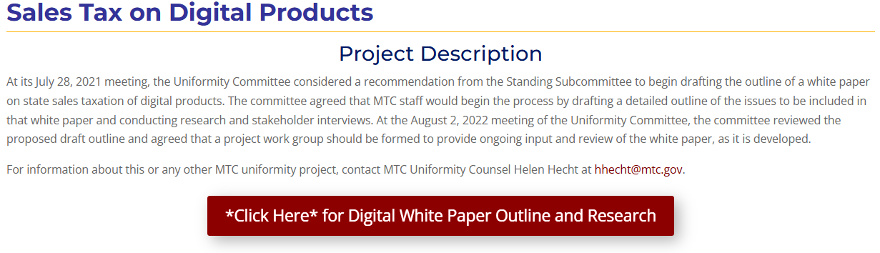
Our Roadmap

Slide 9
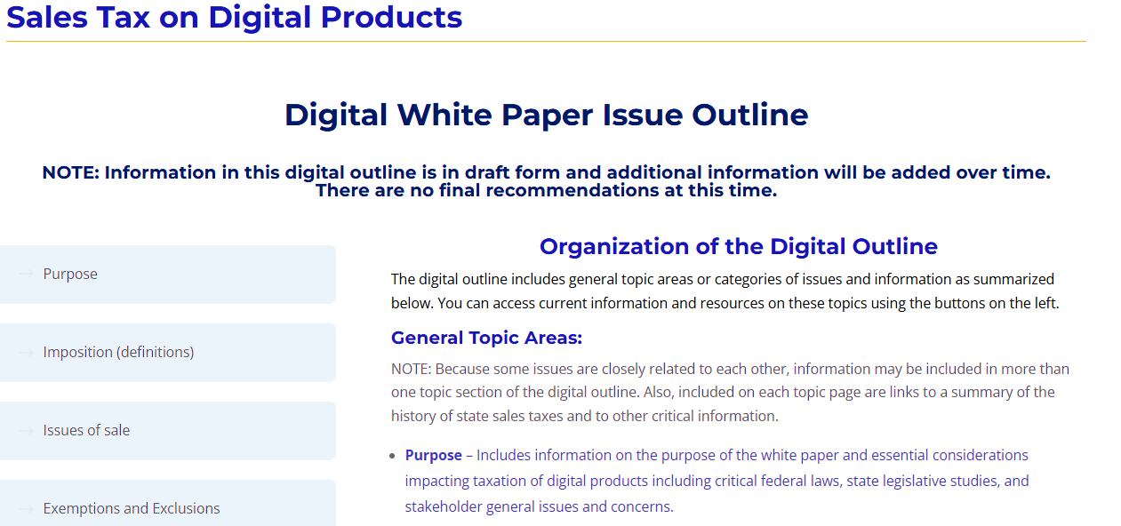
Our Roadmap

Slide 10
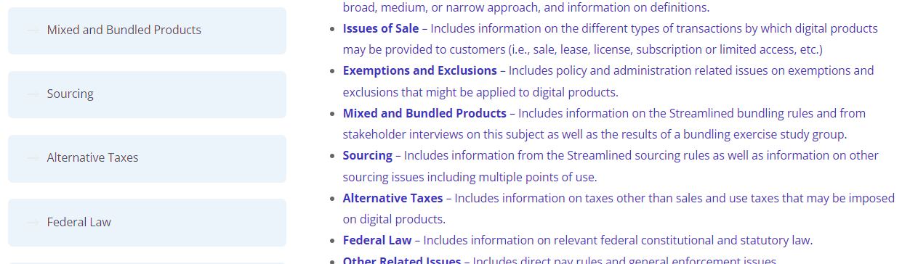
Our Roadmap

Slide 11
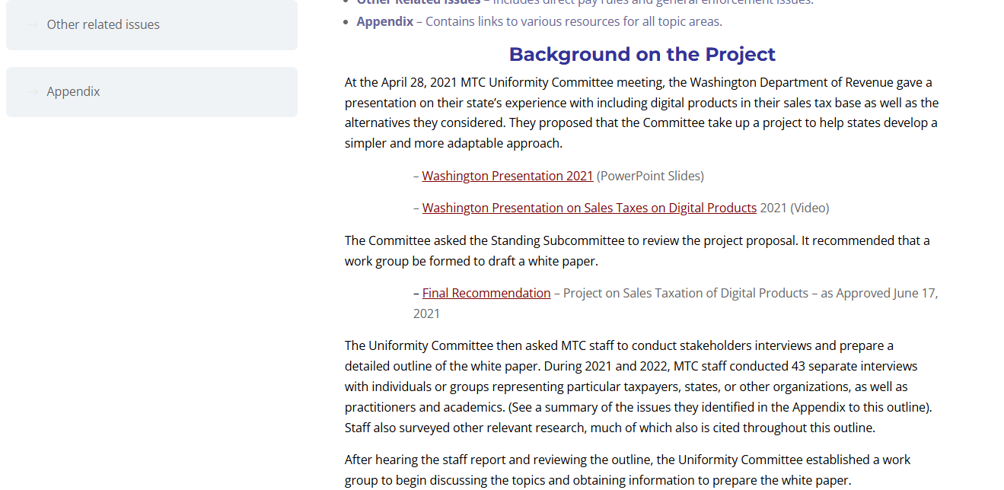
Our Roadmap

Slide 12
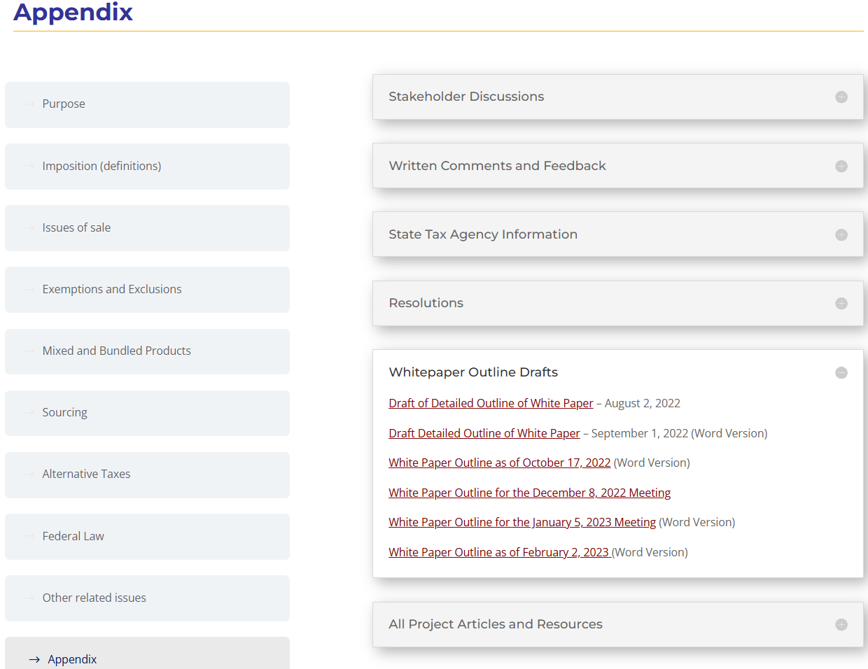
Our Roadmap

Slide 13
Stops Along the Way
32 Work Group meetings – September 2022
to today
Other presentations – MTC, Streamlined, NCSL, ABA, AICPA, etc.
Study groups – definitions and bundling
Notes, research, summaries, comments, etc.

Slide 14
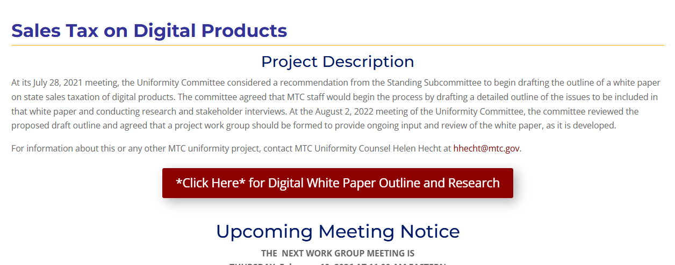
Stops Along the Way
. . .

Slide 15
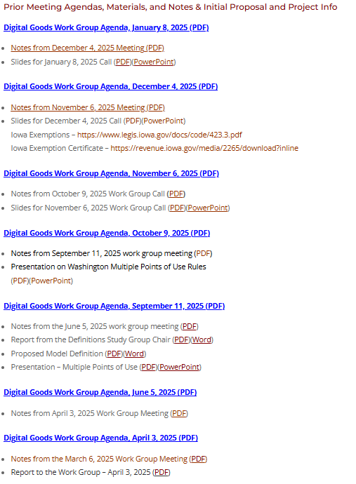
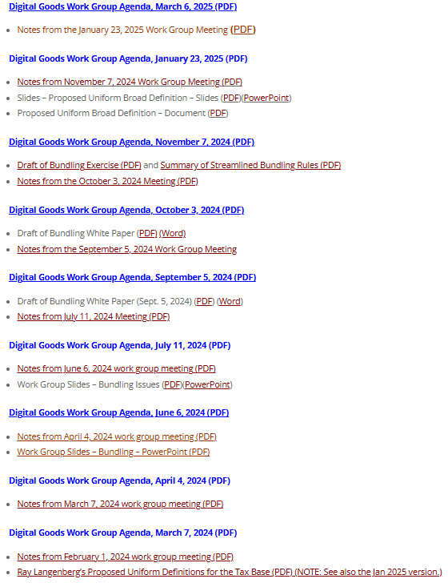
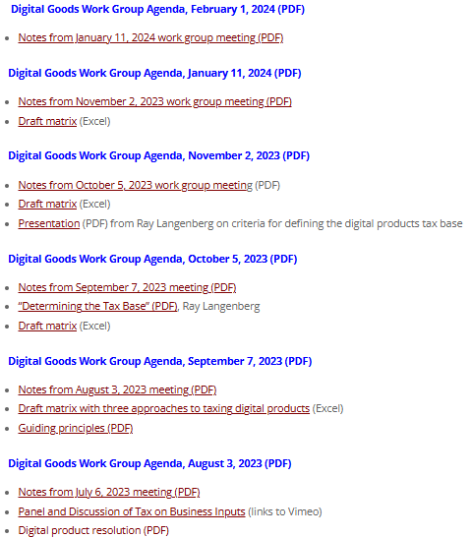
Stops Along the Way

Slide 16
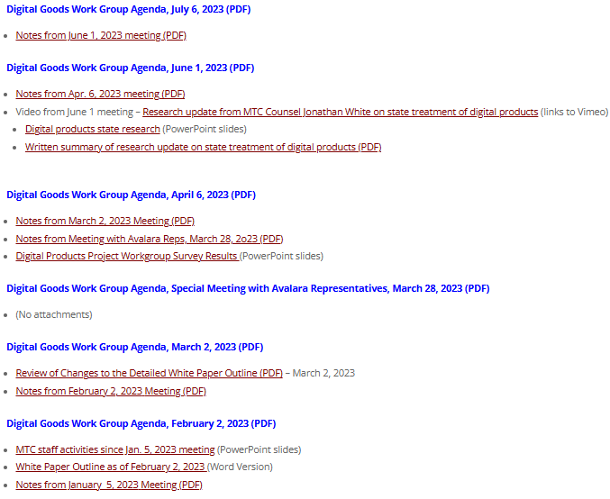
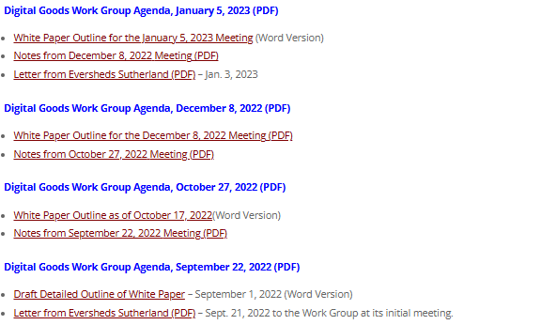
Stops Along the Way

Slide 17
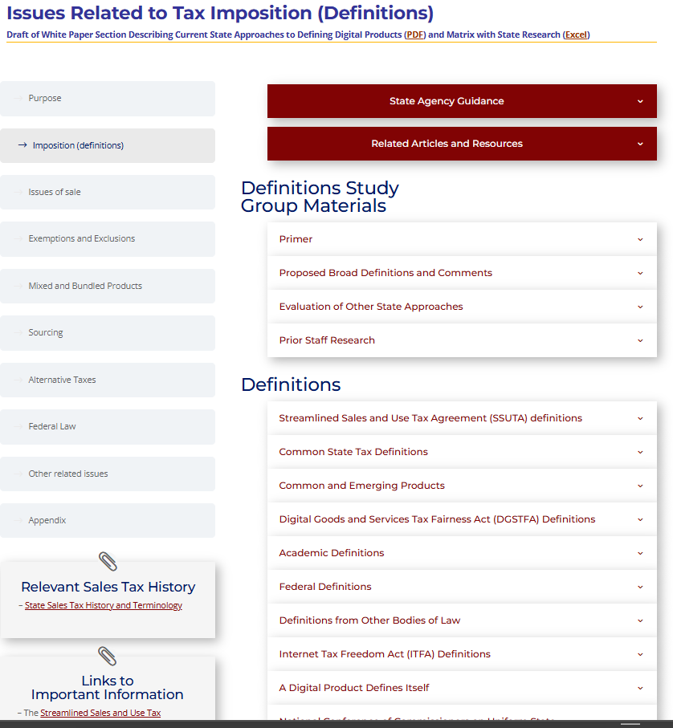
“Souvenirs”

Slide 18
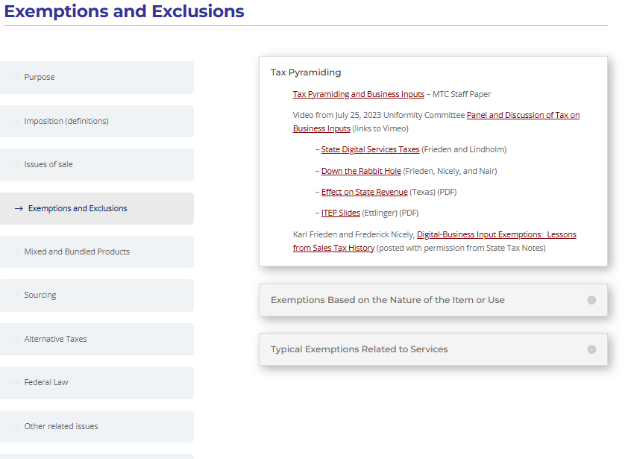
“Souvenirs”

Slide 19

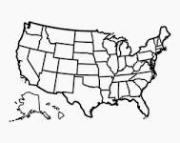
Drafting the White Paper (Travel Guide)
Sales Tax on
Digital Products –
Travel Guide
MTC staff have begun the process of drafting sections of the white paper and updating the web page.
As we do—we publish the drafts.
Goal would be to have a “substantial” draft in time for the April in-person committee meetings.
We can also have work group meetings when necessary to discuss any issues or substantial revisions.

Slide 20
Other Developments
The White House Council of Economic Advisors (CEA) issued a recent report.
It recommends states consider repealing state income taxes and replace the revenue lost with an expanded sales tax.

Slide 21
Other Developments
From the CEA:
“The biggest difference between this new sales tax and existing sales tax is that it would place a tax on both goods and services. Sales taxes in most states are currently levied only on goods and a limited set of services. Because spending on goods is only 30 percent of total personal consumption expenditure, the taxable base of currently-existing sales taxes is quite low relative to what it could be. Consequently, as we will show, most states can replace their personal income tax, corporate income tax, and existing general sales tax with this new sales tax below 10 percent and still attain full revenue replacement.”

Slide 22
Other Developments
The Tax Foundation found that, to achieve the revenue replacement the CEA estimates included:
“All healthcare expenditures, including those covered by private insurance (funded by premiums subject to separate excise taxes) and those paid for by government through Medicare, Medicaid, and other programs (which cannot be taxed as a matter of law).
“Consumption that does not involve a financial transaction, including the full imputed value of banking services that are largely funded by banks’ reinvestment of depositor funds, not by direct fees from depositors.
“The value of services provided by nonprofits at free or subsidized rates, including scholarships and endowment subsidies that reduce college tuition, free or subsidized medical care, aid provided by charitable organizations, and the full operating expenses of houses of worship (none of which are transactions and none of which could be subject to sales tax).
“Other purchases that are not legally taxable, including internet access and purchases from the US Postal Service.”
Even with these assumptions, the revenue replacement amount appears overstated.

Slide 23
It’s a journey, not a destination.
Or more precisely, it’s a description of the journey and the important landmarks along the way.
QUESTIONS OR COMMENTS

