Slide 1

Sales Tax on Digital Products
Work Group Meeting
December 4, 2025

Slide 2
Exclusions and Exemptions
Digital Products Project

Slide 3
Stakeholder issues
From the White Paper Outline (summarizing stakeholder interviews)
  General mechanics of the sales and use taxes – especially exemptions and sourcing
  . . .
  (3) Application of general B2B exemptions to digital products when the purchaser is a business (a) Description of the problem (b) Possible solutions

Slide 4
Stakeholder issues
From the White Paper Outline (summarizing stakeholder interviews)
  General mechanics of the sales and use taxes – especially exemptions and sourcing (cont’d)
  (4) Application of exemptions based on the nature of the item or use, e.g., fabrication, processing, etc. (a) Description of the problem (b) Possible solutions.
  (5) Application of typical exemptions related to services, e.g., educational services, entertainment, etc. (a) Description of the problem (b) Possible solutions

Slide 5
Exclusions and Exemptions – Proposed Outline
I. Sales Tax Base & Related Terms
  A. The ultimate sales tax base is typically determined as follows:
    1. Definitions – which form the starting point for imposition of the tax by:
      Generally defining items (e.g. tangible personal property),
      Specifically defining certain items (e.g. certain digital products).
    2. Broad exclusions – which narrow the general application of the tax by making:
      Limitations on or exceptions to the defined items to which tax applies—typically included in the definitions themselves (e.g. when sold at retail or unless sold for some purpose)
      General exclusions based on easily verifiable criteria (e.g. items sold by government).

Slide 6
Exclusions and Exemptions – proposed outline
    3. Exemptions – which carve out from the tax base certain specific transactions based on various criteria which often have to be verified in some way, including:
      a. Definitions of specific items,
      b. Who the seller is (e.g. hospitals),
      c. Who the buyer is (e.g. government),
      d. Purpose of the item (e.g. prescription drugs),
      Use of the item by the buyer (e.g. resale, manufacturing, agriculture, etc.),
      Other criteria (e.g. sales tax holidays).

Slide 7
Exclusions and Exemptions – proposed outline
  B. Exclusions versus exemptions – The way in which certain transactions or items are removed from the tax base—whether through narrow definitions or exclusions or through exemptions varies by state. Some states may exclude things that are exempted by other states and vice versa.

Slide 8
Exclusions and Exemptions – proposed outline
  C. Different approaches to determining the tax base – states have typically taken two different approaches to determining the sales tax base:
    1. Broad definition with a number of specific exemptions: States generally tax tangible personal property broadly defined, with certain exclusions or exemptions, and
    2. Narrow definition with fewer specific exemptions: States generally tax services and intangible or digital items by narrowly defining specific services or items, with certain exclusions or exemptions

Slide 9
Exclusions and Exemptions – proposed outline
II. Common Exclusions/Exemptions
  Because states approach the determination of the tax base in different ways—the summary here includes common carve-outs whether they are exclusions or exemptions.
  A. Typical general exclusions (not part of the “price” or “receipts”):
    1. Certain additional charges and fees (e.g., shipping and delivery charges)
    2. Cash discounts, coupons, trade-ins, rebates, etc.
    3. Interest, consignment fees, collection fees and similar charges

Slide 10
Exclusions and Exemptions – proposed outline
  B. Common exclusions based primarily on the definition of the item:
    1. Real property and improvements
    2. Clothing and related items
    3. Food
    4. Vehicles and related transportation property
    5. Medical health-related items
    6. Items subject to other excise taxes
    7. Currency and related intangible items
    8. Art and collectibles

Slide 11
Exclusions and Exemptions – proposed outline
  C. Common exclusions/exemptions based primarily on the identity of the seller or buyer:
    1. Occasional sellers
    2. Related-party transactions
    3. Government
    4. Religious organizations
    5. Educational, non-profit, or charitable organizations
    6. Health or medical organizations or persons
    7. Local quasi-governmental functions
    8. Veterans or other persons

Slide 12
Exclusions and Exemptions – proposed outline
  D. Common exemptions based primarily on use:
    1. Purchases or leases for resale or release
    2. Manufacturing or production inputs
    3. Component parts of items to be resold

Slide 13
Exclusions and Exemptions – proposed outline
  E. Common exemptions based on multiple criteria:
    1. Business purchases of office supplies
    2. Business purchases of energy
    3. Manufacturers’ purchases of equipment and production tools
    4. Agricultural business purchases of equipment and production tools
    5. Mining and natural resource industry equipment
    6. Sales tax holidays for certain items

Slide 14
Report of Study Group - Proposed Definition -
“Related Exemption: A product is exempt from taxation as an automated digital product if the product will be used predominantly for a trade or business.”
“Existing exemptions and exemption procedures should be reviewed to determine applicability. If a state has other exemptions that are limited to tangible personal property or taxable services, the state should consider expanding the exemptions to explicitly cover automated digital products.”

Slide 15
What is a “Trade or Business”?
The term is not defined for federal tax purposes but its use depends on context.
For example - from the IRS Website – here: https://www.irs.gov/charities-non-profits/definition-of-trade-or-business.
  The term trade or business generally includes any activity carried on for the production of income from selling goods or performing services. It is not limited to integrated aggregates of assets, activities, and goodwill that comprise businesses for purposes of certain other provisions of the Internal Revenue Code. Activities of producing or distributing goods or performing services from which gross income is derived do not lose their identity as trades or businesses merely because they are carried on within a larger framework of other activities that may, or may not, be related to the organization's exempt purposes.

Slide 16
What is a “Trade or Business”?
One approach might be to refer to the expenses allows as “ordinary and necessary” expenses for conducting a trade or business under IRC Sec. 162.

Slide 17
Implementing a Broad B2B Exemption - Iowa Code section 423.3(104)
Applies to: “a. The sales price of specified digital products and of prewritten computer software sold, and of enumerated services . . . furnished, to a commercial enterprise for use exclusively by the commercial enterprise.”
Limited as follows: “The use of prewritten computer software, a specified digital product, or service fails to qualify as a use exclusively by the commercial enterprise if its use for noncommercial purposes is more than de minimis.”

Slide 18
Implementing a Broad B2B Exemption - Iowa Code section 423.3(104)
Definition of Commercial Enterprise. “b. . . . (1) “Commercial enterprise” means the same as defined in subsection 47, paragraph “d”, subparagraph (1), . . .
  Referenced Section: “(1) Commercial enterprise” means businesses and manufacturers conducted for profit, for-profit and nonprofit insurance companies, and for-profit and nonprofit financial institutions, but excludes other nonprofits and professions and occupations.”
Addition: “ . . . but also includes professions and occupations, and includes public utilities as defined in section 476.1, subsection 2.”

Slide 19
Implementing a Broad B2B Exemption - Iowa Code section 423.3(104)
(2) “De minimis” and “noncommercial purposes” shall be defined by the director by rule.
Iowa Administrative Code, Iowa Admin. Code r. 701-225.7 on De minimis. “’De minimis’ means an amount of use of a product for noncommercial purposes that, when considering the product's value and the frequency with which the use for noncommercial purposes occurs during the product's total use time, is so small as to make accounting for that use unreasonable or impractical. Whether a use is de minimis is a fact-based determination that shall be made on a case-by-case basis.”

Slide 20
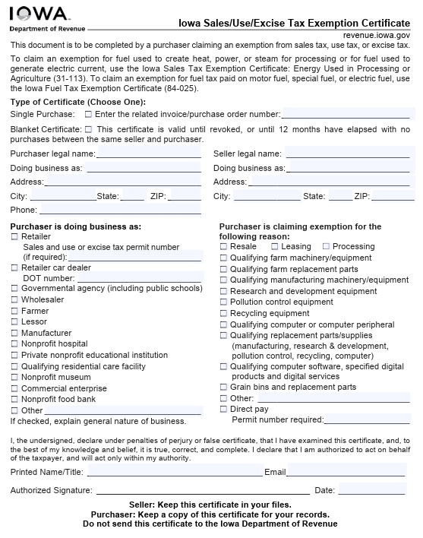
Iowa Exemption Certificate
Available here: https://revenue.iowa.gov/media/2265/download?inline

Slide 21
Iowa is Also an Example of Including digital products in other deductions (Listed in Code section 423.3(104))
17. The sales price of all tangible personal property, specified digital products, or services, used for educational purposes sold to any private nonprofit educational institution in this state. . . .
20. The sales price of tangible personal property or specified digital products sold, or of services furnished, to nonprofit legal aid organizations.
21. The sales price of tangible personal property, of specified digital products, or of services, used for educational, scientific, historic preservation, or aesthetic purpose sold to a nonprofit private museum.
22. The sales price from sales of tangible personal property, of specified digital products, or from services furnished, to a nonprofit private art center to be used in the operation of the art center.
23. The sales price of tangible personal property or specified digital products sold, or of services furnished, if such tangible personal property, specified digital products, or services are sold to or by a fair organized under chapter 174.
ETC., ETC. . . .

Slide 22
Questions – Discussion?

