Slide 1

State Taxation of Partnerships –
Status Report
Report to the Uniformity Committee
November 18, 2025

Slide 2
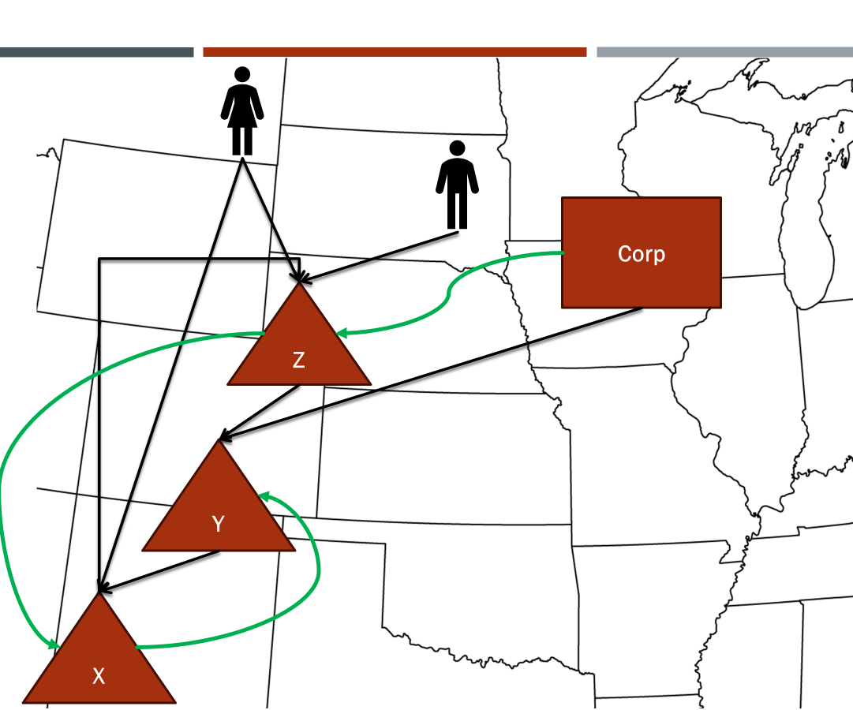
NOTE:
This presentation sets out information from the work group’s discussions, white paper draft, and multistate research, which are on the project webpage here: partnership project webpage. This information is presented to the Uniformity Committee for consideration and discussion. All input is welcomed.
*Our multistate research should not be relied on as tax advice. For specific questions, please contact your state department of revenue and/or tax advisor.

Slide 3
Project status update
Sourcing of partnership income under the pass-through tax system in complex partnership structures & use of blending.
Work group intends to begin drafting model rules based on the white paper’s recommendations.
Anticipation of “aligning” these rules with the special rules for investment partnerships.

Slide 4
Overall Goals
Equity in sourcing of business income of partnerships, proprietorships, and corporations.
This means sourcing to location of income generating activities.
Avoidance of the use of partnerships to shift income and other abuse.

Slide 5
Overall Goals
What is true for Subchapter K will be true for state sourcing rules—there will need to be exceptions for cases involving clear tax-avoidance as well as clear application of the federal anti-abuse rules to state issues.
Equity in sourcing of business income of partnerships, proprietorships, and corporations.
This means sourcing to location of income generating activities.
Avoidance of the use of partnerships to shift income and other abuse.

Slide 6
Recommendations:
  Use terms consistently with partnership law and Subchapter K and define other important terms to avoid ambiguity.
  (See subsection I.B., C. and D.)

Slide 7
Some basic Examples:
“Distributions” and “distributive shares” are two very different things.
“Allocate” can mean different things depending on context –
  State tax systems = using rules of assignment to source income or items.
  Federal pass-through system = determining a partner’s share of items.
“Partnership income” is a very generalized term that may not be specific enough. (“Partnership items” may be more useful.)

Slide 8
Recommendations:
  2. Recognize how the attribution principle may affect application of state tax rules.
  (See subsection I.F.)

Slide 9
Attribution principle
IRC 702(b):
  The character of any item of income, gain, loss, deduction, or credit included in
  a partner’s distributive share under paragraphs (1) through (7) of subsection
  (a) shall be determined as if such item were realized directly from the source
  from which realized by the partnership, or incurred in the same manner as incurred by the partnership.
Items referenced in (a) are basically any items whose tax character will affect the application of the substantive tax rules to that partner.

Slide 10
How the passthrough system works
INCOME ATTRIBUTES
Determined at the partnership level
PARTNER ATTRIBUTES
Determined at the partner level
TAX RESULT
Determined under the substantive tax rules

Slide 11
Prime Examples:
Beneficial tax treatment attributed to partners:
  A lower rate for capital gains would presumably apply to partners’ shares of the partnership’s capital gains.
Sourcing of non-apportionable items attributed to partners:
  Sourcing rules apply based on character of the item or type of income.
  For example, real property rents are sourced to property location.
  This is true regardless of whether the apportionable / non-apportionable decision is made at the partnership or partner level. (More in a minute.)

Slide 12
Recommendations:
3. Adopt the following sourcing framework for sourcing partnership income.
(See subsection II.A.)
  The partnership will determine whether the items of income that it recognizes directly from its own activities are apportionable income or non-apportionable income, using information reasonably available.

Slide 13
Simple framework Example:
Assume Partnership X has two sources of income –
  Retail business
  Sale of real property unrelated to that business.
X would determine that –
  The retail business income is apportionable, and
  The gain from the sale of real property is non-apportionable.
X does not need partner-attribute information for this determination.

Slide 14
Recommendations:
3. Framework, cont’d.
(See subsection II.A.)
  For items which the partnership determines to be non-apportionable, it will then apply state rules of assignment to determine the source of those items, based on their character, and will report this information to partners for their use.

Slide 15
Simple Framework Example (cont’d):
Partnership X determines that, under applicable rules for
non-apportionable income, the source of the gain from the real property sale is the location of the property.
Assuming the location is State 1, it would provide that information to the partners.

Slide 16
Recommendations:
3. Framework, cont’d.
(See subsection II.A.)
  Partnerships will also determine their apportionment factors by state and will provide information sufficient for partners to use those factors in sourcing their share of the apportionable income directly recognized by that partnership.

Slide 17
Simple framework Example (Cont’d):
Partnership X determines its factors for State 1 and that its resulting apportionment factor in State 1 is 50%.
It provides to partners the information they need to source their share of the apportionable income.

Slide 18
Recommendations:
3. Framework, cont’d.
(See subsection II.A.)
  Partners will source their share of items determined by the partnership to be non-apportionable income based on the sourcing information provided by the partnership.

Slide 19
Simple Example (Cont’d):
Corp Y is a partner in Partnership X.
Corp Y would source its share of the gain from X’s sale of real property to State 1.
Might there be an exception to this treatment if the real property had some connection to Corp Y’s business? Potentially. See anti-abuse rules.

Slide 20
Recommendations:
3. Framework, cont’d.
(See subsection II.A.)
  e. Partners will source their share of items determined by the partnership (or the partner) to be apportionable income either by:
  i. Applying the partnership’s apportionment factors to those items, or
  ii. Using blended apportionment.

Slide 21
Simple Example – No Blending (cont’d):
Corp Y is a partner in Partnership X.
Corp Y has no unitary relationship with X.
Corp Y sources 50% of its share of X’s apportionable income to State 1 (using X’s apportionment factors).
It doesn’t matter that Corp Y might characterize the partnership income as non-apportionable. The character of income is determined at the partnership level.

Slide 22
Recommendations:
4. Blending - Use absolute value of distributive share for determining the share of partnership factors to include in the partner’s apportionment factor when blending.
(See subsection II.B.)

Slide 23
What is blending?
Blending the partner’s income and distributive share:
  The partner combines its distributive share of partnership apportionable income with its own apportionable income (which effectively offsets any distributive share of items of income or expense related to transactions with the partnership).
Blending the partner’s factors with share of partnership factors:
  The partner includes in its apportionment factor its share of the partnership factors that represent the related apportionable income (excluding receipts related to any partner-partnership transactions in proportion of the partner’s distributive share).

Slide 24
The problem with Blending
*****SPECIAL ALLOCATIONS!*****
Partnerships do not have to allocate (share) income or items with partners in proportion to the partners’ capital shares.
AND – different partnership items may be allocated to the same partner in different amounts.
So – basing the partner’s share of factors on the partner’s capital share may not reflect the partner’s share of the partnership income.
But basing the share of factors on the partner’s distributive share may also create issues.

Slide 25
Simple Blending Example:
Partnership X has partner Corp Y which uses blending to source its share of X’s apportionable income.
X has two different but unitary income amounts:
  Item 1: $1 million gain (revenue)
  Item 2: $ 2 million loss (expense)
  Net partnership income = $1 million loss
Y receives special allocations of these items as follows:
  Item 1: 70% = $700,000
  Item 2: 10% = ($200,000)
  Y’s net distributive share = $500,000

Slide 26
Simple Blending Example:
Dividing a positive number by a negative number gives you a negative percentage - $500,000 ÷ ($1,000,000) = (50%) (as does dividing a negative number by a positive number).
Does that mean Corp Y should deduct 50% of the partnership factors from its own factors? – NO.
Rather – the share would be calculated using absolute values.

Slide 27
Blending Example:
Total
  Item 1: $1 million gain (revenue)
  Item 2: $ 2 million loss
  Absolute value = $3 million
Y’s shares:
  70% of gain = $700,000
  10% of loss = $200,000
  Absolute value = $900,000
Y’s share of factors = $900,000 ÷ $3,000,000 = 30%

Slide 28
More on Blending
Effects of intercompany transactions are eliminated in income and factors.
A partner or partners using blending will source the partnership income differently than partners using separate apportionment (at the partnership level). This is the effect of the combination of income and partner attributes.

Slide 29
Recommendations:
5. Blending - Apply blended apportionment when there is a sufficient unitary relationship between apportionable income of the partnership and apportionable income of the partner (detailed in subsection II. B.).
(See subsection II.B.)

Slide 30
What is a Sufficient Unitary Relationship?
Based on general principles as applied in the corporate context.
  Problem No. 1 –
    The U.S. Supreme Court has never applied these principles in the context of the partnership pass-through system, where income of the partnership is attributed to the partners.
  Problem No. 2 –
    There are many questions over “entity unity” versus “asset unity”
  Problem No. 3 –
    In partnerships, ownership does not equal control.

Slide 31
Recommendations:
6. Consider a special rule for sourcing mandatory allocations of built-in gains or losses attributed to the contributing partner—at least in some situations.
(See subsection II.C.)
7. Consider how related-entity transactions not eliminated by blended apportionment may affect the sourcing of income and adopt special rules—including add-back statutes and transfer-pricing authority.
(See subsection II.D.)

Slide 32
Recommendations:
9. When adopting more detailed rules, states should also consider limitations or exceptions that may simplify the application of state sourcing requirements to partnership income where there is little chance of abuse and where this would reduce compliance burdens.
10. Many states will also need to adopt more detailed partnership information reporting rules and forms to ensure partners have necessary information to source their distributive share.

Slide 33
  “ALIGNING” WITH SPECIAL RULES FOR QIPS
The special rules for qualified investment partnerships were drafted to apply a “look-through” approach in certain circumstances.
The rules may not address fully how non-qualifying partners (active partners and corporate partners) will source their income.
The rules may also not address how administrative expenses of the investment partnership are sourced.

Slide 34
  DRAFTING MODEL RULES
Models can serve as a “proof of concept.”
They can also highlight areas where a lack of uniformity can lead to multiple taxation, nowhere taxation, or undue complexity.

Slide 35
  Drafting Steps
Rule for use of terms – Use will be consistent with Subchapter K and state law of partnerships unless otherwise clearly indicated. Will also refer to model rules for sourcing.
Rule for attribution – The attribution of the character of items under IRC 702 will also apply where the character of items determines or contributes to the determination of state tax effects—including sourcing.

Slide 36
  Drafting Steps (cont’d)
Framework: Sourcing of distributive share and guaranteed payments for services.
  Partnership level –
    Determine apportionable and non-apportionable items
    Apply rules of assignment (UDITPA rules of allocation) to the non-apportionable items
    Determine apportionment factors and source apportionable income
    Attribute source of partnership income determined at the partnership level to the partners (using results of 2 and 3) – exception where blended apportionment is applied to apportionable income

Slide 37
  Drafting Steps (cont’d)
    Blended apportionment –
      Apply when the business or income of the partnership bears a unitary relationship with the partner’s business or income.
      Use absolute value of the distributive share of items (including guaranteed payments) allocated to the partner to determine the partner’s ratio of the factors and eliminate the share of related-party transactions from the receipts factor.

Slide 38
  Drafting Steps (cont’d)
Framework: Sourcing of distributive share and guaranteed payments for services.
  Limitations or special rules –
    Clarify that federal anti-abuse rules apply where the effect is on state tax, including sourcing, rather than on the federal tax
    Special rules for sourcing of built-in gains (losses) in some circumstances
    Review of model add-back rule and its application to partnerships
    Special rules necessary for investment partnerships
      Address the application of the sourcing rules to non-active partners
      Address the application of sourcing rules to the non-investment income and expense of the partnership
      Address the application of sourcing rules to active/managing partners

Slide 39
  Public Comments
We recently received written comments from the Energy Infrastructure Council (EIC) – posted on the partnership project page.
The work group will be discussing these comments and any other input at its next meeting on December 17.

Slide 40
Does the Committee Have questions or are there any concerns about proceeding to draft model rules?

