Slide 1

Sales Taxation of Digital Products –
Status Report
Report to the Uniformity Committee
November 18, 2025

Slide 2
Overview
Project and work group were created to consider whether digital products could be included in the sales tax base without specifically defining each product (beyond what Streamlined has already done).
This has benefits given that products change, evolve, and are replaced rapidly.
We are working closely with Streamlined to share discussions and information and do not intend to supplant its efforts or issue conflicting guidance.
The goal is to identify and capture information on issues for policy-makers considering expanding their sales tax base to include digital products.

Slide 3
Pace of Change is speeding up
New AI products pop up every week – including those that are free online for uses generally.
AI is potentially disrupting all types of services, including professional services.
This is particularly true within businesses, including start-ups.
AI is also being used to market products, including digital products, and help shoppers compare and try out products virtually.

Slide 4
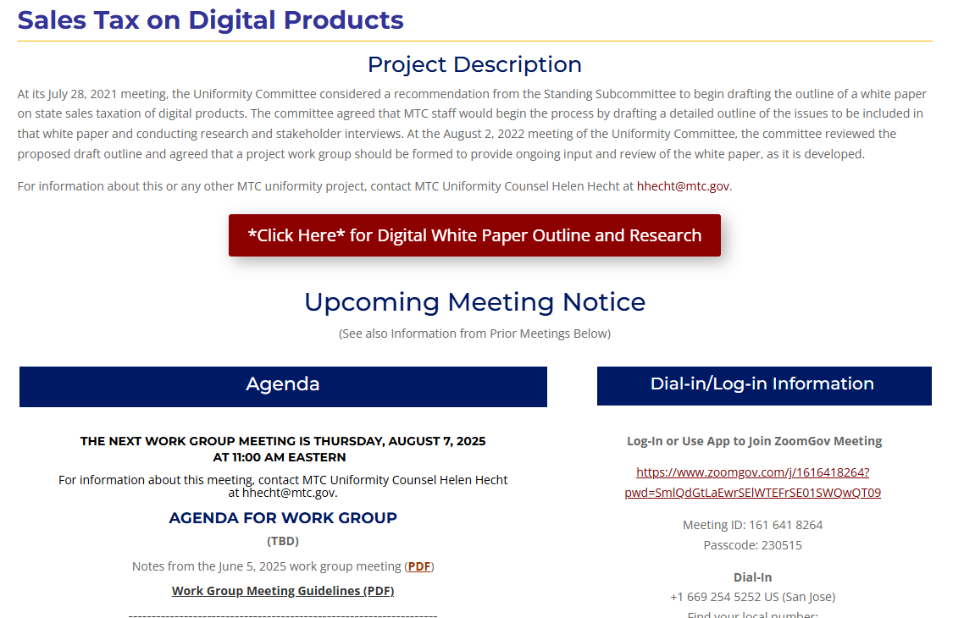
Project Web Page and Online Outline
Information on the project is captured on its web page – here
That project page has a link to an online outline of the white paper

Slide 5
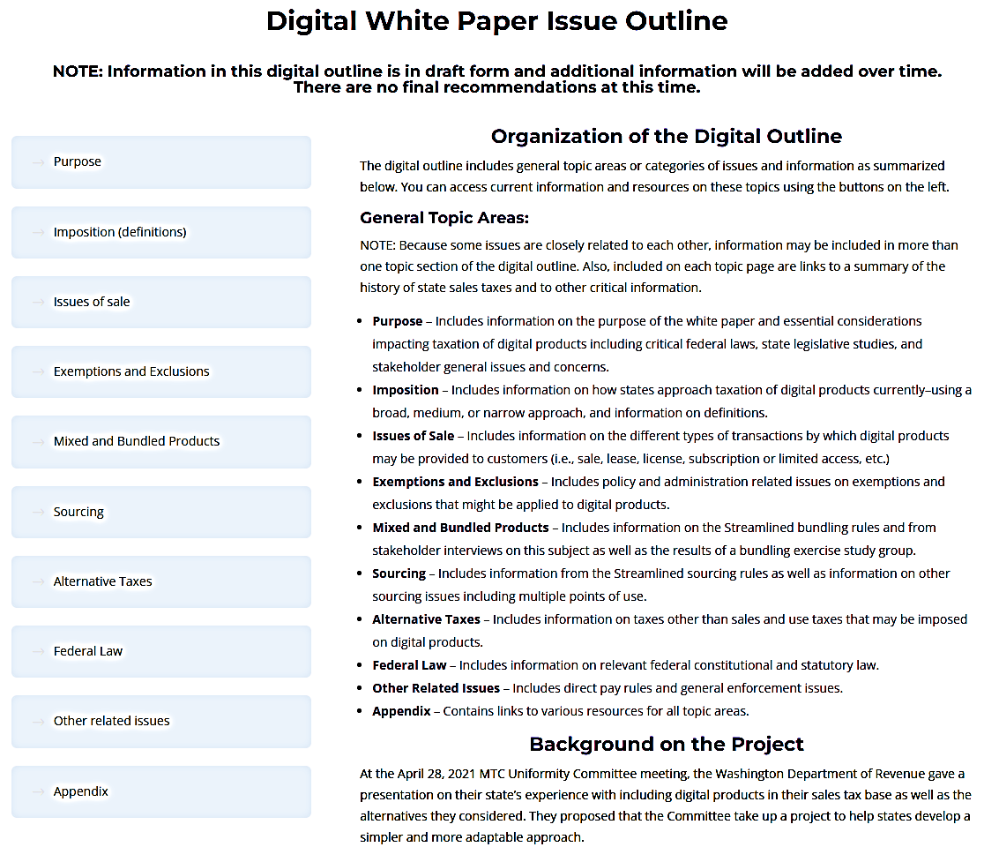


The White Paper

Slide 6
Project Report
Since the last committee meeting, the work group has:
  Wrapped up discussions of a proposal to define digital products broadly along with a general business-input exemption.
    The workgroup will evaluate the results of these discussions to develop any findings or recommendation to be included in the whitepaper.
  Considered issues in sourcing sales of digital products, including multiple points of use (MPU) sourcing.

Slide 7
Proposal to Broadly Define Digital Products
The focus of recent discussions has been mainly on the ability to draw a clear line between what is a digital product and what is a service, including services performed through employment of digital products.
The proposal sets out this discussion in much more detail and is posted on the project page.

Slide 8
Sourcing Digital Products
Streamlined rules as well as other states rules are being summarized for the white paper.
State experience using MPU rules – including in Washington and Massachusetts – has also been discussed.

Slide 9
MPU Sourcing Take-Aways
Streamlined considered an approach to MPU sourcing but did not implement the related rules.
Before adopting MPU rules, states should consider:
  What purchasers will the rules apply to? (Generally business purchasers.)
  What types of products will the rules will apply to?
  When will the rules apply – that is, when is a product available for use in multiple states?
  What method will be used to apportion the value between states?

Slide 10
MPU Sourcing challenges
Challenges states may face in implementing MPU rules :
  Documentation that needs to be kept by seller and purchaser
  Defining “user” for purposes of when the product is used in multiple states
  Addressing complex and varied transactions which may be unique.

Slide 11
MPU Sourcing challenges (Cont’d)
  Refunds are often the means by which purchasers apply MPU to their purchase transactions.
  Apportionment of bundled transactions may pose additional questions (see the work group’s discussion of the bundling issue generally).
  How credits for taxes paid in other states may work with MPU rules.

Slide 12
Next up - Exemptions

Slide 13
Report of Study Group - Proposed Definition -
“Related Exemption: A product is exempt from taxation as an automated digital product if the product will be used predominantly for a trade or business.”
“Existing exemptions and exemption procedures should be reviewed to determine applicability. If a state has other exemptions that are limited to tangible personal property or taxable services, the state should consider expanding the exemptions to explicitly cover automated digital products.”

Slide 14
Exclusions and Exemptions – Proposed Outline
I. Sales Tax Base & Related Terms
  A. The ultimate sales tax base is typically determined as follows:
    1. Definitions – which form the starting point for imposition of the tax by:
      Generally defining items (e.g. tangible personal property),
      Specifically defining certain items (e.g. certain digital products).
    2. Broad exclusions – which narrow the general application of the tax by making:
      Limitations on or exceptions to the defined items to which tax applies—typically included in the definitions themselves (e.g. when sold at retail or unless sold for some purpose)
      General exclusions based on easily verifiable criteria (e.g. items sold by government).

Slide 15
Exclusions and Exemptions – proposed outline
    3. Exemptions – which carve out from the tax base certain specific transactions based on various criteria which often have to be verified in some way, including:
      a. Definitions of specific items,
      b. Who the seller is (e.g. hospitals),
      c. Who the buyer is (e.g. government),
      d. Purpose of the item (e.g. prescription drugs),
      Use of the item by the buyer (e.g. resale, manufacturing, agriculture, etc.),
      Other criteria (e.g. sales tax holidays).

Slide 16
Exclusions and Exemptions – proposed outline
  B. Exclusions versus exemptions – The way in which certain transactions or items are removed from the tax base—whether through narrow definitions or exclusions or through exemptions varies by state. Some states may exclude things that are exempted by other states and vice versa.

Slide 17
Exclusions and Exemptions – proposed outline
  C. Different approaches to determining the tax base – states have typically taken two different approaches to determining the sales tax base:
    1. Broad definition with a number of specific exemptions: States generally tax tangible personal property broadly defined, with certain exclusions or exemptions, and
    2. Narrow definition with fewer specific exemptions: States generally tax services and intangible or digital items by narrowly defining specific services or items, with certain exclusions or exemptions

Slide 18
Exclusions and Exemptions – proposed outline
II. Common Exclusions/Exemptions
  Because states approach the determination of the tax base in different ways—the summary here includes common carve-outs whether they are exclusions or exemptions.
  A. Typical general exclusions (not part of the “price” or “receipts”):
    1. Certain additional charges and fees (e.g., shipping and delivery charges)
    2. Cash discounts, coupons, trade-ins, rebates, etc.
    3. Interest, consignment fees, collection fees and similar charges

Slide 19
Exclusions and Exemptions – proposed outline
  B. Common exclusions based primarily on the definition of the item:
    1. Real property and improvements
    2. Clothing and related items
    3. Food
    4. Vehicles and related transportation property
    5. Medical health-related items
    6. Items subject to other excise taxes
    7. Currency and related intangible items
    8. Art and collectibles

Slide 20
Exclusions and Exemptions – proposed outline
  C. Common exclusions/exemptions based primarily on the identity of the seller or buyer:
    1. Occasional sellers
    2. Related-party transactions
    3. Government
    4. Religious organizations
    5. Educational, non-profit, or charitable organizations
    6. Health or medical organizations or persons
    7. Local quasi-governmental functions
    8. Veterans or other persons

Slide 21
Exclusions and Exemptions – proposed outline
  D. Common exemptions based primarily on use:
    1. Purchases or leases for resale or release
    2. Manufacturing or production inputs
    3. Component parts of items to be resold

Slide 22
Exclusions and Exemptions – proposed outline
  E. Common exemptions based on multiple criteria:
    1. Business purchases of office supplies
    2. Business purchases of energy
    3. Manufacturers’ purchases of equipment and production tools
    4. Agricultural business purchases of equipment and production tools
    5. Mining and natural resource industry equipment
    6. Sales tax holidays for certain items

Slide 23
So far based on work group Discussions
Some practitioner concerns would apply to exemptions generally – including documentation and good faith requirements for sellers to accept exemption certificates.
States that provide broad B2B exemptions may not have to amend various exemption provisions but will still have to look at how the general exemption is documented.

Slide 24
Other Related issues
States are continuing to look at digital advertising.
Litigation involving Maryland’s tax is ongoing.

Slide 25
Questions or Feedback

