Slide 1

Sales Tax on Digital Products
Work Group Meeting
November 6, 2025

Slide 2
Status – Sourcing discussion
Discussed the Streamlined rules at prior meetings
Discussed the multiple points of use (MPU) issue
Looked at the Washington and Massachusetts approaches and also talked about Streamlined’s work in this area
Main points –
  Important to determine what the rules apply to
  Non-B2B purchases may be excluded
  Refunds are a major means for implementing MPU
  Other issues may not be fully addressed
This information will be part of the white paper

Slide 3
Exclusions and Exemptions
Digital Products Project

Slide 4
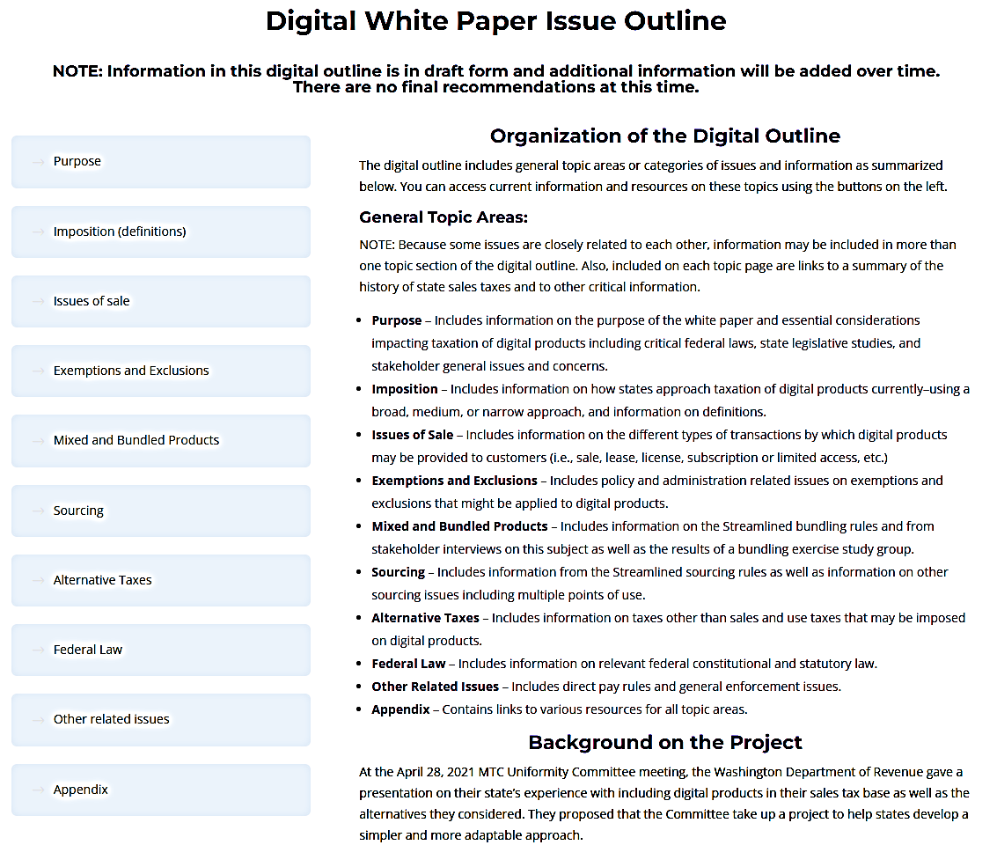
The White Paper

Slide 5


The White Paper

Slide 6
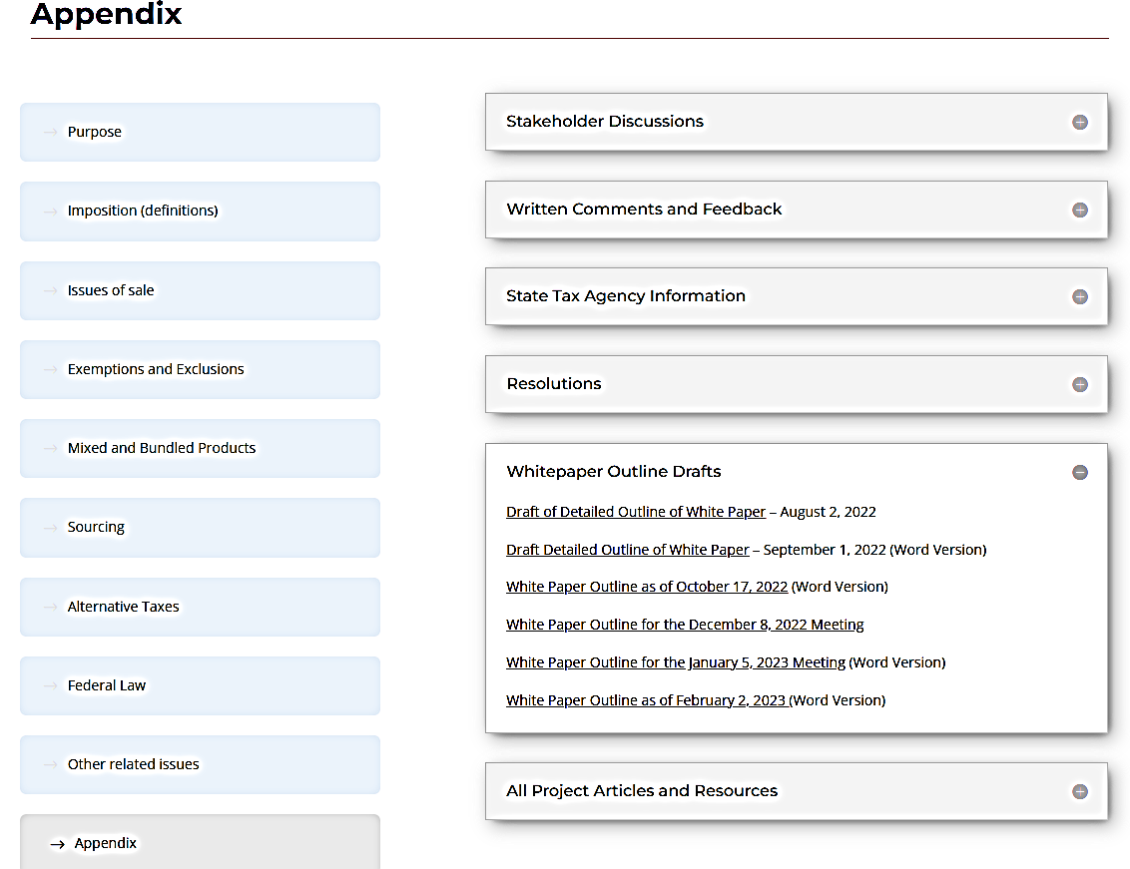
The White Paper

Slide 7
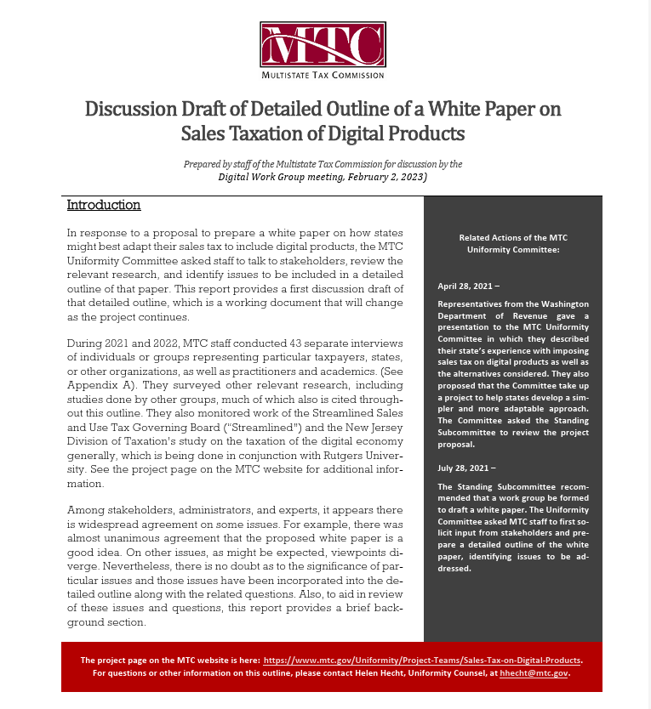
The White Paper
Outline

Slide 8
Exemptions & Exclusions
From the White Paper Outline
  “Exemptions – As noted above, states typically provide a number of exemptions. Many of these exemptions address B2B transactions to reduce tax pyramiding or address the inherent regressivity of the tax. Others may single out particular industries or activities for tax benefit. There is a wide variation in the types of exemption states offer and even similar exemptions may rely on slightly different defined terms or requirements.”

Slide 9
Stakeholder issues
From the White Paper Outline (summarizing stakeholder interviews)
  General mechanics of the sales and use taxes – especially exemptions and sourcing
  (1) Sales tax versus use tax and whether difference in the nature of the taxes might justify additional rules (a) Multiple points of use (i) Description of the problem (ii) Adoption and repeal of rule by Streamlined (iii) Possible solutions
  (2) Possible limit on the period after first use during which a subsequent use in a state may give rise to tax
  (3) Application of general B2B exemptions to digital products when the purchaser is a business (a) Description of the problem (b) Possible solutions

Slide 10
Stakeholder issues
From the White Paper Outline (summarizing stakeholder interviews)
  General mechanics of the sales and use taxes – especially exemptions and sourcing (cont’d)
  (4) Application of exemptions based on the nature of the item or use, e.g., fabrication, processing, etc. (a) Description of the problem (b) Possible solutions.
  (5) Application of typical exemptions related to services, e.g., educational services, entertainment, etc. (a) Description of the problem (b) Possible solutions

Slide 11
Report of Study Group - Proposed Definition -
“Related Exemption: A product is exempt from taxation as an automated digital product if the product will be used predominantly for a trade or business.”
“Existing exemptions and exemption procedures should be reviewed to determine applicability. If a state has other exemptions that are limited to tangible personal property or taxable services, the state should consider expanding the exemptions to explicitly cover automated digital products.”

Slide 12
Exclusions and Exemptions – Proposed Outline
I. Sales Tax Base & Related Terms
  A. The ultimate sales tax base is typically determined as follows:
    1. Definitions – which form the starting point for imposition of the tax by:
      Generally defining items (e.g. tangible personal property),
      Specifically defining certain items (e.g. certain digital products).
    2. Broad exclusions – which narrow the general application of the tax by making:
      Limitations on or exceptions to the defined items to which tax applies—typically included in the definitions themselves (e.g. when sold at retail or unless sold for some purpose)
      General exclusions based on easily verifiable criteria (e.g. items sold by government).

Slide 13
Exclusions and Exemptions – proposed outline
    3. Exemptions – which carve out from the tax base certain specific transactions based on various criteria which often have to be verified in some way, including:
      a. Definitions of specific items,
      b. Who the seller is (e.g. hospitals),
      c. Who the buyer is (e.g. government),
      d. Purpose of the item (e.g. prescription drugs),
      Use of the item by the buyer (e.g. resale, manufacturing, agriculture, etc.),
      Other criteria (e.g. sales tax holidays).

Slide 14
Exclusions and Exemptions – proposed outline
  B. Exclusions versus exemptions – The way in which certain transactions or items are removed from the tax base—whether through narrow definitions or exclusions or through exemptions varies by state. Some states may exclude things that are exempted by other states and vice versa.

Slide 15
Exclusions and Exemptions – proposed outline
  C. Different approaches to determining the tax base – states have typically taken two different approaches to determining the sales tax base:
    1. Broad definition with a number of specific exemptions: States generally tax tangible personal property broadly defined, with certain exclusions or exemptions, and
    2. Narrow definition with fewer specific exemptions: States generally tax services and intangible or digital items by narrowly defining specific services or items, with certain exclusions or exemptions

Slide 16
Exclusions and Exemptions – proposed outline
II. Common Exclusions/Exemptions
  Because states approach the determination of the tax base in different ways—the summary here includes common carve-outs whether they are exclusions or exemptions.
  A. Typical general exclusions (not part of the “price” or “receipts”):
    1. Certain additional charges and fees (e.g., shipping and delivery charges)
    2. Cash discounts, coupons, trade-ins, rebates, etc.
    3. Interest, consignment fees, collection fees and similar charges

Slide 17
Exclusions and Exemptions – proposed outline
  B. Common exclusions based primarily on the definition of the item:
    1. Real property and improvements
    2. Clothing and related items
    3. Food
    4. Vehicles and related transportation property
    5. Medical health-related items
    6. Items subject to other excise taxes
    7. Currency and related intangible items
    8. Art and collectibles

Slide 18
Exclusions and Exemptions – proposed outline
  C. Common exclusions/exemptions based primarily on the identity of the seller or buyer:
    1. Occasional sellers
    2. Related-party transactions
    3. Government
    4. Religious organizations
    5. Educational, non-profit, or charitable organizations
    6. Health or medical organizations or persons
    7. Local quasi-governmental functions
    8. Veterans or other persons

Slide 19
Exclusions and Exemptions – proposed outline
  D. Common exemptions based primarily on use:
    1. Purchases or leases for resale or release
    2. Manufacturing or production inputs
    3. Component parts of items to be resold

Slide 20
Exclusions and Exemptions – proposed outline
  E. Common exemptions based on multiple criteria:
    1. Business purchases of office supplies
    2. Business purchases of energy
    3. Manufacturers’ purchases of equipment and production tools
    4. Agricultural business purchases of equipment and production tools
    5. Mining and natural resource industry equipment
    6. Sales tax holidays for certain items

Slide 21
Questions – Discussion?

