Slide 1
CHANGES IN TAXATION OF
INTERNATIONAL BUSINESS INCOME
How the federal and international systems are evolving and what it means for the states.
Presented at the MTC Uniformity Committee Meeting
November 18, 2025

Slide 2
Caveats
Our goal is to help states better understand substantial changes in the taxation of international income.
Presenters don’t speak officially for the MTC or member states.
We are not advocating a particular policy.
There’s more to cover than we have time.
We may speak in general terms, but as with all tax matters, the devil is in the details.

Slide 3
Some Context
How the state and the federal/international systems
evolved in different ways.

Slide 4
Three Important Sets of Rules
  Taxing Jurisdiction –
    When can a non-domiciled business be taxed on its income.
  Income Sourcing –
    How is the jurisdiction’s share of income determined.
  Transfer Pricing, Consolidation, or Attribution –
    How are related-entity transactions treated.

Slide 5
Why this Matters
These rules have their foundation in –
  U.S. Constitution (for states), and
  Bi-lateral treaties and other agreements (for the U.S./foreign countries).
But their application can shift over time.
These shifts affected state and federal/international systems differently.
These differences are important to understanding where we are.

Slide 6
Evolution – Early to Later Years (Pre-TCJA)
Trends show an evolution in a particular direction on these issues.
In many ways, the international system has been slower to change (in part because the states benefit from their federal system which allows more joint effort).
Comparing the two systems can be difficult because of the different paths taken.

Slide 7
State Taxing Jurisdiction
Early Years:
Later Years:
Physical Presence - States had jurisdiction to tax non-domiciliary businesses and income if:
  The business had substantial physical presence, and
  The income was from an activity beyond mere solicitation of sales.
Economic Presence - States have jurisdiction to tax non-domiciliary businesses and income if:
  The business has economic presence, and
  The income is from an activity, including sales, that has an economic connection to the state (customers).

Slide 8
State Income Sourcing
Early Years:
Later Years:
Rules of Assignment:
  Most items of income and direct expense were sourced using rules of assignment based on the item’s character.
Use of a Ratio:
  Indirect expense was sourced using a ratio (generally the ratio of total direct income assigned to the state).
Use of a Ratio:
  Most items of income and expense are netted and that amount is sourced using a ratio (generally the total receipts or other factors assigned to the state).
Rules of Assignment:
  Certain items are sourced using rules of assignment based on the item’s character.

Slide 9
State Transfer Pricing, Consolidation, or Attribution
Early Years:
Later Years:
Separate Filing & Transfer Pricing:
  Most states required or permitted separate entity filing and relied on transfer pricing with domestic/ foreign subsidiaries.
No Attribution of Subsidiary Income:
Dividend Treatment:
  Dividends taxed to the parent unless a deduction applies.
Combined (Consolidated) Filing:
  Most states require combined filing for the domestic group (50% ownership test), so that transfer pricing primarily effects multinational groups.
No Attribution of Subsidiary Income:
Dividend Treatment:
  Dividends not eliminated are taxed to the parent unless a deduction applies.

Slide 10
Federal/International Taxing Jurisdiction
Early Years:
Pre-TCJA:
U.S. taxing jurisdiction over non-domiciliary businesses and income if:
  Business had a permanent establishment (trade or business location).
  Business had effectively connected income attributed to that location.
U.S. has taxing jurisdiction over non-domiciliary businesses and income if:
  The business has a permanent establishment.
  The business has effectively connected trade or business income or other types of income attributed to that location.

Slide 11
Federal/International Income Sourcing
Early Years:
Pre-TCJA:
Rules of Assignment:
  Most income and expense items sourced using rules of assignment based on the item’s character.
Use of a Ratio:
  Indirect expense sourced using a ratio (generally the ratio of total direct income assigned to the country).
Rules of Assignment:
  Most income and expense items are sourced using rules of assignment based on the item’s character.
Use of a Ratio:
  Indirect expense is sourced using a ratio (generally the ratio of total direct income assigned to the country).

Slide 12
Federal Consolidation or Attribution
Early Years:
Pre-TCJA:
Consolidated Filing:
  Domestic election (80% ownership)
Multinational Transfer Pricing
No Subsidiary Income Attribution
Dividend Treatment:
  Dividends were taxed to the parent unless a deduction applies.
Consolidated Filing:
  Domestic election (80% ownership)
Multinational Transfer Pricing
Subsidiary Income Attribution:
  Passive Subpart F income of (CFC) subsidiaries is attributed to the U.S. parent.
Dividend Treatment:
  Dividends are taxed to the parent unless a deduction applies.

Slide 13
How did that transfer pricing thing go?
The federal/international system has long relied on transfer pricing rules,
but intangible assets have pushed those rules past the breaking point.

Slide 14
Transfer Pricing
Where consolidation of related entities is not required—transfer pricing is the means by which their intercompany transactions are imputed and valued.
This sounds much easier than it has turned out to be.

Slide 15
IRC Sec. 482
In any case of two or more organizations, trades, or businesses (whether or not incorporated, whether or not organized in the United States, and whether or not affiliated) owned or controlled directly or indirectly by the same interests, the Secretary may distribute, apportion, or allocate gross income, deductions, credits, or allowances between or among such organizations, trades, or businesses, if he determines that such distribution, apportionment, or allocation is necessary in order to prevent evasion of taxes or clearly to reflect the income of any of such organizations, trades, or businesses. In the case of any transfer (or license) of intangible property (within the meaning of section 367(d)(4)), the income with respect to such transfer or license shall be commensurate with the income attributable to the intangible. For purposes of this section, the Secretary shall require the valuation of transfers of intangible property (including intangible property transferred with other property or services) on an aggregate basis or the valuation of such a transfer on the basis of the realistic alternatives to such a transfer, if the Secretary determines that such basis is the most reliable means of valuation of such transfers.

Slide 16
Problems Just Keep Growing
It’s not just about valuing an intercompany “transaction”—it’s about first recognizing or imputing the transaction that may not be apparent.
And if the taxpayer recognizes the transaction—then valuing it is especially hard when there is no way to value the item in question and no similar transaction between unrelated entities.
This is a much, much bigger problem with intangible items.
But there’s more . . .

Slide 17
Problems Just Keep Growing
What if the arm’s-length price changes over time—does that mean prior year’s treatment is now in question?
How do taxpayers know what will be acceptable in multiple jurisdictions (or even one jurisdiction)?
When the IRS says—we know it when we see it—will the courts now respect that?
Given the length of time and expense it takes to get an advanced pricing agreement or litigate the issues—how can all this possibly be justified?

Slide 18
Finally . . .
Answer – It can’t.
About 10 years ago – both the U.S. and the OECD and other organizations began to admit this is a failed system.
Does this affect the states – yes.

Slide 19
So What’s Happened Recently?
Good question.

Slide 20
Some Terminology
Inbound and outbound transactions relate to the territorial boundaries of the US jurisdiction providing limits to what the US can potentially tax.
Sourcing of income determines what the US taxes and generally depend on where title is transferred, a property is used or services are performed.
Inbound Transactions Regime: US and Foreign persons are taxed on income derived from transactions sourced to the US.
Outbound Transactions Regime: US persons may be taxed on their income derived directly or indirectly from outbound transactions. Income sourced without the US may generate a foreign tax credit (FTC).
Note: Income from outbound transactions is often qualified as foreign income. However, the IRC does not define or use the term “foreign income.” It now defines and uses the term foreign-derived income. In this presentation we assign foreign derived income to the outbound transactions regime.

Slide 21
Theoretical Reach of US Jurisdiction for Tax Purposes
US Persons
Domestic Activity
Within Reach
US Persons’
Activity Abroad
Within Reach
Foreign country may tax first → FTC
Inbound
Outbound
Foreign Persons’
Activity in the US
Within Reach
Foreign Activity
Out of Reach
US Taxes First
Foreign Persons

Slide 22
Global Context 2017
Income shifting to tax havens was a concern.
BEPS 1 (2015): Laundry list of profit-shifting issues leads to:
  Country by Country reporting
  Enhanced documentation on transfer pricing
  Enhanced exchange of information
  A recognition that preferential tax regimes had to be limited
International competition:
  Average OECD statutory tax rate was about 24%
  Race to the bottom on intangibles: e.g. UK “patent box” had a 10% rate in 2017.

Slide 23
Theoretical Reach of US Jurisdiction for Tax Purposes
US Persons
Domestic Activity
Within Reach
US Persons’
Activity Abroad
Within Reach
Inbound
Outbound
Foreign Persons’
Activity in the US
Within Reach
Foreign Activity
Out of Reach
Competitors
Foreign Persons

Slide 24
Solving The Competitivity Problem
TCJA lowered the corporate tax rate from a progressive table with the highest marginal rate at 35% to a flat 21%.
The dividend received deduction (DRD) from controlled foreign corporations (CFCs) marked a turn towards territoriality.
  That is 100% of the dividend received from CFCs.
  Separate accounting (SA) on a territorial basis was seen as the solution to corporate inversions. (When a corporation moves its HQ and operations to another country).
Still the 21% reduced rate was seen as not competitive enough in a context of race to the bottom, especially with regards to “patent boxes”.

Slide 25
The Competitivity Problem
TCJA created a US patent box reduced rate of 13.125%.
IRC 250 deduction on foreign derived intangible income (FDII) was designed to bring the rate down to 13.125%
  Starts with net income from outbound transactions of US persons.
  Reduces this amount by 10% of QBAI (Qualified Business Assets Investments) which represented a default rate of return on tangible assets included in the outbound transactions.
  Applies a deduction of 37.5%. [$100 – 37.5% = $62.5 & $62.5 x 21% = $13.125]
Why 13.125%? Yes, why? That is an odd rate!

Slide 26
Profit Shifting Problem
FDII does not solve profit shifting issues.
  [ For a corporation 13.125% is better than 21% but worse than 0%]
By using transfer pricing techniques, US MNEs could still shift foreign derived income to very low tax jurisdictions.
Solution: locking the rate at 13.125% regardless of where in the world the assets are located.
TCJA goes worldwide with global intangible low-taxed income (GILTI).

Slide 27
The Return of Subpart F
Direct Attribution of 50% of net CFC income
1962 Subpart F adopted the principle of combining income of CFCs with income of the US parent through direct attribution to eliminate the effect of some intercompany transactions in the year these transactions occurred.
TCJA expended that principle to combine net income derived from intangible assets worldwide in the US corporate tax base.
Attributed income is not a dividend.

Slide 28
The Return of Subpart F
GILTI base excludes:
  A default 10% rate of return on investment on tangible assets. (QBAI deduction)
  1962 Subpart F income already attributed.
  High tax jurisdiction income, when the foreign tax rate is at least 18.9% (90% of 21%). When a corporation elect this exclusion, the foreign taxes cannot be used as foreign tax credit (FTC).
  Net losses.

Slide 29
The Return of Subpart F
Sourcing under Subpart F
Subpart F (including GILTI) does not:
  source attributed income before its inclusion in the tax base,
  which means it does not dissociate domestic shifted income and genuine income from outbound transactions.
Why? Because accurate sourcing would require a transfer pricing analysis.
Double taxation is solved the old fashion way with an FTC limited to 80% of the foreign taxes paid.

Slide 30
The Return of Subpart F
GILTI acts like a global minimum tax,
Achieved through a 50% deduction and a foreign tax credit.
  Half of 21% equals 10.5%. GILTI deduction under IRC 250 = 50%
  To offset a US tax at 10.5%, the foreign tax must be equal to 13.125%
  (10.5% = 13.125% x 80%).
  If the foreign rate is lower than 13.125%, then the US parent pays US taxes on GILTI and foreign taxes. [Example: Foreign tax rate is 5% -- Global tax is 11.5% (10.5 - 4 + 5 )].
The variability of the rate (10.5% to 13.125%) is a result of the FTC limitation expressed as a percentage.

Slide 31
Taxation of Outbound Transactions
US Corporations
Inbound
Outbound
FDII and GILTI apply to income from outbound transactions on intangibles.
They constitute a virtual separate combined return bound by a global minimum tax.
Together they address the competitivity and the profit shifting concerns.
Domestic Activities
of US Corps
21%
Outbound Activities of US Corps
10.5% to 13.125%
FDII and GILTI

Slide 32
Taxation of Inbound Transactions
US Persons
Domestic Activity
Within Reach
TCJA also subjected foreign entities to a base erosion and anti-abuse tax. (BEAT)
BEAT is Subpart F in reverse:
  It functions like an alternative minimum tax. It modifies the taxable income adding back certain deductible intercompany payments know for being ground for profit shifting abuses.
  It tops off the regular income tax.
Inbound
Foreign Persons’
Activity in the US
Within Reach
BEAT
Foreign Persons

Slide 33
Change in Global Context
BEPS 2.0 (2019)
Pillar One: Market based sourcing of residual profits, regardless of where the MNE has a physical presence.
Pillar Two: Global minimum tax with a minimum effective tax rate of 15%.
Improving Tax Treaty Coherence: Minimum standards and recommendations to prevent MNEs from exploiting mismatches and loopholes across different countries' tax systems.
Enhancing Substance and Transparency: Mandates increased transparency through requirements like country-by-country reporting to tax authorities.

Slide 34
OB3
  What did OB3 change from TCJA?
  In terms of general principles – not much.
  QBAI was removed – FDII and GILTI now include income from tangible assets.
    FDII was renamed Foreign Derived Deduction Eligible Income (FDDEI).
    GILTI was renamed Net CFC Tested Income (NCTI).
  IRC 250 deductions and FTC limit on NCTI were changed to top at 14% instead of 13.125%. (Closer to the OECD minimum tax of 15%)
    NCTI deduction is now 40% but with 90% of FTC. New range 12.6% to 14%
    FDDEI deduction is now 33.34% or 1/3. [2/3 of 21% = 14%]

Slide 35
Comments on State Conformity
Effect on taxable base:
  Attributing foreign derived income in the taxable base eliminates intercompany transactions the same way for both federal and state.
  However, combination of apportionable income at the state level does not necessarily equate the federal combined income because of how the unitary principle shapes the combined income.
  The global minimum tax doesn’t prevent formal profit shifting within the taxable base, it neutralizes it and drastically reduces the need for transfer pricing audits.
    Assets can still be moved globally with minimal effect on the minimum rate. This is a matter of competitivity at the federal level.
    Not conforming to NCTI or other broad base principle may result in loss of apportionable base.

Slide 36
Comments on State Conformity
  Effect of sourcing model on profit shifting?
    In the federal global minimum tax system sourcing is foreign jurisdiction dependent:
      The federal regime attributes all NCTI income and then relies on the FTC to reduce income effectively taxed in the US.
      State sourcing is not foreign jurisdiction dependent:
        When a state uses market-based sourcing (MBS), receipts that cannot be located in the state are not included in the numerator of the receipts factor.
        A single receipts factor (SRF) with MBS results in the taxation of state receipts based on the group net income, with an economic allocation of deductions.
    The MTC sourcing model is more efficient with SRF and MBS. When other factors are involved, it is less clear.

Slide 37
Comments on State Conformity
What about conformity to IRC 250 deductions?
  Apparent purpose of IRC 250 deductions is to effectuate the targeted minimum rate.
  Apportionment would just spread these deductions across the taxable base.
  Conforming to these deductions is:
    Just a voluntary reduction of taxable base of MNEs with no upside.
    Therefore disadvantaging to local businesses.
  Federal sourcing focusses on the federal tax credit.
But a similar approach, that is the use of a set deduction, could also be used by states to approximate sourcing of income and simplify reporting.

Slide 38

History of the Relationship Between State & Federal Tax Systems
Why has federal tax policy affected the states in the way it has.

Slide 39
Understanding the (Legacy) Federal
International Tax System
Why did the federal tax code defer recognition of CFC earnings, until and unless repatriated as a taxable dividend, while taxing direct earnings of the U.S. parent?
Why does the federal tax code allow a credit for taxes paid to foreign countries?

Slide 40
State Taxing Systems
States use formulary apportionment to gauge the amount of income generated within the state.
State corporate income taxes are source-based, not residency-based.
There is no need for a tax crediting system to avoid double taxation of earnings.
Compare: most states impose personal income taxes based on residency and source, necessitating crediting systems.

Slide 41
State Taxing Systems
States expanded the use of formulary apportionment to apply to separately- incorporated “unitary businesses” beginning in the 1930’s.
About 20 states used combined filing from 1960’s through 2000’s; seen as a natural extension of the principles underlying formulary apportionment.
Combined filing was a judicially-recognized doctrine—combination of alternative apportionment and “IRC 482-like” authority to more fairly reflect income.
Many state statutes did not define the members of the combined group. The inclusion of foreign entities was also seen as a natural outgrowth of formulary apportionment authority.
Worldwide Combined Reporting (WWCR) was eventually recognized as a potential reporting requirement by 12 states.

Slide 42

Container Corporation of America v. FTB (1983)
Seminal U.S. Supreme Court case upholding the states’ use of worldwide combined reporting.
Said the potential conflict with federal system (deferral of CFC earnings, arms-length accounting) did not violate the foreign commerce clause: (a) no inevitable double taxation; (b) not contrary to express U.S. policy for state taxation.

Slide 43
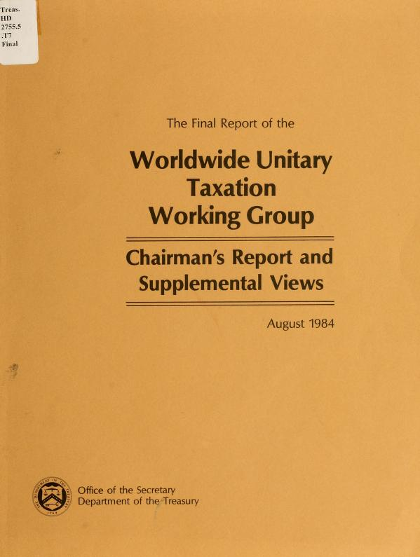
Our trading partners “express concern”
(The British Empire Strikes Back?)
In reaction to Container, some in Congress threatened to preempt use of formulary apportionment, both internationally and domestically.
Prime Minister Margaret Thatcher writes to her friend, President Reagan, to complain.
The Dept. of the Treasury organizes a “working group” of stakeholders in 1984.
States agreed to eliminate mandatory WWCR in favor of allowing “water’s edge” combined reporting.
No agreement on two issues: (a) state taxation of dividends; (b) exclusion of “80/20” companies.

Slide 44

The Battle Over Foreign Dividends
Mobil Oil v. Commissioner of Revenue (Vermont), USSCT 1980: because foreign dividends (incl. partnership distributive share and gains) were part of the unitary oil business operating in Vermont, the state could include them in apportioned income base.
No constitutional requirement that such “investment income” is only taxable by the state of domicile.
Justice John Paul Stevens dissent: if its unitary income, you needed to add the foreign companies’ factors to prevent extra-territorial taxation!

Slide 45

The Foreign Dividend Conundrum:
Whose Earnings?
As U.S. corporations expanded internationally, and states agreed to abandon WWCR, state taxation of foreign dividends became a more pressing issue.
Are dividends:
Entirely the earnings of the parent (a return on investment),
Entirely the earnings of the subsidiary, or
Like Schrodinger’s Cat: both (a) and (b), simultaneously?

Slide 46

The Foreign Dividend Conundrum
The IRC imposes a sliding scale, based on ownership percentage for taxing domestic dividends: 50% if you own less than 20%; 35% if you own 20% or more; 0% if part of consolidated return (80% ownership).
Implication: maybe “(c)” is correct, for both foreign and domestic dividends.
Even if the dividends could be said to be the parent’s earnings, the source of the income certainly included foreign activity.

Slide 47
Another Bump in the Road
Just two years after Mobil, the Supreme Court held that if the foreign subsidiaries were not operationally unitary, the dividends couldn’t be in the apportioned tax base. ARAMCO v. Idaho; F.W. Woolworth v. New Mexico (1982).
The MTC filed an amicus brief in Woolworth asserting that the dividends were apportionable because they arose out of the taxpayer’s unitary business, but urged the Court to remand to require factor representation.
(The question of whether including income in the apportioned tax base requires “enterprise unity” versus “asset unity” appeared to have been resolved in favor of the latter in Allied-Signal v. Director (1992), but the controversy continues.)

Slide 48

Aftermath of the Treasury Unitary Taxation
Working Group Agreement
The states acted with “unusual speed” in passing legislation in 1984-86 instituting the option or requirement for water’s edge combined filing.
Some states taxed a portion of foreign dividends without factor relief, seeking to approximate what MNE’s would have owed under WWCR. See, e.g., Microsoft v. Oregon (20% inclusion).
Other states followed industry recommendations to eliminate all foreign dividends from the base.
Taxpayers also convinced many states to carve out “80/20” companies from the water’s edge return. These are U.S. companies with 80% of their property and payroll overseas.

Slide 49
The Foreign Dividend Conundrum
NCR Corporation challenged state taxation of foreign dividends (and other income received from its CFCs) in the 1980’s-1990’s in numerous states.
Paul Frankel (1937-2017) sought to turn Justice Steven’s dissent into a mantra that still echoes today:
“no taxation without factor representation.”
Even the courts that ruled against NCR were generally sympathetic to the argument.
In response, some states agreed to allow a proportional amount of foreign factors based on the ratio of income to dividends paid: the “Detroit method” of factor relief.

Slide 50

Subpart F Income: Then and Now
Meanwhile…
Subpart F income is CFC income from passive investment activity, such as receipt of dividends, royalties, premiums from insuring U.S. companies, and later, the amount of bribes paid to foreign officials, reported as earnings in low tax countries.
President Kennedy said in 1962 that allowing deferral of such earnings was an invitation to income shifting that had to be curbed, and Congress agreed.
Subpart F income was accorded the same treatment as foreign dividends by most states, even though the economic source of the income was arguably domestic activity.
Oddly, a few states continued to include a percentage of actual
dividends in the tax base while eliminating Subpart F income.
In Moore v. United States (2024), the Supreme Court likened
Subpart F to receipt of distributive share income from a partnership.
Subpart F income continues to be an important part of the
federal tax base.

Slide 51
Kraft General Foods v. Iowa (1992)
Iowa is a separate-entity filing state. It followed federal treatment of dividends: foreign dividends were taxed, while most domestic dividends are deducted under IRC 243.
Iowa did not follow the federal credit for foreign taxes paid. Iowa also didn’t allow factor relief.
The Supreme Court concluded that Iowa’s system systematically discriminated against companies with foreign subsidiaries as opposed to domestic subsidiaries.
The Court said it would be “hard-pressed” to find similar facial discrimination in a water’s edge context, since all domestic entities’ income would be included in the tax base. (fn. 23)
Note that the Court did not mandate identical treatment of foreign and domestic dividends.
Five state supreme courts subsequently upheld foreign dividend inclusion in the water’s edge tax base.

Slide 52
The TCJA Changes (Almost) Everything
December 23, 2017: Congress passes the TCJA.
Most provisions apply only to U.S. corporations and individuals.
  Foreign Dividends are no longer taxed.
  Deferred Earnings from 1986 are required to be repatriated (as subpart F income) at a reduced rate effective for 2017.
  To discourage profit shifting, a new category of income, Global Intangible Low-Taxed Income (GILTI) is created.
  FDII (IRC 250) comes in encourage domestic production by providing a substantial deduction for income derived from foreign sales of property and services.
  Congress includes other measures (e.g. BEAT) to discourage profit shifting.

Slide 53
The GILTI Conundrum
NOTE: GILTI is owed by the U.S. Parent of CFC’s. Foreign entities doing business in the U.S. are not subject to GILTI.
Can U.S. MNE’s avoid state taxation of GILTI by reporting the income through a non-nexus entity in separate filing states, or through a 80/20 corporation in states that exclude such companies from the water’s edge combined return?
Most states looked at GILTI and concluded that the existing policies on foreign dividend deductions should be extended to GILTI.

Slide 54
The GILTI Conundrum
Note: the IRC 250 deduction is a “special deduction” appearing on Line 29 of the federal 1120. Many states conform to Line 28 calculations.
There has been confusion over whether the state deduction for foreign dividends is in addition to the IRC 250 deduction.
In states that tax some portion of GILTI, should there also be factor representation? If so, what should it look like?
Some states have concluded that GILTI should be included in the sales factor denominator, but should the amount be the total amount of GILTI before the IRC 250 deduction, or before the state dividends-received deductions?
Other states have concluded that GILTI represents displaced U.S. income and no factor adjustment is appropriate.

Slide 55
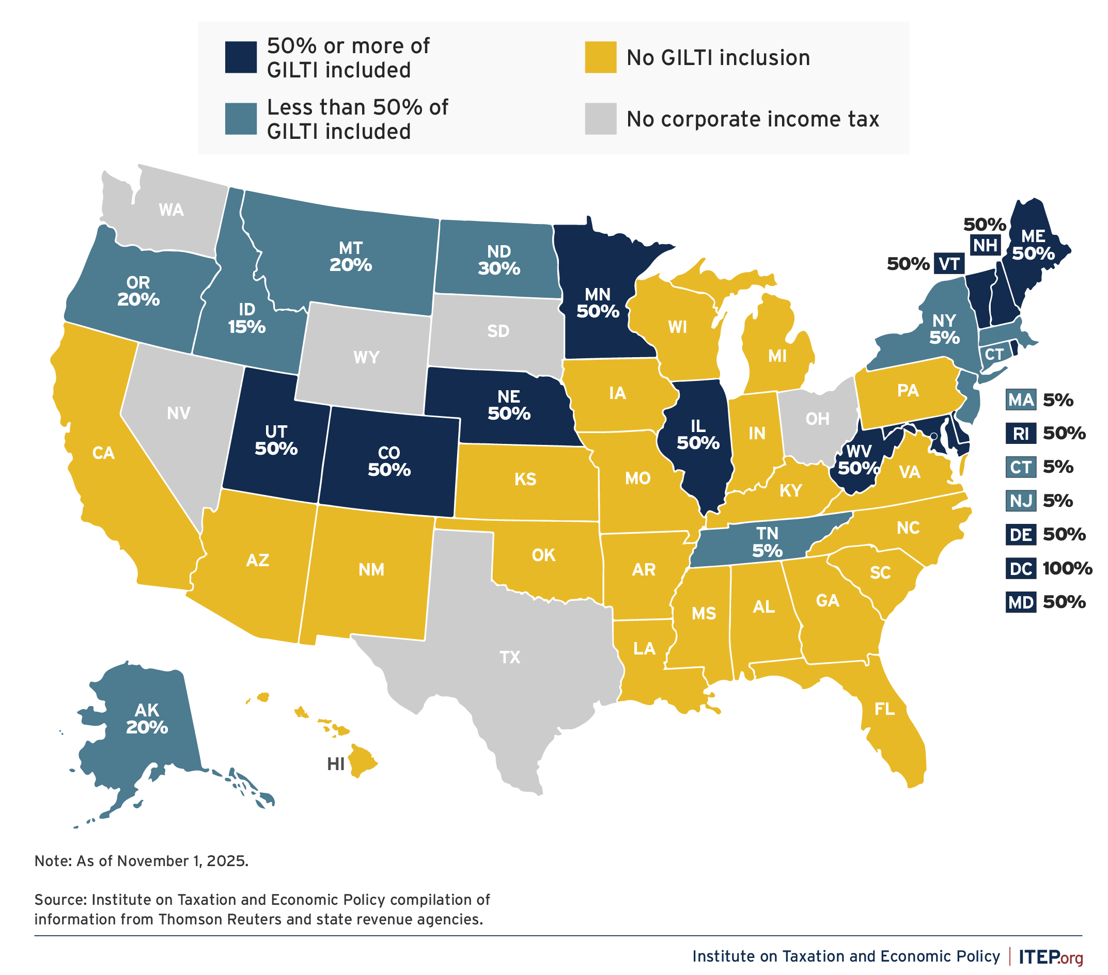
State Approaches to Taxing GILTI
(ITEP – 2025)

Slide 56
2020 Federal Fiscal Estimates
Total federal corporate receipts: $2.67 trillion
GILTI: $225 billion ($440 billion before IRC 250 deduction)—most states decoupled or only tax ~5%, following foreign dividend tax treatment.
Subpart F income: $43.6 billion—most states had already decoupled after Kraft decision; some states tax 5%-25%.
FDII: $71 billion--most states did not decouple;
That is, TCJA policies represents 13% of the federal tax base, and a far higher percentage for Fortune 100: tech companies; pharmaceutical companies, etc.
Repatriation Transition Tax: states treated it as Subpart F income, i.e., mostly not taxed or taxed 5%. Now water under the bridge.

