Slide 1

State Taxation of Partnerships –
Status Report
July 22, 2025

Slide 2
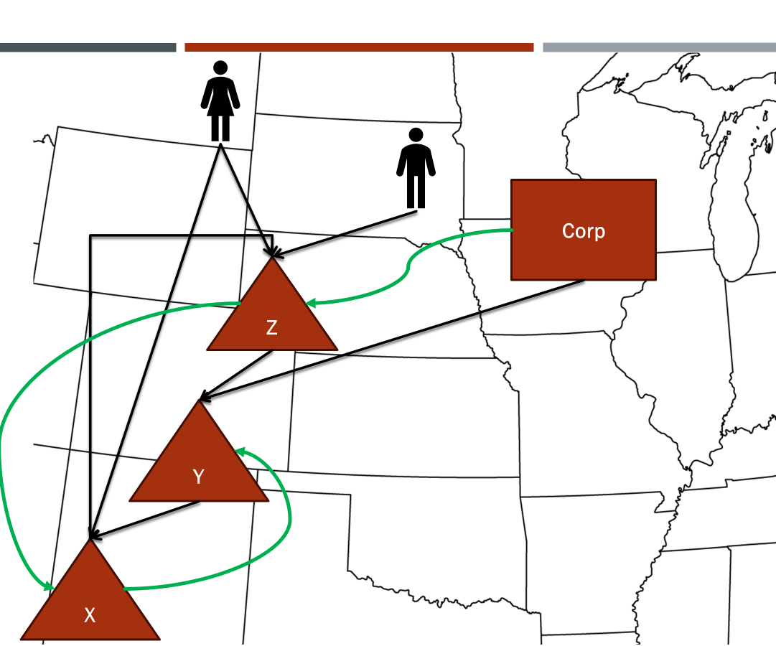
NOTE:
This presentation sets out information from the work group’s discussions, white paper draft, and multistate research, which are on the project webpage here: partnership project webpage. This information is presented to the Uniformity Committee for consideration and discussion. All input is welcomed.
*Our multistate research should not be relied on as tax advice. For specific questions, please contact your state department of revenue and/or tax advisor.

Slide 3
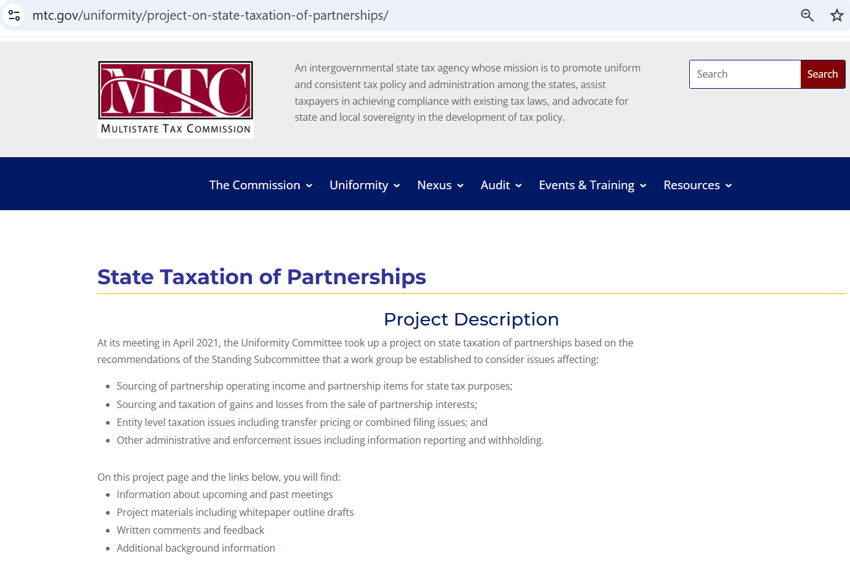
Project Webpage:

Slide 4
Wait . . . what’s this?
April 2021?

Slide 5

Actually it’s worse than that . . . In 1991 . . .
The MTC began looking at partnership issues.
It issued a draft composite return/withholding model statute in 1992.
Here’s what that working draft noted:
  “Although not all states appear to provide firm guidance, partnership items
  of income, gain, deduction, and loss are, as a general rule, attributed to a
  taxing state by application of the state's apportionment and allocation rules.”
So when was the composite/withholding model adopted?

Slide 6
First – Remember what else happened in 1992.
Quill happened.
In light of that, and for other reasons, some argued that even if the partnership was doing business in a state, the state lacked the constitutional authority to tax the income attributed to nonresident partners.
The MTC also began working on its factor-presence nexus standard (which was also opposed). Adopted in 2002, here’s part of what that model said:
    Pass-through entities, including, but not limited to, partnerships, limited
    liability companies, S corporations, and trusts, shall determine threshold
    amounts at the entity level.
So did the Commission ever approve the composite/withholding model?

Slide 7
Yes. . . In 2003 . . .
By that time, about half the states with tax on partnership income had already adopted something similar.
After approving the composite/withholding model, the MTC then formed a work group to study pass-through taxation generally.
The work group surveyed the states to see what issues they thought were most important.
They got responses from 25 states.

Slide 8
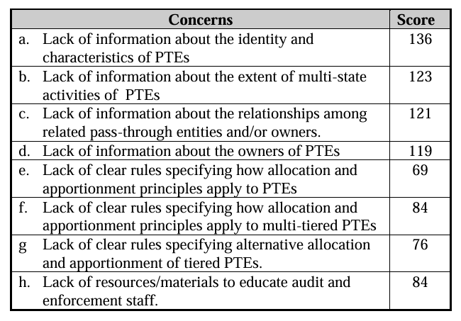
Here are the issues those states scored
for importance—most important getting the highest score.

Slide 9
Other efforts after 2004
The MTC approved its first model combined filing statute (Joyce) in 2006. That model provides (in Sec.1.F):
    “Unitary business” means [a single economic enterprise that is made up either of separate parts of a single business entity or of a commonly controlled group of business entities that are sufficiently interdependent, integrated and interrelated through their activities so as to provide a synergy and mutual benefit that produces a sharing or exchange of value among them and a significant flow of value to the separate parts.] Drafter’s note: This portion of the definition is drafted to follow MTC Reg. IV(b), defining a “unitary business.” . . .

Slide 10
    (“Unitary business” cont’d) . . .
    . . . Any business conducted by a partnership shall be treated as conducted by its partners, whether directly held or indirectly held through a series of partnerships, to the extent of the partner's distributive share of the partnership's income, regardless of the percentage of the partner's ownership interest or its distributive or any other share of partnership income. A business conducted directly or indirectly by one corporation is unitary with that portion of a business conducted by another corporation through its direct or indirect interest in a partnership if the conditions of the first sentence of this section 1.F. are satisfied . . . and the two corporations are members of the same commonly controlled group.

Slide 11
  Then in Sec. 3.B. Determination of taxpayer’s share of the business income of a combined group apportionable to this State:
      “ii. . . . The [property, payroll, and sales] of a partnership shall be included in the determination of the partner's apportionment percentage in proportion to a ratio the numerator of which is the amount of the partner's distributive share of partnership’s unitary income included in the income of the combined group in accordance with Section 3.C.ii.(c). and the denominator of which is the amount of the partnership’s total unitary income.”

Slide 12
  And in Sec. 3.C Determination of the business income of the combined group:
      “ii.(c) If a unitary business includes income from a partnership, the income to be included in the total income of the combined group shall be the member of the combined group's direct and indirect distributive share of the partnership's unitary business income.”
    Remember this is the Joyce model—but the Finnigan model contains similar language.

Slide 13
So to sum up – By 2004 The MTC’s position was:
A non-resident partner’s distributive share of partnership income is properly sourced (using allocation or apportionment) at the partnership (entity) level.
With respect to corporate partners “any business conducted by a partnership shall be treated as conducted by its partners, whether directly held or indirectly held through a series of partnerships, to the extent of the partner's distributive share of the partnership's income . . .”
If a corporation’s distributive share of partnership income is part of a unitary business conducted by the corporation or group, that distributive share income is combined with that business’s income, and a share of the partnership’s factors (using distributive share) are included in the formula. (This is what we now refer to as blended apportionment.)

Slide 14
So – We’re done then, right?
  Not quite. There may be some big questions left:
    What if a partnership doesn’t engage in business?
    What exactly does it mean when we say that a corporation is engaged in the business of the partnership?
    And how do we determine if the partnership income is part of a unitary business of the corporation?

Slide 15
What if the Partnership Doesn’t Engage in Business?
  See our draft investment partnership white paper and model
  For individual partners, assuming the conditions are met, the source of the items of partnership income, expense, gain, and loss are sourced as though the partners directly held the assets from which those items came.

Slide 16
What Does it mean that the Corporate Partner is engaging in the Partnership’s business?
  This reflects the attribution rule of Subchapter K (§ 702(b)).
  If the partnership is engaged in a unitary business—then so is the corporate partner.
  But that does NOT mean the corporate partner simply combines its distributive share with its own apportionable income or uses blending.
  The default is that the source of the income, determined at the partnership level, would be attributed to the corporate partner.

Slide 17
What Does it mean that the distributive share income of the partnership is part of a Unitary business of the corporate Partner? (That is—when can blended apportionment be used?)
  Good question.
  That’s what we’re hoping to turn to – (along with the detailed “how” questions).

Slide 18
But it’s complicated. WhY?
The U.S. Supreme Court, has never addressed the question of how states can source the partnership items or income that are attributed to a corporate partner or when blended apportionment can be used. (Of course, altogether, the Court has only issued about 20 decisions
on the issue of how the unitary business principle relates to formulary apportionment.)
But to get to some acceptable answer – everyone needs to understand that partnership (entity) level sourcing is the default.

Slide 19
That brings us to Today
Working on a white paper laying out the general rules for sourcing partnership income and how those rules are applied in complex partnership structures, where there are corporate or tiered partners, special or mandatory allocations of income, or related-entity transactions.
Basing this on the foundation already laid.

Slide 20

Big Picture
Partnerships apply the general state sourcing rules to their income and this source is attributed to nonresident partners.
Partnership

Slide 21
Big Picture
Investment Partnership
Investment partnerships do not affect sourcing – rather – the nonresident partner would source the income as if they held the asset directly.
Partnership

Slide 22
Big Picture
The partnership level sourcing (“separate sourcing” or “separate apportionment”) would also apply to corporate partners unless blending applies.
Corporate Partner
Partnership

Slide 23
Big Picture
Corporate Partner
Tiered Partnership
And a tiered partnership would not change this general approach—rather the distributive share income would retain its source as it flows up unless blending applies.
Partnership

Slide 24
EXCEPTIONS (There are always exceptions . . .)
States may need special rules in certain circumstances to avoid abuse.
  Special or mandatory allocations or the use of partnerships solely to shift the sourcing of income.
  Related party transactions that have the effect of altering sourcing and cannot be eliminated by blending.
  Other?

Slide 25
Example No. 1
Partnership conducts business activities. Applying the state sourcing rules to that business results in a capital loss being properly treated as nonbusiness income and sourced to State A.
Corporate partner generally treats its distributive share income from the partnership as part of a unitary business conducted by that corporate partner.
Does corporate partner source it’s share of loss:
  To State A
  Based on its apportionment formula for the corporate partner’s business (using blending if the state provides for it).

Slide 26

Example No. 1
Partnership conducts business activities. Applying the state sourcing rules to that business results in a capital loss being properly treated as nonbusiness income and sourced to State A.
Corporate partner generally treats its distributive share income from the partnership as part of a unitary business conducted by that corporate partner.
Does corporate partner source it’s share of loss:
  To State A
  Based on its apportionment formula for the corporate partner’s business (using blending if the state provides for it).

Slide 27
Example No. 2
Partnership conducts business activities. It’s application of the state sourcing rules to that business results in items of income, expense, gain, and loss being apportioned 50% to State A.
Corporate partner generally treats its distributive share income from the partnership as nonbusiness income (not part of any unitary business conducted by that corporation).
Does it source it’s share of the partnership’s business income:
  50% to State A
  By allocating that income as non-business income

Slide 28

Example No. 2
Partnership conducts business activities. It’s application of the state sourcing rules to that business results in items of income, expense, gain, and loss being apportioned 50% to State A.
Corporate partner generally treats its distributive share income from the partnership as nonbusiness income (not part of any unitary business conducted by that corporation).
Does it source it’s share of the partnership’s business income:
  50% to State A
  By allocating that income as non-business income

Slide 29
Note on Example No. 2 and Follow up
  If you said (b) – By allocating that income as non-business income – then how would those allocation rules apply?
  To the distributive share as a whole?
  Item by item
  (Extra points to anyone that can find any reference to partnership distributive share income in UDITPA—let alone the rules for allocating nonbusiness income.)
  And remember – distributive share is NOT a dividend.

Slide 30
NOTE ON Example No. 2 and Follow up
  Given the attribution principle on which pass-through taxation relies and to which states conform—we assume the item-by-item approach must be used. (And UDITPA’s allocation rules could then be applied to those items.)
  So in example No. 2, the partner would look through to each partnership item of income or gain (loss) attributed to it by the partnership and then source them using the rules of allocation for that income/gain(loss), associating any partnership’s expenses that are part of the partner’s distributive share with those items of income/gain (loss).

Slide 31
NOTE ON Example No. 2 and Follow up
  But is that even possible given that – at the partnership level – all those items were properly treated as part of the partnership’s own unitary business?
  Sure
  No way

Slide 32
Bottom line
  The nature of the item as business (apportionable) or nonbusiness (non-apportionable) is determined at the partnership level (the entity that recognized the item) and sourced using the general state sourcing rules. That sourcing doesn’t change unless it is determined that blended apportionment should be used.

Slide 33
Steps in Sourcing Partnership Income - Corporate or Tiered Partners
Are partnership items of income apportionable to the partnership?

Slide 34
Steps in Sourcing Partnership Income - Corporate or Tiered Partners
Are partnership items of income apportionable to the partnership?
NO
Assign the items using state sourcing rules and attribute to partner.

Slide 35
Steps in Sourcing Partnership Income - Corporate or Tiered Partners
Are partnership items of income apportionable to the partnership?
NO
Assign the items using state sourcing rules and attribute to partner.
YES
Is the partnership distributive share apportionable income to the partner?

Slide 36
Steps in Sourcing Partnership Income - Corporate or Tiered Partners
Are partnership items of income apportionable to the partnership?
NO
Assign the items using state sourcing rules and attribute to partner.
YES
Is the partnership distributive share apportionable income to the partner?
NO
Apportion the items using state rules applied at the partnership level.

Slide 37
Steps in Sourcing Partnership Income - Corporate or Tiered Partners
Are partnership items of income apportionable to the partnership?
NO
Assign the items using state sourcing rules and attribute to partner.
YES
Is the partnership distributive share apportionable income to the partner?
NO
Apportion the items using state rules applied at the partnership level.
YES
Does the state provide for blended apportionment in this case?

Slide 38
Steps in Sourcing Partnership Income - Corporate or Tiered Partners
Are partnership items of income apportionable to the partnership?
NO
Assign the items using state sourcing rules and attribute to partner.
YES
Is the partnership distributive share apportionable income to the partner?
NO
Apportion the items using state rules applied at the partnership level.
YES
NO
Does the state provide for blended apportionment in this case?

Slide 39
Steps in Sourcing Partnership Income - Corporate or Tiered Partners
Are partnership items of income apportionable to the partnership?
NO
Assign the items using state sourcing rules and attribute to partner.
YES
Is the partnership distributive share apportionable income to the partner?
NO
Apportion the items using state rules applied at the partnership level.
YES
NO
Does the state provide for blended apportionment in this case?
YES
Use blended apportionment.

Slide 40
So - When Might blending be used?
Assuming partnership is engaging in business and has apportionable income which is attributed to the corporate (or tiered) partner –
When the partner and the partnership are unitary entities.
When the partnership income attributed to the partner is part of a unitary business also conducted by the corporate partner.

Slide 41
again – the U.S. Supreme Court has never said how the UBP applies in this context.
MeadWestvaco does not address the issue. It involved the sale of a business division by the corporation, not distributive share income. (And the Court declined to address the question of whether the factors of that business could be applied to source the gain.)
Allied-Signal also does not address the question.

Slide 42
Answer a) – Problems with the entity unity tests:
We treat the corporate partner as engaging in the business of the partnerships.
  The corporation’s entire business need not all be unitary or unitary with the partnership’s business.
  The corporate partner may have separate unitary businesses in which it is engaged – including the business of the partnership.
Application of traditional entity unity tests to partnerships can be difficult given that
  Partnership control is not dependent on ownership of capital or income share
  Partnership agreements may assign control of different decisions to different partners
  Special purpose entities may have very discrete or limited activities.
Basically, entity unity is ill-suited to this question.

Slide 43
Answer b) – Problems with this “operational” approach
This may mean identifying a separate activity of the corporate partner with which the partnership income and factors can be “blended.”
But remember – the alternative is simply separate apportionment at the partnership level.

Slide 44
What about Tiered partners or partnerships owned by common partners?
Presumably the same unitary test would be applied – so that blending would happen to the extent that the items of partnership income are part of the same unitary business.
But the devil is in the details.

Slide 45
Speaking of those details – there are still How questions
Blending will require more information to be provided by the partnership to the partners.
Blending where there are multiple tiers or related partnerships may increase complexity of that method significantly.
BUT – states don’t HAVE to blend just because there is a unitary business in which multiple businesses may be engaged. So rules that limit the application are also permissible.

Slide 46
STATUS
Continuing to work on the draft white paper.
Working on a more advanced Excel workbook that can be used to see how the blending approach – using absolute value of distributive share items of partnership income to determine the share of partnership factors – will work.
Answering the when question.
Working on anti-abuse rules that states may need.

Slide 47
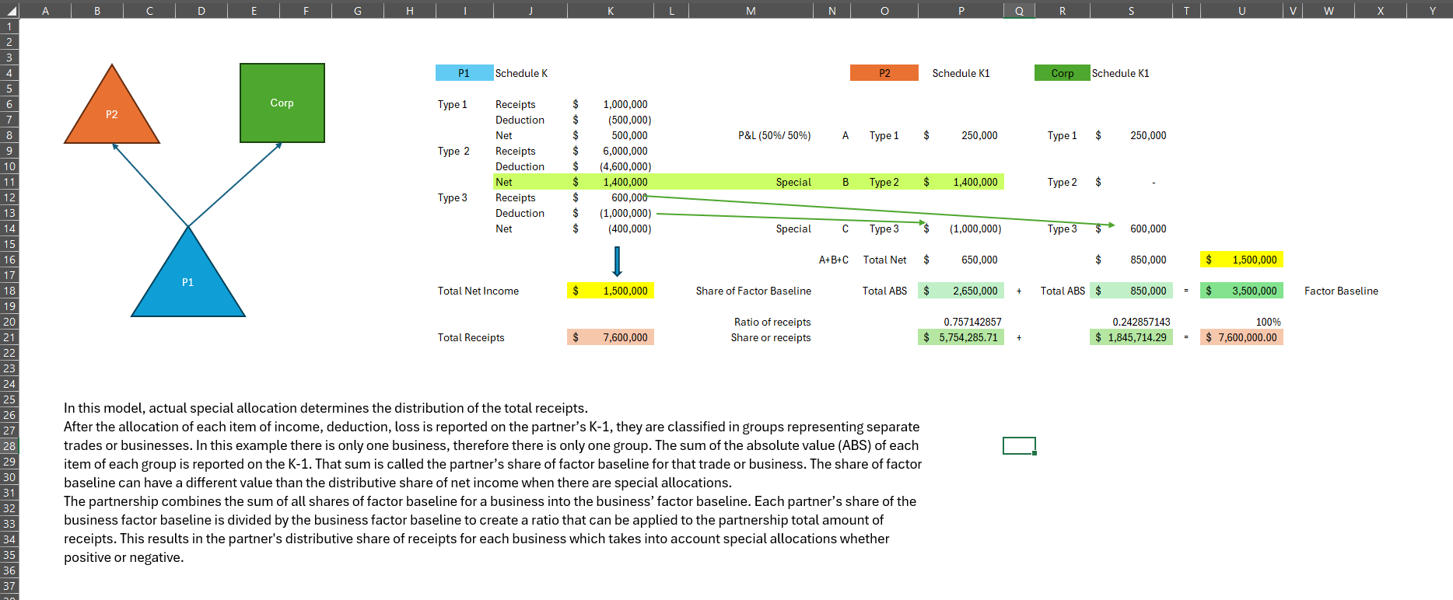

Slide 48
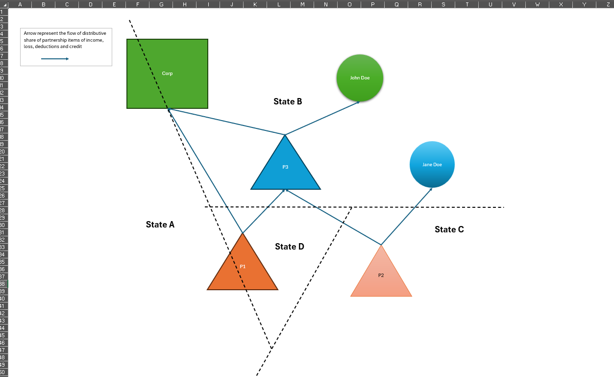

Slide 49
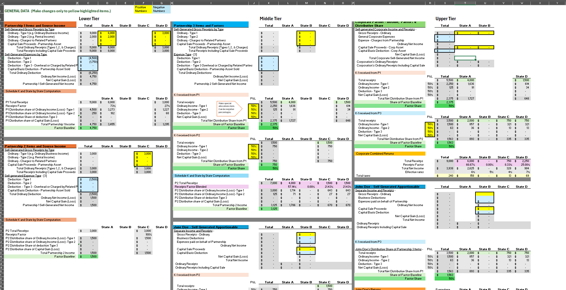

Slide 50
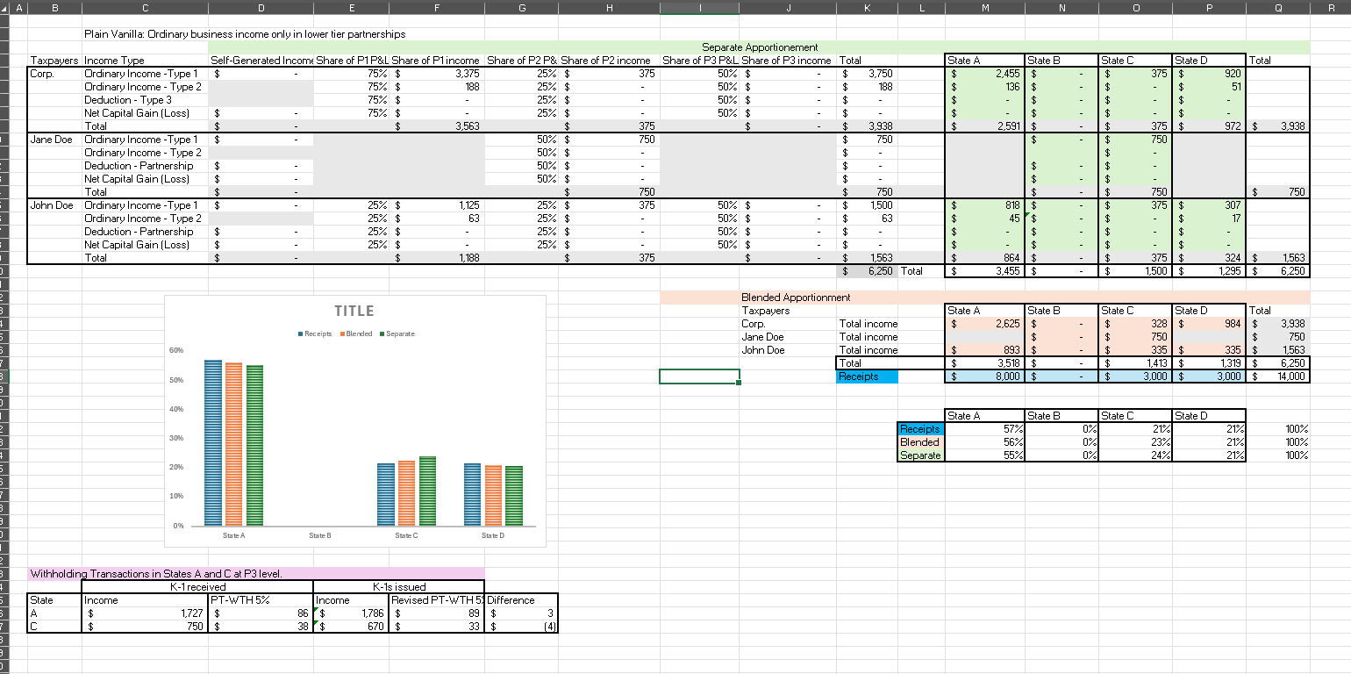

Slide 51
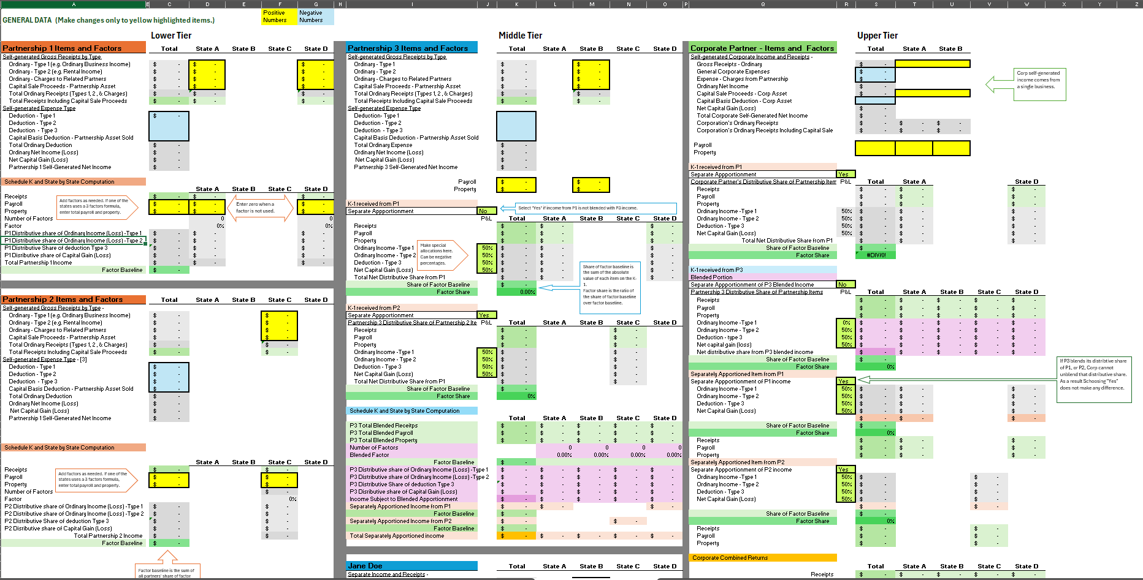

Slide 52
QUESTIONS?

