Slide 1

State Taxation of Partnerships –
Status Report
June 18, 2025

Slide 2
Developments –
H.R.1 (amended) Pass-Through work-around
These developments are still being studied by the MTC and states

Slide 3
House Reconciliation Bill - Section 112018
Changes to Subchapters K and S
Amended IRC 275
New IRC 6659

Slide 4
Amended IRC Sec. 275
Would limit “Specified Taxes” to $30k $40,400 with a faster phase out down to $10k once taxpayers reach $400k $505k of modified AGI.
“Specified Taxes”
  Any tax described in IRC 164(a), IRC 164(b)(5) [sales taxes] and IRC 216(a) [Cooperative Housing], except for GST taxes in IRC 164(a)(4) and “Excepted Taxes.”
&
  Any “Substitute Payment.”

Slide 5
“Substitute payments”
The definition of substitute payments now excludes state and local income taxes qualifying as excepted taxes.
As a result, when a state income tax is paid by a qualifying entity, that payment is no longer a substitute payment and qualifies for the workaround.
That eliminates the difficulty to navigate the substitute payment requirements.

Slide 6
“Excepted Taxes ”
Includes taxes paid or accrued on account of state and local income derived by a “Qualifying Entity” with respect to a trade or business as defined in 199A(d), without regards to IRC 199A(b)(3).
Is this a typo? Section (b)(3) allows an exception to the limit to the QBI deduction in IRC 199A(a) for all taxpayers under the “threshold amount” with a phase-out of the exception for taxpayers above the threshold amount. It does not modify the definition of qualified trade or business (QTB) in IRC 199A(d). This ambiguity casts a doubt about the intent of Congress with regards to specified services trade or businesses which are only partially excluded from the QTB definition.

Slide 7
“Excepted Taxes ”
“Qualifying Entities” are PTEs with at least 75% of gross receipts derived from qualifying trades or businesses which are under common control within the meaning of Section 52(b).
Entities related through controlling interest must therefore aggregate their gross receipts before being tested. Controlling interest is defined under Treas. Reg. 1.52-1 as an interest o more than 50% of the profit interest or capital interest of the partnership, or more than 80% in the case of a brother-sister group.
How will partnerships know that they qualify before filing their return?

Slide 8
Result
  The amendment would exclude state and local income taxes paid by qualifying entities from the limitation under IRC 275.
  There would still be an ambiguity as to what disregarding IRC 199A(b)(3) means when it comes to the exclusion of SSTBs from the scope of qualifying entities.
  The combination of rules would cast a doubt on the value of the reporting of specified taxes on the partner’s K-1 and may create basis and capital account adjustment problems. The bill assumes a high level of communication between entities related through common ownership. It would require the reporting of specified taxes as separately stated items not deductible at the partnership level if they do not pass the test under IRC 52(b) at the controlling interest level. It is unclear partnerships will have the information to make that determination accurately before filing their returns.

Slide 9
Developments –
Senate Bill Pass-Through work-around
These developments are still being studied by the MTC and states

Slide 10
Senate Reconciliation Bill - Section 70601
Changes to Subchapters K and S
Amended IRC 275
New IRC 6660, same as IRC 6659 in HR1.

Slide 11
Senate Reconciliation Bill - Section 70601
Changes to Subchapters K and S
  Pass-through entity taxes (PTET) and specified taxes must be separately stated under 702(a)(6) and cannot be deducted in IRC 703(a)(2)(B).
  A PTET is defined as a tax described under IRC 164(3) [state and local income tax] and derived from a trade or business (other than being an employee), or from any activity described in IRC 212.
    Thus, a PTET would not depend on the definition of a qualified trade or business under IRC 199A.
    PTET would include “investment partnerships”.
  However, the definition excludes some PTET.

Slide 12
Senate Reconciliation Bill - Section 70601
  For states imposing an income tax on individuals:
    The definition would not include PTET imposed after 2027 if the tax exceeds 102% of the liability that would be imposed on an unmarried individual with same net income.
    That is supposed to eliminate the risk of PTET paying for income tax on other items of income and thus extending the scope of the pass-through work-around.
  For states that are not imposing an income tax on individuals:
    A PTET on net income of the entity would be treated as a substitute payment which is a specified tax, if the partners receive corresponding state tax benefits of more than 25%.
    This matters because of how IRC 275 would be amended.

Slide 13
Senate Reconciliation Bill - Section 70601
Amended IRC 275
  Deduction limited to $10k for married individuals on specified taxes plus
  A deduction for PTET if such tax exceeds in the aggregate the sum of:
    Any remaining amount left form the $10k limit, plus
    The greater of
      $40k (for married individuals) or,
      50% of the taxpayer’s distributive share of PTET
  The workaround would hold at least 50% of its current value for states imposing an income tax on individuals.

Slide 14
UPDATE on the White Paper
See the version dated 6-18-2025 on the Project Webpage

Slide 15
Versions of the White Paper
Current version is dated June 18, 2025.
We have been making versions available for comment so that if there are issues or problems we can address those.
Comments submitted on prior versions will be welcomed and considered.

Slide 16
Versions of the White Paper
In this version note:
  On the last call—an issue concerning throw-back rules for sales factor sourcing was raised along with the question of how P.L. 86-272 would apply to income of partnerships where the partnership or partner claims protection. We addressed that issue. See Section I.E.
  We also revised and added other information to that Section I.E. on state sourcing rules, generally.
  We included a new Section III.C. with examples of cases and commentary on unitary issues in the state tax sourcing of partnership income.
  And we began drafting “Findings” for the Executive Summary.

Slide 17
CAVEAT
These slides discuss a general, uniform approach to sourcing partnership income that may be used by the states.
If there is agreement on the approach – we will also need to consider:
  Necessary reporting requirements
  Limits to address administrative burdens on small partnerships
  Anti-abuse rules

Slide 18
Income Tax 101 –
Rules for tax treatment generally look to two things:
  Character of Items – the nature of income, expense, gain, loss, etc. that affects the tax treatment.
    Under Subchapter K, the character of partnership items is attributed to any partner receiving a share of those items—“as if such item were realized directly from the source from which realized by the partnership, or incurred in the same manner as incurred by the partnership.”

Slide 19

Partnership Attribution Principle
In other words, determination of an item’s character goes this way:

Slide 20
Income Tax 101 –
Rules for tax treatment generally look to two things:
  Attributes of the Taxpayer (Including Taxpaying Partners) – any taxpayer-specific tax attributes including whether the taxpayer is an individual or corporation, domestic or foreign, etc., as well as the taxpayer’s own reportable items from other sources.

Slide 21
Example – Item Character versus Partner Attributes
Partnership sells property for a net capital loss.
Loss is allocated equally to two partners – X and Y.
X also has a capital gain from another source that it offsets against the loss.
Y’s outside basis is less than the loss (so that a portion of the loss is deferred).
So both have a capital loss—but the effect on their individual taxes is different.

Slide 22
Tax Treatment (Rules)
Character of Items
Partner Attributes
Tax Result

Slide 23
State Sourcing Of Business income Generally
States generally apply the rules to source the income of partnerships that they use to source the income of corporations and proprietorships, saying something like:
    “A partnership that has income from both within and without the state shall apportion income under the [state sourcing rules or Uniform Division of Income for Tax Purposes Act].

Slide 24
State Sourcing Rules – Two methods
Business (apportionable) net income:
  Determine all items of income, expense, gain, loss of a business.
  Net the amounts into one base amount.
  Determine and assign to the state certain factors related to the business.
  Compute a ratio for the state based on those factors.
  Apply the ratio to the net base amount.

Slide 25
State Sourcing Rules – Two methods
Nonbusiness (non-apportionable) items:
  Identify items of income that are not related to the business.
  Determine the character of each item (interest, royalties, rents from real property, etc.).
  Apply a rule of assignment (which may include a ratio) to source the item (net of related expense) to the state.

Slide 26
What is Business or “apportionable” Income?
Under the ULC version of UDITPA:
  Income arising in the “regular course of” or from “property related to” the “taxpayer’s trade or business.”
Under U.S. Supreme Court precedent:
  Income associated with the unitary business to which the state is applying formulary apportionment.

Slide 27
What is Business or “apportionable” Income?
Does that mean a single taxpayer cannot have two separate (unitary) businesses?
  NO – and many states and the MTC explicitly provide that in such cases, the taxpayer would have two separate net apportionable incomes to which two apportionment formulas would be applied.

Slide 28
What is Business or “apportionable” Income?
And just because there is a unitary business does not mean a state is required to include all of the income of that business when applying formulary apportionment.
(See separate filing states and combined states that exclude foreign corporations from the unitary group).

Slide 29
What is Business or “apportionable” Income?
Under MTC’s revised definition:
  “all income that is apportionable under the Constitution of the United States and is not allocated under the laws of this state.”

Slide 30
So What is NOT Business or “apportionable” Income?
Nonbusiness or non-apportionable income is income that cannot be included in any net income base to be apportioned using a single formula applying factors that have relationship to the apportionable base.

Slide 31
Partner Attribute:
Does the partner or any of its businesses have any type of unitary relationship with the partnership?
YES
NO
Income Character & Treatment: separate sourcing applies – using partnership information and state sourcing rules.
Income Character & Treatment: blended apportionment may apply – using both partnership and partner information.
Translating this to sourcing partnership income

Slide 32
Separate Sourcing Approach
Partnership items are characterized and then sourced by applying the state sourcing rules—both rules of assignment (non-apportionable income) and formulary apportionment (apportionable income)—based on the business activities of the partnership.
If the partner lacks any unitary relationship with the partnership interest, then the source of the partnership income would not change. Rather, that source would simply be attributed to the partner, as with other characteristics of the income for tax purposes.

Slide 33
Assume:
Partnership
  Operates a business entirely in State 1
  Has only apportionable income
  Has all of it receipts, property, and payroll in State 1
State 1 would apportion 100% of Partnership’s income to the state.
Partnership has two partners which have no other businesses or PTEs with which Partnership has any unitary relationship – Smith and Corp.

Slide 34
So What if:
Smith lives in State 2. Does that mean Smith will not source any Partnership income to State 1?

Slide 35
So What if:
Smith lives in State 2. Does that mean Smith will not source any Partnership income to State 1?
  ANSWER: NO - Smith will source the distributive share income of Partnership to State 1 (and will take a credit in State 2 for taxes paid).

Slide 36
So What if:
Corp is domiciled in State 2. Does that mean Corp will not source any Partnership income to State 1?

Slide 37
So What if:
Corp is domiciled in State 2. Does that mean Corp will not source any Partnership income to State 1?
  ANSWER: NO - Corp will source its distributive share income entirely to State 1.

Slide 38
Now assume:
Partnership also has capital gain income from selling real property in State 3.
The gain is non-apportionable income to Partnership and properly assigned to State 3.
Would Corp source its share of the gain to State 1 or State 2 or State 3?

Slide 39
Now assume:
Partnership also has capital gain income from selling real property in State 3.
The gain is non-apportionable income to Partnership and properly assigned to State 3.
Would Corp source its share of the gain to State 1 or State 2 or State 3?
  ANSWER: State 3.

Slide 40
Partner Attribute:
Does the partner or any of its businesses have any type of unitary relationship with the partnership?
YES
NO
Income Character & Treatment: separate sourcing applies – using partnership information and state sourcing rules.
Income Character & Treatment: blended apportionment may apply – using both partnership and partner information.
Again – No unitary relationship = Separate Sourcing

Slide 41

Partner Attribute:
Does the partner or any of its businesses have any type of unitary relationship with the partnership?
YES
NO
Income Character & Treatment: separate sourcing applies – using partnership information and state sourcing rules.
Income Character & Treatment: blended apportionment may apply – using both partnership and partner information.
Source to residence or domicile or assign at the partner level.

Slide 42
Partner Attribute:
Does the partner or any of its businesses have any type of unitary relationship with the partnership?
YES
NO
Income Character & Treatment: separate sourcing applies – using partnership information and state sourcing rules.
Income Character & Treatment: blended apportionment may apply – using both partnership and partner information.
But when exactly does Blending apply?

Slide 43
What is blending?
The partner’s distributive share of partnership income is included in the partner’s apportionable income (eliminating the same share of any income and expense from partner-partnership transactions).
The partner’s factors are combined with a share of the partnership’s factors (eliminating the same share of receipts from partner-partnership transactions).
The blended apportionment formula is applied to the blended income.

Slide 44
Partnerships and the UBP
Partnerships are not treated as separate taxable entities. Rather—the activities of the partnership are attributed to the tax-paying partners.
In addition—unlike corporations—partnerships can be controlled regardless of ownership—or control might be spread between different partners.
Many partnership structures are so complex that identifying common control among related entities can be nearly impossible.
A partner might substantially use its interest in the partnership and the partnership’s intangible assets without the type of “functional integration” or “economies of scale” that were more typical in traditional businesses involving shared physical assets.

Slide 45
Partnerships and the UBP
For these and other reasons, the 3-prong or “entity-unity” test is difficult to apply or would apply differently than to corporations.
Some states make clear that capital ownership does not matter.
And states may look to the way in which the partnership interest contributes to the partner’s business.
Other criteria might include situations in which there are significant partner-partnership transactions or other related entities that are part of a single business.

Slide 46
Based on our Research:
Corporate partners - most states expressly limit blended apportionment where :
There is unitary relationship (California, Hawaii, Indiana, Illinois, Maryland, Massachusetts, Michigan, Minnesota, Montana, Nebraska, New Jersey, Vermont, West Virginia, Wisconsin); or
The income is apportionable (Idaho, North Carolina, North Dakota); or
The partnership is a business interest (Alabama – business interest; Arizona – business interest; Iowa – connection with the taxpayer’s regular trade or business operations; Oregon – part of the corporation's overall business operations).
The remaining blended apportionment states do not explicitly specify when blended apportionment applies.

Slide 47
Based on our Research:
When the partner is another partnership:
  7 of the 12 states with blended apportionment—California, Colorado, Illinois, Massachusetts, Vermont, West Virginia, and Wisconsin—expressly limit its application to situations involving a unitary relationship.
  The remaining blended apportionment states do not explicitly specify when blended apportionment applies.

Slide 48
How does the attribution principle fit in with the unitary analysis?
A few states have attribution language in their unitary definition stating that any business conducted by a pass-through entity shall be treated as conducted by its members, whether directly held or indirectly held through a series of pass-through entities, to the extent of the member's distributive share of the pass-through entity's income.

Slide 49
How does the attribution principle fit in the unitary analysis?
What if a presumption of blended apportionment were applied to corporate and partnership partners that could be overridden in certain circumstances—for example, if there is a lack of a unitary relationship or operational function?
If this presumption is rebutted, the taxpayer would instead use the recognizing entity’s apportionment factors to apportion the items without blending the factors.

Slide 50
Recommendation:
Draft an approach to blended apportionment applying a standard based on whether the partnership interest has a sufficient relationship to the partner’s unitary business such that blended apportionment is more fair than separate apportionment.

Slide 51
Workbook Introduction
  Factor Baseline Method Tab. This is an example of how the method using absolute value works to solve factor representation in case of special allocations of values with disparate signs within items of the same character: e.g. ordinary income to a partner and ordinary losses to another.
    This Method works whether you are using one or several factors in your apportionment formula.
  Chart Tab: This is the model structure we are going to use to illustrate the effect of separate sourcing when facing various partnership situations. We are using the same chart for all the workbook tabs.

Slide 52
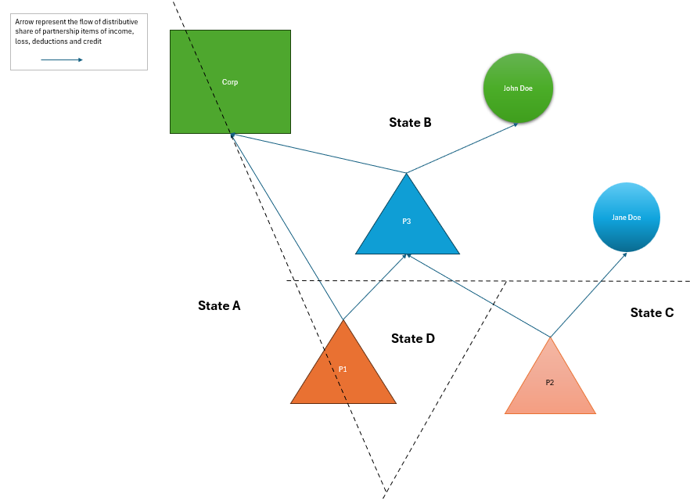
Workbook Introduction
CHART

Slide 53
Workbook Introduction
  All-Blended Tab. This is a simplified tab calculating the sourcing of income when all the distributive shares of income, loss, deduction are blended. The factor baseline method is calculated automatically. Each state calculation is represented in a different column.
  Bld-Sep Comparison Tab. This tab extrapolates the all separately apportioned results from the previous tab as if all the income was sourced using separate apportionment. It compares the result to the all-blended result.
  Separate Sourcing Tab. This tab uses the same features as the All-Blended Tab and in addition allows the user to choose between blended and separate apportionment for each distributive shares received at the partners’ level. It also allows you to choose between one or several factors for each states.

Slide 54
Questions? Comments?
What's Next?

