Slide 1

State Taxation of Partnerships –
Status Report
July 16, 2025

Slide 2
Developments – OBBBA final version
These developments are still being studied by the MTC and states

Slide 3
Pass-through workaround
No change

Slide 4
Amended IRC Sec. 707 – Small change / big impact
Section 707(a)(2) is amended to strike ‘‘Under regulations prescribed’’ and insert ‘‘Except as provided’’.
Finalized regulations are no longer required to qualify disguised sales or disguised fees as transactions between a partnership and a partner not acting as a partner.
Some allocations and distributions are in substance payments for property or services rather than allocations and distributions from a partnership to a partner.
Expected federal revenue impact according to JCT: $12,4 billion over 10 years.

Slide 5
Comments on the Draft White Paper
Provided by the AICPA

Slide 6
Background
Drafting the white paper over time – taking any input
  Defining the scope and issues
  Researching what states have done
  Considering alternatives
  Analyzing the issues that may not be fully addressed
  Making findings – what states should know about the issues
  Making recommendations – in this case – for the uniform treatment of partnership income
  Revising as necessary

Slide 7
Thanks to the AICPA for its Comments
Practitioner input is important — especially on issues where they need guidance or can comment on whether approaches are workable
There are some parts of the white paper that can be clarified and expanded
Some comments ask for clarification of issues that may be outside the scope of this white paper but the work group should consider addressing
We have questions about some of the comments

Slide 8
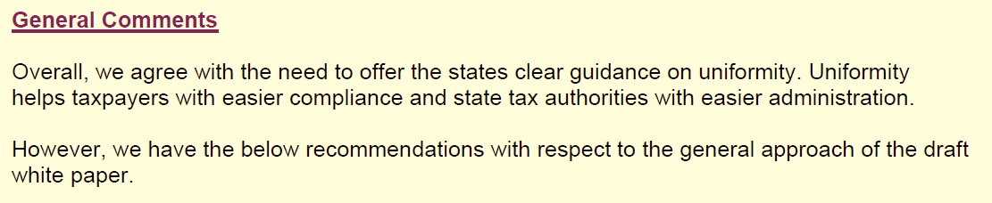
NOTE: The comments from the AICPA have been posted on the project web page. A document with those comments and the draft responses summarized below has also been posted. The comments are shown in boxes with the response following.

Slide 9
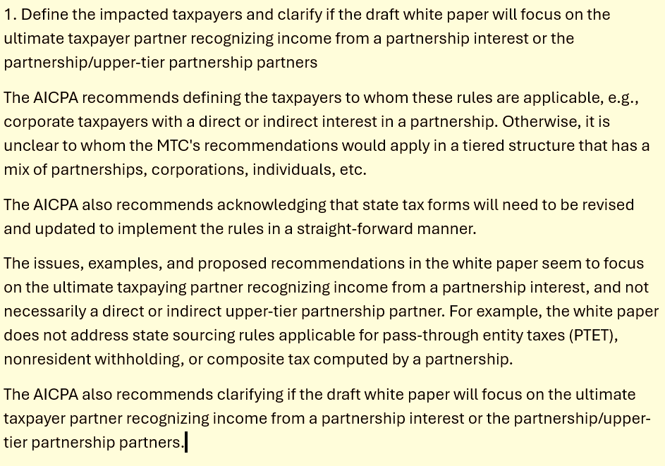

Slide 11
The scope of this white paper is broad—as we say in the Introduction—it includes:
  “. . . how complex partnership structures, special allocations, and related-party transactions affect the ability of states to tax partnership income and, in particular, how partnership income is sourced. It addresses the application of long-standing state sourcing rules to the distributive share income of multistate partnerships, which is taxed to partners under the pass-through system. It focuses most on issues that have not been fully addressed by the states including the application of sourcing rules where there are corporate or tiered partners, related partnerships, and special or mandatory allocations of income.”
So the white paper will address both corporate partners and tiered partnership partners.

Slide 12
We agree that when calculating the withholding on nonresident partners or elective entity-level taxes (PTETs and composite returns) state sourcing rules should be applied as consistently as possible with the way those rules are generally applied to distributive share income under the pass-through system. We also agree that states that adopt any changes to their sourcing approach may need to make changes to forms, instructions, and systems.
Once the work group has addressed sourcing of distributive share income under the pass-through system, it may also consider any recommendations to states on these other issues.

Slide 13
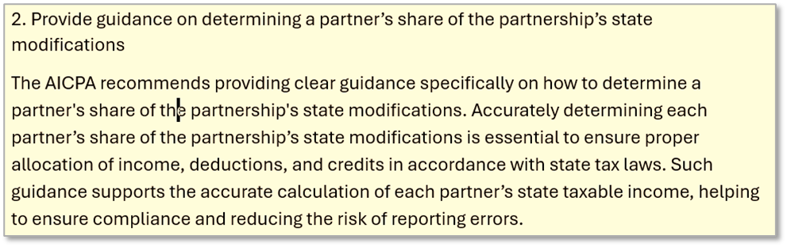

Slide 14
We agree that how state tax modification or adjustments are handled in the pass-through system is an important issue. We have included that issue in the project’s comprehensive outline, along with other issues the work group may address. We also note that a few states require partnerships to track state tax capital accounts, reflecting state tax modifications or adjustments. The work group may also address this issue in the future.
But because this particular white paper is focused on sourcing, it would not address the treatment of state adjustments or modifications unless that treatment directly affects sourcing generally. To the extent that any participants or members of the public believe there are state tax modifications or adjust-ments that have a significant effect on sourcing rules, that input would be helpful.

Slide 15
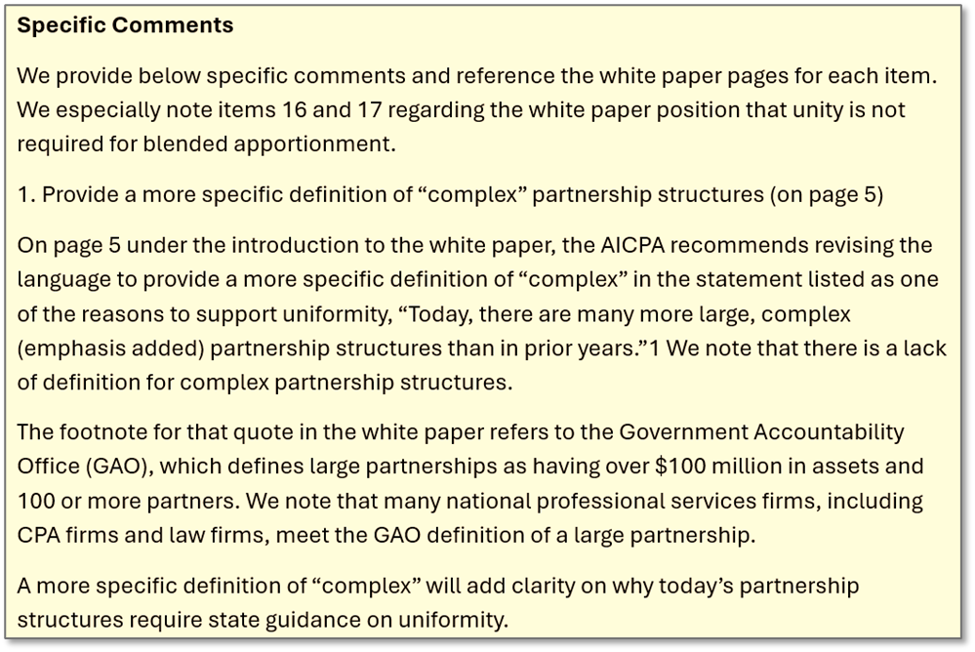

Slide 17
As noted in the response to general comment No. 1., this white paper’s focus is on the application of long-standing state sourcing rules to partnership income where there are certain complicating features such as corporate or tiered partners, related partnership transactions, and special or mandatory allocations. We are not proposing new or special sourcing rules for “complex partnerships,” in the way that federal legislation might apply different rules to “large partnerships.”
So the title of the white paper and the references to complex partnerships are merely intended to indicate the types of issues that it will focus on. But we agree that where the application of a particular rule is based on certain facts or circumstances, those would need to be defined clearly. And to the extent that the rules vary from the general sourcing rules used by states, we would want to highlight that.

Slide 18
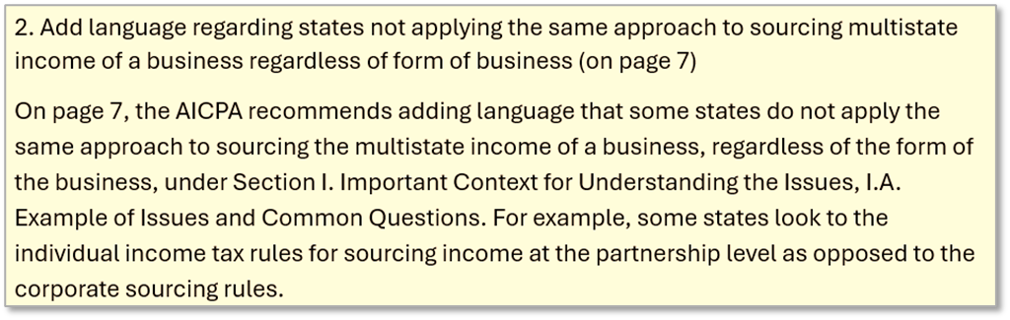

Slide 19
The information on page 7 is based on our research and responses from work group participants. Like the rest of the white paper, it is not meant to be a comprehensive summary of every state’s rules. That said, we look at differences in the rules for information on what alternatives might be and how those alternatives work.
Our research and discussion indicates that when states tax income from a multistate business, they generally reference (directly or indirectly) the same sourcing rules (including rules of apportionment) regardless of whether the business is conducted by a corporation or a partnership. These rules may be “embedded” or referenced in the tax rules for individuals and corporations—but again, for the sourcing of business income. But what is critical is that they use both formulary apportionment and rules for assigning nonbusiness (non-apportionable) income.

Slide 20
The comment may refer to specific state sourcing rules for the income of certain partnerships deemed not to be engaged in business activities—so-called investment partnerships. These rules typically apply where the activities of the partnership are limited to holding or managing under-lying assets. This is the subject of a separate draft white paper and model issued by the work group. (See links here: Draft White Paper and Draft Model.) In the May 19, 2025 version of the current white paper draft, we referred to the investment partnership model in a footnote. But we have now included that reference as part of the body of the Scope section in the Introduction.
If we have misread this comment of if the AICPA wishes to provide additional information, we would welcome any clarification or additional input.

Slide 21
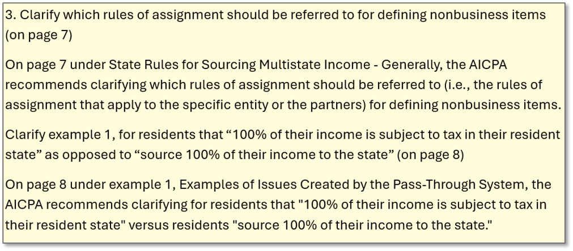

Slide 22
As noted in response to comment No. 2, above, most states reference the same general sourcing rules when they source the income of a multistate business, including when the business is conducted by a partnership. Those rules define business (apportionable) or nonbusiness (non-apportionable) income in light of the related activities of the business and then apply specific rules for sourcing the items of non-apportionable income based on the character of that income (rents, royalties, gains, etc.).

Slide 23
That said, we agree that in the case of residents, states generally use a hybrid system, taxing 100% of the resident’s income and then giving a credit for taxes paid to other states—typically limited to taxes imposed using similar sourcing rules and at the same or lesser rate. So we are happy to clarify in the examples cited in the comment that the resident partners would be taxable on 100% of their income but would receive a credit for taxes paid (again—limited to amount of tax the resident would have paid on the income applying the state’s own sourcing rules and its applicable tax rate). Also note that this hybrid approach is explained in more detail later in the white paper.
We also agree that where states have sourcing rules for income of businesses that are fundamentally different for nonresident or corporate partners, they should review those rules and make sure that these differences are intended and are clear. And we can add this to the white paper.

Slide 24
AICPA Comments 4 and 5 – asking for clarification –
These issues will be addressed and clarified.

Slide 25
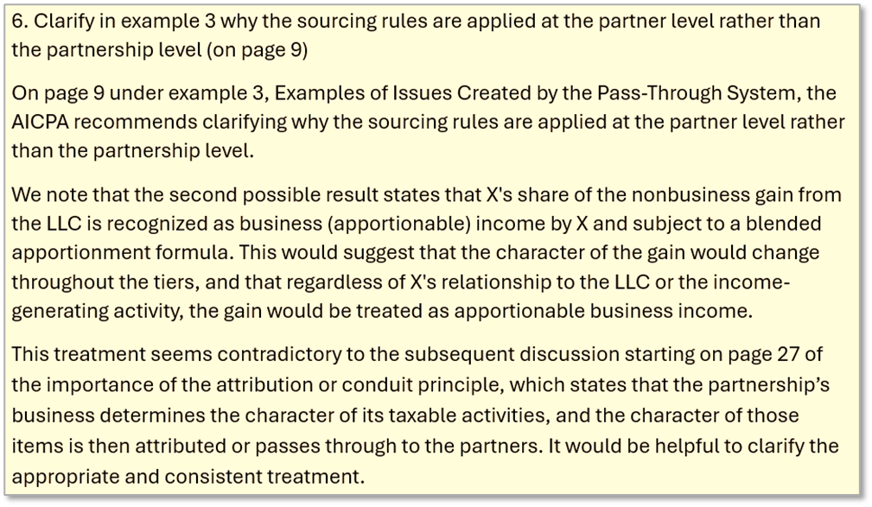

Slide 26
This section of the white paper simply provides examples of the questions raised by applying general state sourcing rules under the pass-through tax system. We hope these examples will help illustrate the type of uncertainty that the pass-through system creates and the need for more detailed sourcing rules for partnership income.
In the example cited, application of state sourcing rules to the LLC based on its own information would result in an item of income being properly treated as nonbusiness (non-apportionable) and sourced based on state rules of assignment. But, because the corporate partner would properly treat its share of partnership income as business (apportionable), it might not be clear whether this effectively changes the nature and source of that nonbusiness item.

Slide 27
A similar issue has been raised in work group discussions. There, the situation was a multistate partnership conducting business activities and generating income that would be properly treated as business income if the state sourcing rules were applied at the entity level. This would, presumably determine the partnership’s withholding for non-resident partners (and their taxable in-state income) as well as any entity-level taxes. Nevertheless, it was suggested that if a corporate partner would generally treat its distributive share of that partnership’s income as nonbusiness income, then it would source that income using the state’s rules of assignment, instead.

Slide 28
As the comment notes, the approach discussed by the work group and included in the white paper addresses both of these questions. Under that approach, state sourcing rules are first applied to the business conducted by the partnership so that its income is characterized as business (apportionable) or nonbusiness (non-apportionable) and sourced appropriately. The source of the income is then attributed to the partners, along with the partners’ shares of that income, and does not change except in situations where blended apportionment is used. (See the response to comment No. 14.)

Slide 29
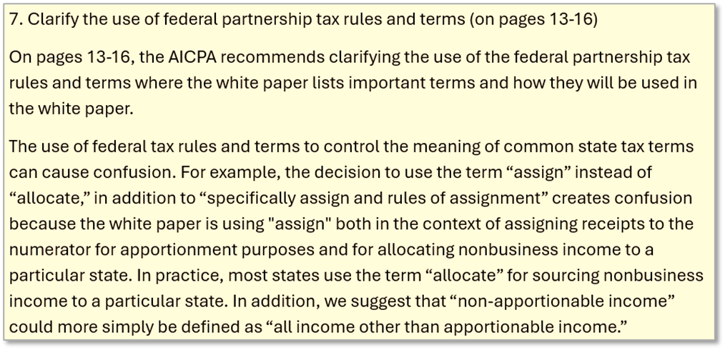

Slide 30
We agree that terminology can be confusing here, in part, because different terms are used by some states. . . . But there are two problems with using the term “allocate” in the way suggested.
As we note in the list of federal terms (at the beginning of that same section), the term “allocate” has an important role to play in the pass-through system: “Subchapter K uses the term ‘allocate’ to refer to the dividing up and attributing of partnership distributive share income (loss) or items to the partners, see IRC § 704(b) and related regulations . . ..” So saying that the “partnership allocates income” might refer to how it sources the income or to how it determines the partners’ shares of the income.
Some states refer the use of formulary apportionment as “allocation” of the income. And so there can also be some confusion when using the term in the state sourcing context.

Slide 31
Using “rules of assignment” and “assign” to describe the general method of sourcing non-apportionable income reduces the risk of miscommunication. The paper also makes clear that states do not follow the federal rules of assignment when sourcing domestic multistate income. But in order to clarify which rules of assignment are referred to, we have included the modifier “state” before “rules of assignment” in various places in the text.
The comment also notes that the term “assign” could refer to the rules for determining the receipts included in the state’s numerator. We have attempted to use the general terms “source,” “locate,” or “include” to refer to how states determine when sales or receipts are part of the apportionment factor numerator. We also hope that the context will help to provide clarity. But if a particular statement in the white paper is still unclear, we can address that specifically.

Slide 32
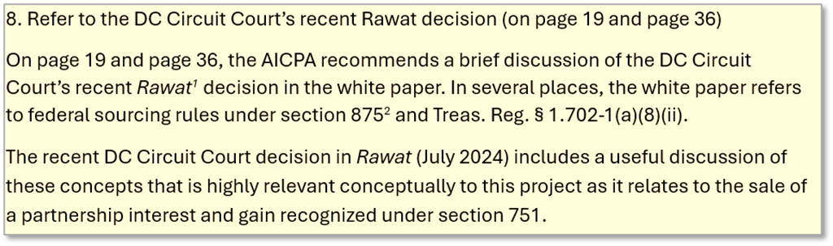

Slide 33
This comment addresses two sections in the white paper that discuss the application of federal sourcing rules to a foreign partner’s distributive share income. The source of partnership items under these rules is determined based on the character of those items which is, in turn, determined at the partnership level and attributed to the foreign partners. (While states do not conform to federal sourcing rules when sourcing multistate income, they do generally conform when determining the domestic tax base.)
The Rawat case, referred to in the comment, raised an entirely different question. This case was not about the sourcing of a foreign partner’s distributive share income, but rather how foreign partners should source gains from their sale of partnership interests—income which does not pass through and is not attributed from the partnership to the partners. Nor is Rawat of any continuing importance given Congress’s adoption, under the TCJA, of a rule requiring foreign partners to source the gain (loss) as if the partnership had sold its assets. See IRC § 864(c)(8).

Slide 34
While the focus of this white paper is on the sourcing of partnership distributive share income, rather than the gain (loss) from the sale of a partnership interest, we agree that states may need to address that question. This is especially true now that it is clear that foreign partners are required to source these gains (losses) from domestic partnership interests to the U.S., and state conformity to this determination of domestic taxable income means they should make clear the extent to which these foreign partners may also have state-sourced gain or loss.

Slide 35
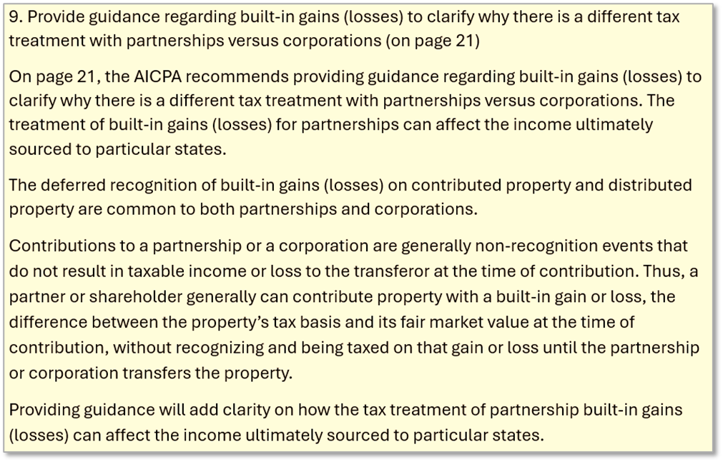

Slide 36
The white paper’s discussion of built-in gains (losses) and the way in which they might be sourced is not meant to suggest that there is a clear, uniform treatment at this point. But we expect that this discussion will be expanded and that the work group may ultimately propose a uniform sourcing treatment.
We agree with the comment that non-recognition applies to assets contributed to and distributed from both corporations and partnerships (with some exceptions). However, there is, of course, a fundamental difference. Corporate income is taxed twice whereas partnership income is taxed only once. So with respect to contributed assets, for example, when the partnership sells or transfers those assets, the contributing partner’s outside basis will be increased (decreased) by their mandatory allocation of any built-in gain (loss). So when the partner later sells that interest or take a distribution, there will be no second gain (loss) recognized. This treatment does not apply to a contributing-shareholder’s basis in their corporate stock.

Slide 37
And because, all things being equal, any built-in gain on assets contributed to a corporation will be taxed twice, it will also be sourced twice—first when the assets are sold or transferred by the corporation, and second when the contributing shareholder sells their stock or takes a distribution. With partnerships, however, built-in gain (loss) will only be recognized and sourced once.
This might provide an incentive to use partnerships to effectively shift the source of built-in gains (losses) on assets that a taxpayer expects to sell. But also see comment 10 and the response below.

Slide 38
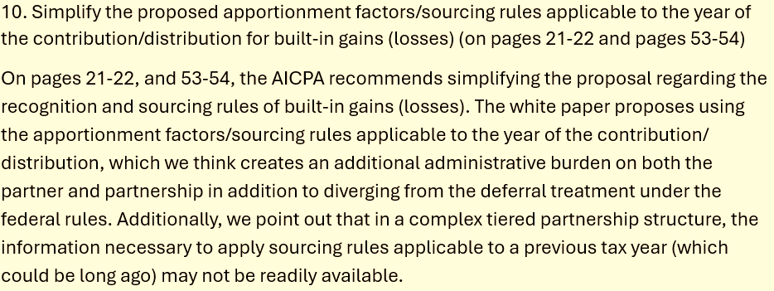

Slide 39
The rules for built-in gains (losses) under Subchapter K, including the mandatory allocation rules of IRC § 704(c) and the disguised sale rules, were enacted by Congress in response to concerns that the general non-recognition treatment could be used to effectively shift, defer, or avoid tax on accrued gains (losses). And because Subchapter K imposes these anti-abuse rules, partnerships and partners must already comply with certain specific record-keeping and tracking rules. Therefore, we can reasonably assume that partnerships are complying with these rules, even in complex, multi-tiered structures.

Slide 40
As for the sourcing information that may be needed, we can also reasonably assume that a contributing partner (or distributing partnership) would be able to determine where the built-in gain (loss) would be sourced if recognized at the time of the contribution or distribution. This information could therefore be reported, as necessary, including to compute any entity-level tax (PTET, composite returns, or withholding). So it is not clear that requiring the built-in gain (loss) to be sourced using this type of information would add significant complexity.
All that said, there is also an alternative approach to requiring that built-in gains (losses) always be sourced looking to where they would have been sourced at the time of contribution or distribution. States might, instead, apply this look-back approach only where there is evidence that the partnership was used primarily to change the sourcing of accrued gains or losses.
We would invite the AICPA to provide any further thoughts they might have on this alternative approach.

Slide 41
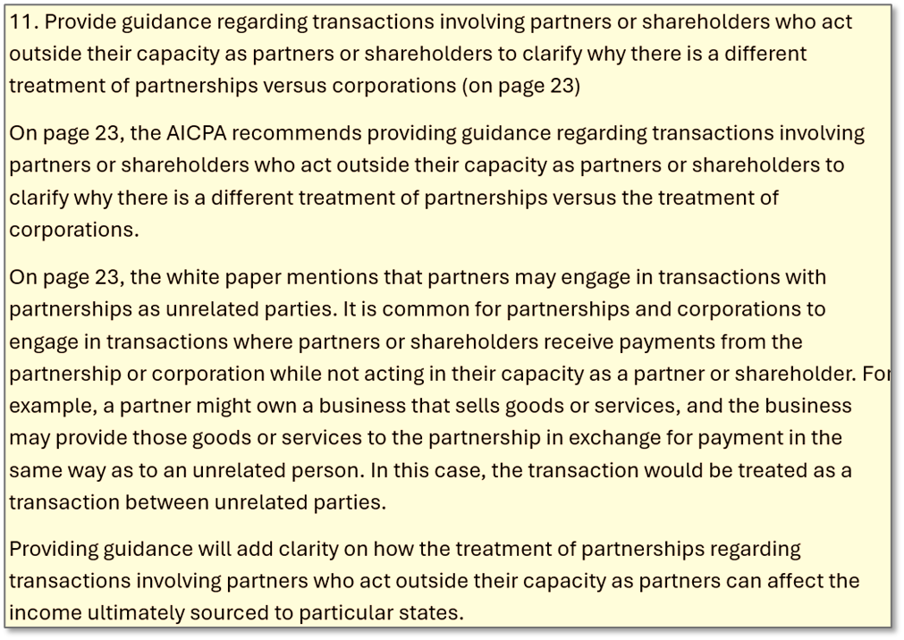

Slide 42
We agree that transactions between partners and partnerships are common. And these transactions can affect sourcing of income, sometimes in unintended ways.
Under the entity tax system used for corporations, the unintended sourcing effects of intercompany transactions can be addressed in one of three ways. The first, very simple approach is to apply add-back requirements to eliminate income and expense from certain transactions. The second, somewhat more complicated approach is combining the income and factors of related corporations so that all intercompany income and expense is effectively eliminated. (Some states view related-entity transactions among corporations as an indicia of a unitary relationship that might require combined filing.) The third, much more complicated approach is to ensure that all these intercompany transactions are imputed and priced properly. For this, the IRS uses its delegated authority under IRC § 482 and states may use similar authority.

Slide 43
While it is generally not possible to simply combine partnerships taxed under the pass-through system, states may apply blended apportionment to certain partners and partnerships. And where they do, it is common for the rules to require elimination of a share of intercompany transactions from both the partner’s blended apportionable income and the blended sales (receipts) factor. We expect to address this issue more fully in the white paper. We also expect to address the usefulness of IRC § 482 type authority as well as add-back statutes.

Slide 44
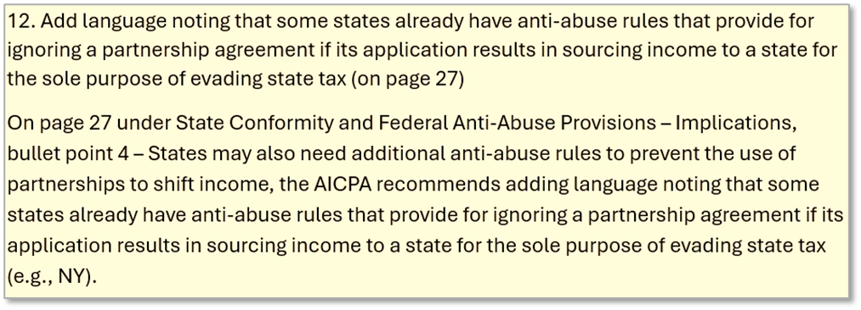
We agree that all states should adopt anti-abuse rules similar to those adopted by a number of states, including New York. We expect to address this issue in greater detail.

Slide 45
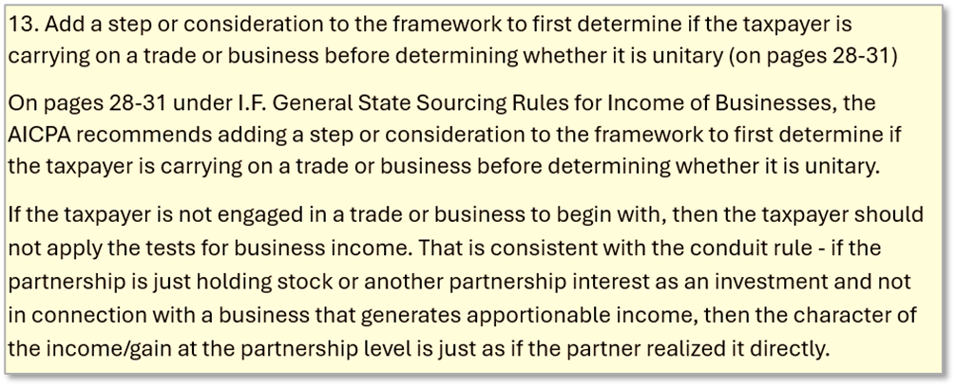

Slide 46
This comment refers to whether the “taxpayer” is carrying on a trade or business, but then it says, “if the partnership is just holding stock or another partnership interest as an investment . . ..” So it is not clear whether the focus here is on the taxpaying partner or the partnership.
This comment may be related to comment No. 2 above. So, we will just note again that the work group has addressed the sourcing of investment partnership income in a separate draft white paper and model. That draft model takes the approach to sourcing the income that this comment also appears to reference. It sets out a general definition as well as a safe harbor test for partner-ships that will be treated as investment partnerships. The model then treats the individual tax-paying partners of the investment partnership as if they held the underlying investments directly.
When we drafted that investment partnership model, we made clear that it would not apply to corporate partners. However, this is the kind of issue that may be reviewed once the more general sourcing rules addressed by this white paper are finalized. See the response to comment No. 14 below as well.

Slide 47
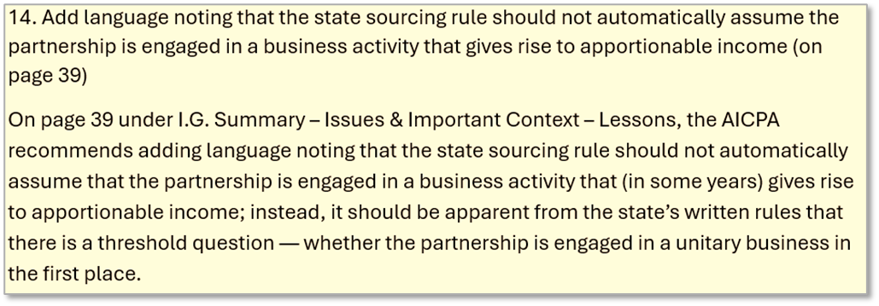

Slide 48
See the response to comment No. 13 discussing the work group’s draft model on investment partnerships. Note also that the draft model’s definition of an investment partnership applies based on the activities in the tax year. If it is the case that the AICPA believes there is some type of partnership that is not engaging in any trade or business, but also does not fit the definition of an investment partnership, it would be helpful if they could provide examples.
But we also note that the comment ends by asserting the threshold question is whether the partnership is engaged in a “unitary business.” The use of the word “unitary” here may reflect a more fundamental difference in how the AICPA assumes state sourcing rules apply to partnership income.

Slide 49
It may be that the AICPA assumes state sourcing rules, including formulary apportionment of business income, cannot be applied at the partnership level, but only to the taxpaying partner. If so, then the threshold question for applying apportionment might be whether the partnership is engaged in a single unitary business with the partner. This view does not reflect our research, the discussion of this issue by the work group, or the input we have received from states.

Slide 50
That said, part of what the work group seeks to do is clarify how the general rules apply. And as we have noted, this may be complicated by the fact that the sourcing rules for partnership income are typically “embedded” in the rules for individual or corporate income tax. But this, alone, does not mean those rules apply only at the partner level. For example, the Multistate Tax Compact itself, which incorporates UDITPA, defines the term “taxpayer” (used throughout the sourcing rules) as “any corporation, partnership, firm, association, governmental unit or agency or person acting as a business entity in more than one State,” indicating that the rules are applied to the business conducting the activity, regardless of its form.

Slide 51
The approach discussed by the work group and reflected in the white paper applies state sourcing rules, including apportionment of business income, to partnership income at the partnership level. This partnership-level approach, referred to as “separate sourcing” or “separate apportionment,” would determine the source of the partnership’s income which would then be attributed to taxpaying partners, along with their share of that income. This sourcing information would therefore be reported by the partnership to the partners who would source their share of the partnership income accordingly, regardless of whether they are individuals or corporations, hold direct or indirect interests, or take an active or passive role in the partnership.
The only exception would be where blended apportionment is applied—combining the income and factors of the partner and partnership or related partnerships. The majority of states that have provided for the use of blended apportionment will do so where there is a unitary relationship between the partner and the partnership or related partnerships. But we also expect to address this “when” question more fully in the white paper.

Slide 52
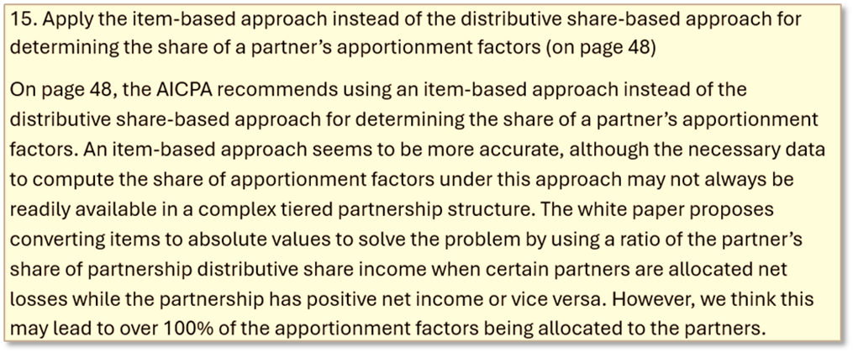

Slide 53
We’re not sure what an “item-based approach” would entail. If it means that each partner receiving a particular share of a given partnership item would then also be attributed an equal share of any related receipts, then there are three problems with this approach.
First, as the comment notes, “necessary data to compute the share of apportionment factors under this approach may not always be readily available in a complex tiered partnership structure.” Second, partners may also receive special allocations of items of expense, which may not be directly associated with any particular receipts. In fact, this is the issue that the absolute value method is meant to address. Third, the separate item approach undercuts the primary purpose of using formulary apportionment—which is that it is the combined receipts (or other factors) of the business that give rise to its overall profit or net income.

Slide 54
It does not appear that the use of the absolute value method can possibly lead to “over 100% of the apportionment factors would be allocated to the partners” as the comment suggests. The ratio computed using absolute values is simply the total shares of partnership items allocated to the partners, using absolute values, divided by the total partnership items, again—using absolute values. Because the numerator and denominator are computed on the same basis, the combined ratios cannot exceed 100%.
It is possible that this comment is referring to the fact that partners may end up sourcing their partnership income differently depending on whether they use blended apportionment or separate apportionment. But this is simply an example of the effect that the partner’s own attributes will have on the ultimate tax result.

Slide 55
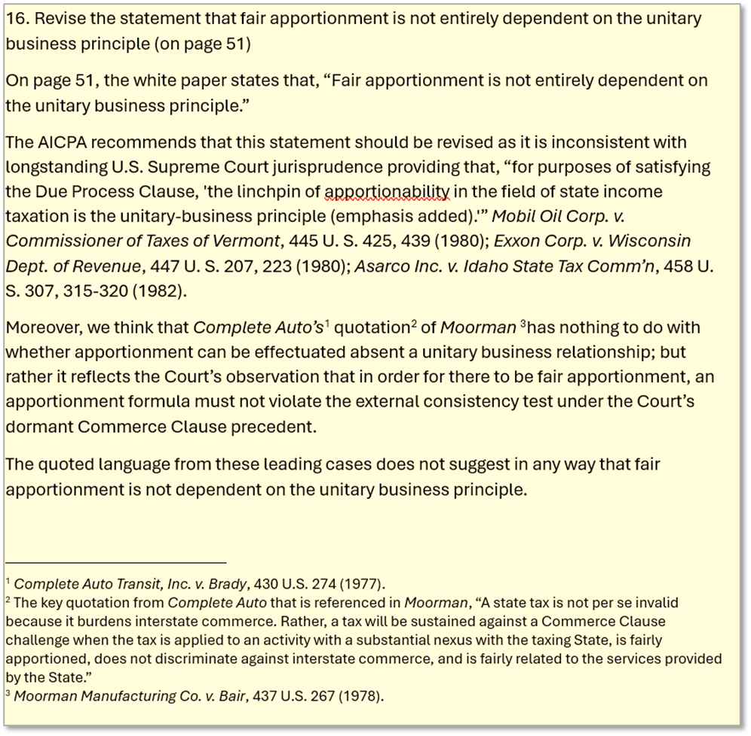

Slide 57
Here is the text in the draft white paper this comment appears to reference:
“Fair apportionment is not entirely dependent on the unitary business principle.
“The unitary business principle may serve to show that a state has nexus over the business and its income, but also that the income has a connection to the apportionment formula used. But as the Supreme Court said in Container Corp. of America v. Franchise Tax Board, that constitutional fairness standard is low: . . . we will strike down the application of an apportionment formula if the taxpayer can prove "by 'clear and cogent evidence' that the income attributed to the State is in fact 'out of all appropriate proportions to the business transacted . . . in that State,' [Hans Rees' Sons, Inc.,] 283 U. S., at 135, or has 'led to a grossly distorted result,' [Norfolk & Western R. Co. v. State Tax Comm'n, 390 U. S. 317, 326 (1968)]." Moorman Mfg. Co., supra, at 274.”

Slide 58
So the white paper cites Container Corp. of America v. Franchise Tax Bd., 463 U.S. 159 (1983), the comment, instead, refers to “Complete Auto’s quotation of Moorman.” Since Complete Auto never references the unitary business principle and was decided a year before Moorman, we assume the comment was, instead, referring to Container Corp. (Note that Container Corp also never references Complete Auto.)
We agree that an apportionment formula must be fair or that the components of fairness have been articulated in various Supreme Court cases, including Container Corp. But we disagree with the comment’s suggestion that there is some absolute standard for determining a unitary business and that this, in turn, controls when formulary apportionment may be used for business income. Here is the longer quote from Container Corp.:

Slide 59
  “A final point that needs to be made about the unitary business concept is that it is not, so to speak, unitary: there are variations on the theme, and any number of them are logically consistent with the underlying principles motivating the approach. For example, a State might decide to respect formal corporate lines and treat the ownership of a corporate subsidiary as per se a passive investment. In Mobil Oil Corp., 445 U.S. at 445 U. S. 440-441, however, we made clear that, as a general matter, such a per se rule is not constitutionally required: "Superficially, intercorporate division might appear to be a[n] . . . attractive basis for limiting apportionability. But the form of business organization may have nothing to do with the underlying unity or diversity of business enterprise."

Slide 60
When the draft white paper says that fair apportionment is not “entirely dependent” on the unitary business principle, and cites Container Corp for that purpose, we are primarily thinking of the different, accepted approaches to apportionment used by states:
Apportioning parts of the unitary tax base using different formulas: States that allow separate entity filing apply different apportionment formulas to different parts of the income earned by the unitary business.
Use of industry-specific formulas: In some states where industry specific formulas are used for apportioning income from certain activities, a single taxpayer conducting both activities that are covered by the rule as well as other activities may apportion the income related to those two activities separately, even if both are part of a unitary business.
Requiring taxpayers with separate unitary businesses to use separate apportionment: It is not uncommon for a single taxpayer—whether a separate corporate entity or unitary group—to be engaged in more than one unitary business—so that the activities of each are clearly separable. In that case, most states require that the apportionable income of the separate businesses be apportioned separately.

Slide 61
The take-away from Container Corp. and these common and accepted variations in apportionment is that there is nothing in the unitary business principle that prevents:
(1) certain categories of income of a single unitary business from being apportioned separately, using separate formulas related to those categories, or
(2) requiring a taxpayer with income from two separate unitary businesses to apportion the income from those businesses separately.
Again, this is relevant to the work group’s discussion of the sourcing of partnership income since the approach we have discussed would apply apportionment to a partnership’s business income at the partnership level unless the income is subject to blended apportionment. There is nothing inherent in the unitary business principle that prevents this approach.
This portion of the work paper will likely be revised somewhat to make this more clear. But see also the response to comment No. 17 below.

Slide 62
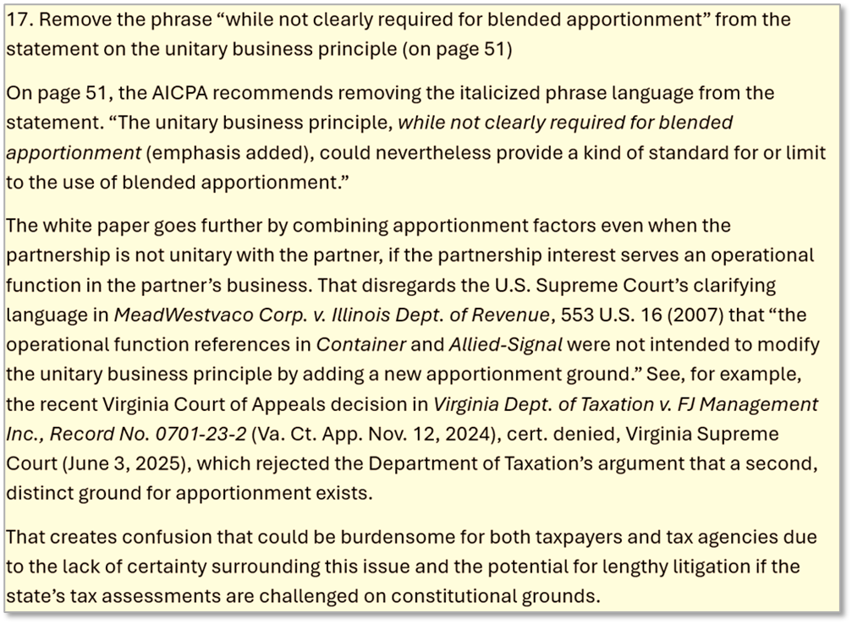

Slide 64
This comment appears related to comment No. 16 above. The portion of the white paper this comment refences is focused on when blended apportionment should be used. That is, it addresses when the partner’s share of partnership income should be combined with its own apportionable income and apportioned using a formula that also includes a share of the partnership’s factors. The U.S. Supreme Court has never addressed this question.
The decision in MeadWestvaco Corp. is inapplicable. The question there was whether gain from the sale of a business, recognized directly by the parent, could be included in the parent’s apportionable income and apportioned using the parent’s factors. Not only did the case not involve distributive share income of a partnership, but the Court also declined to address the question of whether the gain in that case could be separately apportioned using the factors of the business sold. See MeadWestvaco Corp. v. Ill. Dep't of Revenue, 553 U.S. 16, 30-32 (2008).

Slide 65
Nor do we agree with the comment’s reading of FJ Management. The Virginia appeals court first determined that the partner and partnership had no entity unity. Then, under Allied-Signal’s operational function test, it determined there was no evidence that the partner used its partnership income as part of its own working capital “or for any other operational purpose related to partner’s independent business activities.” In any case, as we note, neither Allied-Signal nor MeadWestvaco addressed the sourcing of a partner’s distributive share income or whether such income could be apportioned at the entity level using just the partnership’s factors. (Nor is it clear how Virginia’s rules of assignment would treat distributive share income or whether they recognize that such income is made up of separate items that may be sourced separately.)

Slide 66
Not only has the U.S. Supreme Court never addressed the question of how the unitary business principle applies to distributive share income (taxed under the pass-through system), but the traditional test for entity unity can also be very difficult to apply in the modern partnership context. In that context, ownership does not equal control, limited liability does not equal passive investment, and the value of the interest to the partner may not determine the partner’s share of the partnership income. Moreover, the partnership may conduct only limited business activities, while holding assets that are valuable or used in the partner’s own business.

Slide 67
In short, the question of when to apply blended apportionment is an open question. We can imagine situations in which the state might prefer the use of blended apportionment versus separate apportionment. But we can also imagine situations in which the taxpaying partner would prefer the blended approach—viewing it as a kind of necessary factor representation.
This is an area where we expect to expand on the information in the white paper and ask for additional input from participating states and the public.

