Slide 1

Sales Taxation of Digital Products –
Status Report
July 22, 2025

Slide 2
Project Report
Project resulted from a presentation by Washington state and input from a number of stakeholder interviews.
The focus of this project is on sales taxation of digital products and whether there is a simple, workable approach to broadly defining those products so that the tax base is more adaptable over time.
The committee established the work group to draft a white paper on this subject, following a draft outline prepared based on stakeholder input.

Slide 3
Project Report
Since the last committee meeting the work group and its study groups have:
  Finished reviewing possible bundling issues and submitted comments to Streamlined
  Continued discussions of a proposal to define digital products broadly along with a business input exemption
  Begun considering sourcing of digital products

Slide 4
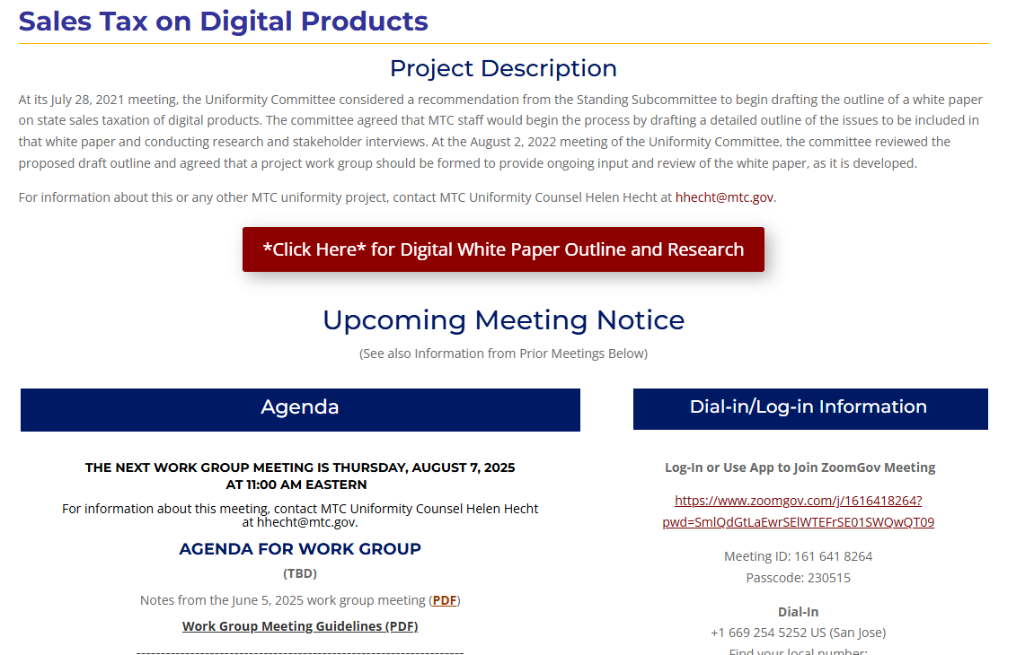
Project Web Page and Online Outline
Information on the project is captured on its web page – here
That project page has a link to an online outline of the white paper

Slide 5
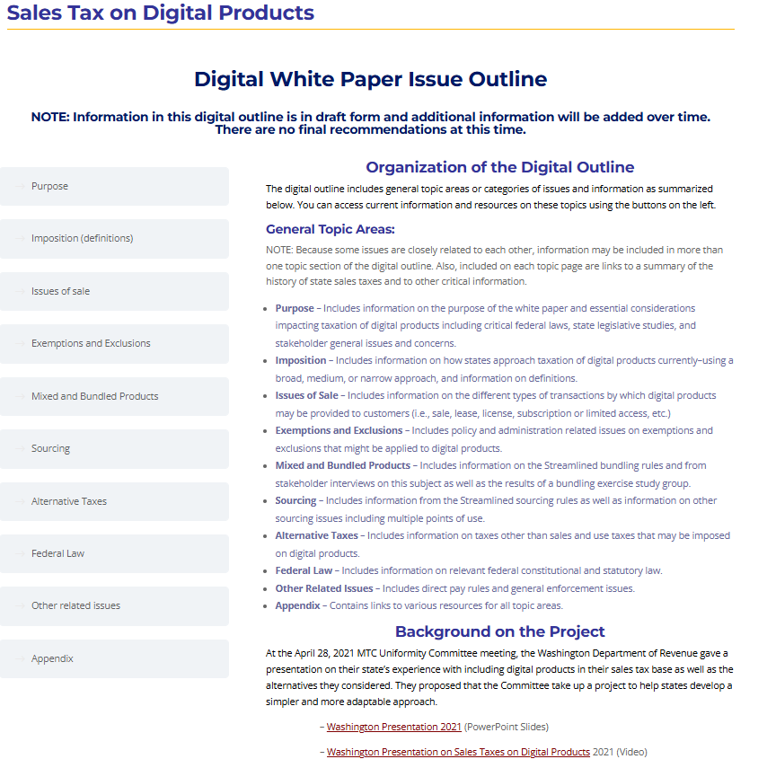
Online Outline
With sub-pages for particular topics

Slide 6
Today’s Subjects
Current state efforts in taxing digital products
Update on the definitions study group work
Presentation on sourcing and the rules used in the Mobile Telecom Sourcing Act and Digital Goods and Fairness Act legislation
Questions and comments from the committee and the public

Slide 7
CURRENT STATE EFFORTS
Digital Products Project

Slide 8
Louisiana
Streamlined Plus
Includes as taxable “[d]igital audiovisual works, digital audio works, digital books, digital codes, digital applications and games, digital periodicals and discussion forums, and any other otherwise taxable tangible personal property transferred electronically[.]”
  Whether digitally delivered, streamed, or accessed and whether purchased singly, by subscription, or in any other manner.
Act 10, H.B. 8, Louisiana State Legislature, Third Extraordinary Session, 2024.

Slide 9
Maine
Streaming
Taxes “[d]igital audiovisual and digital audio services.”
Defined as “electronic transfer of digital audiovisual works and digital audio works to an end user with the right of less than permanent use granted.”
  Includes transfers conditioned upon continued payment and subscriptions.
Chapter 388, LD 210, 132 Maine Legislature, First Special Session, 2025.

Slide 10
Maryland
NAICS codes
Includes as a taxable service a data or information technology service described under NAICS sector 518, 519, or 5915, and a system software or application software publishing service described under NAICS sector 5132.
  Excludes sales of cloud computing to qualified cybersecurity business. Defines cloud computing as a service that enables on-demand, self-service network access to a shared pool of configurable computer resources.
Chapter 604, H.B. 352, Maryland General Assembly, 2025.

Slide 11
Washington
Changes to Digital Automated Services, other
Repeals several exclusions from digital automated services:
  (1) services that primarily involve the application of human effort;
  (2) live seminars, workshops, or courses where participants connect via the Internet;
  (3) advertising services and data processing services.
Includes as “sale at retail” sales of information technology training services, technical support, custom website development, advertising services, custom software, and customization of software.
Chapter 422, S.B. 5814, Washington State Legislature, 2025

Slide 12
Definitions study group
Digital Products Project

Slide 13
Definition Study Group
Task
The Study Group: 26 agency and non-agency participants plus alternates
The Task: Evaluate methods of broadly defining a digital products tax base
Discussed criteria for evaluation
Identified some existing methods for evaluation: Washington, South Dakota, Ohio, Utah, and Maryland
One proposed new method for the taxation of “automated digital products”

Slide 14
Definition Study Group
Criteria for Evaluation
Clarity and ease of application
Revenue generation or stability
Compatibility with other elements of the tax structure
Pyramiding of taxes
Other considerations

Slide 15
Definition Study Group
Small,
Medium, and Large
Categories
Refined categories:
  Large - unitary definition
  Medium - expansive definitions
  Small – specific definitions
Large, medium, or small outcome depends upon exclusions
  A large method could have a small outcome if there are many exclusions

Slide 16
Definition Study Group
Unitary Definition Method
Uses a single definition for inclusion in the tax base with one or more exclusions applied to the definition, and external exemptions such as the sale-for-resale exemption.
Examples
  Washington
  Utah
  Proposed tax on “automated digital products”

Slide 17
Definition Study Group
Unitary Definition Method
Washington
  Digital automated service - "any service transferred electronically that uses one or more software applications.”
  Digital goods - “sounds, images, data, facts, or information, or any combination thereof, transferred electronically, including, but not limited to, specified digital products and other products transferred electronically not included within the definition of specified digital products.”
  Limited by over a dozen exclusions. Until recently, excluded services involving primarily human effort.

Slide 18
Definition Study Group
Unitary Definition Method
Utah
  Sales and use tax on amounts paid or charged for a sale of: (i) a “product transferred electronically” and (ii) a repair or renovation of a product transferred electronically, including maintenance agreements.
  “Product transferred electronically” is limited to “a product transferred electronically that would be subject to a tax under this chapter if that product was transferred in a manner other than electronically.”
  The State Tax Commission has interpreted “product transferred electronically” to include such products only if the purchaser may download them.

Slide 19
Definition Study Group
Unitary Definition Method
Proposed tax on “automated digital products”
  Automated digital product – an item, including software or a service or a right to access or use the item regardless of duration, that is provided in a binary format and for which additional human intervention required to produce the same or a substantially similar item for additional customers is minimal.
  “Minimal human intervention” – a concept used by the OECD, the United Nations, and the European Union

Slide 20
Definition Study Group
Unitary Definition Method
Proposed tax on “automated digital products”
  Proposed rules
    The definition only looks to the supplier of the product, without regard to any human intervention on the side of the user (e.g., where the user may input certain parameters into an automated system to obtain a customized result).
    The definition focuses on the human effort to provide the product and therefore does not include human effort in creating or supporting the system by which the item is provided.
    The threshold of minimal human intervention would not be crossed where the provision of the same or similar product to new users generally requires very limited human response to individual user requests.

Slide 21
Definition Study Group
Expansive Definition Method
Concept
  Uses several expansive, but not all-inclusive, definitions for inclusion in the tax base with one or more exclusions applied to the definitions, and external exemptions.
  Examples
    Ohio
    Maryland

Slide 22
Definition Study Group
Expansive Definition Method
Ohio
  In addition to the inclusion of SST “specified digital products,” the tax base also includes transactions in which “[a]utomatic data processing, computer services, or electronic information services are or are to be provided for use in business when the true object of the transaction is the receipt by the consumer of automatic data processing, computer services, or electronic information services rather than the receipt of personal or professional services to which automatic data processing, computer services, or electronic information services are incidental or supplemental.”

Slide 23
Definition Study Group
Expansive Definition Method
Ohio
  “’Automatic data processing’ means processing of others’ data, including keypunching or similar data entry services together with verification thereof, or providing access to computer equipment for the purpose of processing data.”
  “’Computer services’ means providing services consisting of specifying computer hardware configurations and evaluating technical processing characteristics, computer programming, and training of computer programmers and operators, provided in conjunction with and to support the sale, lease, or operation of taxable computer equipment or systems.”
  “’Electronic information services’ means providing access to computer equipment by means of telecommunications equipment for either examining or acquiring data stored in or accessible to the computer equipment or placing data into the computer to be retrieved by a designated recipient with access to the computer equipment.”
  Automatic data processing, computer services, and electronic information services do not include personal or professional services.

Slide 24
Definition Study Group
Specific Definition Method
Concept
  Uses multiple narrow definitions aimed at specific products, typically with exclusions, and external exemptions.
  Example – Wisconsin
    Taxes SST “specified digital products”
    Plus “additional digital goods” transferred electronically: greeting cards, finished artwork, periodicals, video or electronic games, and newspaper or other news or information products.

Slide 25
Definition Study Group
Observationof the Chair
  Generally speaking, because unitary and expansive definitions will be broader than specific definitions, they have the potential to raise more revenue and be more adaptable to new and innovative products than specific definitions.
  But, revenue from broad terms of inclusion could be significantly reduced by terms of exclusion that are applied to the definitions.

Slide 26
Definition Study Group
Observationof the Chair
  Generally speaking, unitary and expansive definitions have the potential to be less clear than specific definitions focused on particular products.
  But, multiple specific definitions for multiple products also require the articulation of more taxability boundaries than are required for a unitary definition or for a few expansive definitions.
  For example, the definition of “digital book” in the Streamlined Sales Tax Agreement still requires a detailed rule to explain what is and is not a “book.”
  Ultimately, clarity depends upon the articulation of precise and ascertainable terms of inclusion and exclusion rather than the type of approach.

Slide 27
Definition Study Group
B2B Exclusion
  Some suggested B2B exclusions:
    The sale of a “[Insert digital products definition (DP)]” to a qualified business that is the exclusive user of the [DP], including sharing the use of the [DP] with other qualified business users, is not subject to the [insert state SUT definition]; provided, however, that this exclusion shall not apply to non-business use of a [DP] by a qualified business unless the non-business use is inconsequential.
    A product is exempt from taxation as an automated digital product if the product will be used predominantly for a trade or business.

Slide 28
Definition Study Group
Wrap-Up
  Wrap-Up – Next month?
  Written evaluations of selected existing methods from different viewpoints.
  Written evaluations of proposed tax on automated digital services” from different viewpoints.

