Slide 1

Uniformity DEVELOPMENTS
Report to the MTC Uniformity Committee
July 22, 2025
Helen Hecht, MTC Uniformity Counsel

Slide 2
Uniformity DEVELOPMENTS
QUESTIONS
Report to the MTC Uniformity Committee
July 22, 2025
Helen Hecht, MTC Uniformity Counsel

Slide 3
Big Corporate Income Tax Questions

Slide 4
But first -
From the MTC History page –
July 1985 . . .
During meetings of the Worldwide Unity Taxation Working Group (aka the Regan Committee), the MTC and FTA —
  “mounted strong objections to the federal government’s attempts to interfere with the use of formulary apportionment to tax multinationals—providing evidence that the federal government’s approach to transfer pricing allowed companies to shift income overseas.”
So the Treasury Department came out with draft legislation to address the states’ concerns promising—
  “to implement corporate reporting requirements so that the sourcing of their worldwide income could at least be tracked. . . .

Slide 5
But first -
From the MTC History page –
July 1985 . . .
During meetings of the Worldwide Unity Taxation Working Group (aka the Regan Committee), the MTC and FTA —
  “mounted strong objections to the federal government’s attempts to interfere with the use of formulary apportionment to tax multinationals—providing evidence that the federal government’s approach to transfer pricing allowed companies to shift income overseas.”
So the Treasury Department came out with draft legislation to address the states’ concerns promising—
  “to implement corporate reporting requirements so that the sourcing of their worldwide income could at least be tracked. The legislation was never adopted.

Slide 6
So – How’s that Transfer Pricing thing Been working?
Eaton Corp. – litigating audit for 2017-2019 – refusing to disclose records related to foreign employment arguing that doing so would violate foreign law. (6th Cir.)
Coca-Cola – litigating audit for 2007-2009 – challenging the IRS’s Sec. 482 regulations under Loper Bright and the APA (11th Cir.)
Facebook – litigating audit for 2010 – tax court addressed periodic adjustments in a 51,000-word opinion after a trial involving 26 expert witnesses

Slide 7
So – How’s that Transfer Pricing thing Been working?
PayPal – quoting an expert opinion in TaxNotes – “In this final installment of a two-part report, Curtis continues his analysis of PayPal’s cost-sharing arrangement, explains how the cost-sharing regulations can be exploited to possibly shift billions in U.S. profits offshore with little or no IRS detection or enforcement . . .”
Medtronic – involving royalty rates – quoting another expert’s observations in TaxNotes as to arguments before the 8th Cir.– “The section 482 regulations’ seemingly unique ability to inspire diametrically opposed interpretations was on full display during oral arguments in Medtronic II.”(This is a second round of litigation that has been going on for over a decade.)

Slide 8
We asked AI – IS transfer Pricing a good Career Choice?
PROs
Transfer pricing is a specialized area, leading to high demand for qualified professionals and, consequently, competitive salaries, according to a career guide from StarTax Education.
As companies expand internationally and regulations evolve, the demand for transfer pricing expertise is likely to continue growing, offering oppor-tunities for career advancement.
CONs
Transfer pricing can be a challenging field to enter, as it requires specific knowledge and expertise . . .
Transfer pricing rules and regulations are constantly evolving, requiring professionals to stay up-to-date with the latest developments.
Transfer pricing can be a complex area, making it challenging to explain the work to those outside the field.

Slide 9
Is there any Recent Federal Legislation?
Yes. The One Big Beautiful Bill Act
First, What Do we call it?
One Big Beautiful Bill Act
“OBBBA”
“Oh-Ba”
“3-Bs”
The 2025 Reconciliation Act
H.R. 1
Or maybe – P.L. 119-21

Slide 10
What got cut from the bill?
  Federal “revenge tax”
  Restrictions on states from using pass-through entity taxes
  Expanded preemption of state taxing authority under P.L. 86-272
What about corporate tax changes?
  Continues many TCJA policies including accelerated depreciation and allows immediate expensing of R&D
  Changes the §163(j) calculation both for 2025 and after—affecting MNEs
  Changes how mandatory domestic sourcing of certain income (i.e. GILTI) works

Slide 11
How will OBBBA impact the largest corporate taxpayers?
Major changes to treatment of multi-national enterprises (MNEs)
  Global Intangible Low-Taxed Income (GILTI) –
    Now Net CFC Tested Income (NCTI),
    Calculated on total CFC income, not QBAI, and
  Foreign-Derived Intangible Income (FDII) –
    Now Foreign-Derived Deduction Eligible Income (FDDEI),
    reduced from 50 to 40%.
  Foreign Tax Credit (FTC) –
    Raised from 80% to 90%
  Determination of what are Controlled Foreign Corporations (CFCs)
    TCJA repealed § 958(b)(4) to try to avoid downward attribution of foreign stock, but OBBA undid that change
    New § 951B that extends the CFC inclusion rules to “foreign controlled US shareholders” (FUSSHs) of “foreign controlled CFCs” (FCFCs) and modifies those definitions.

Slide 12
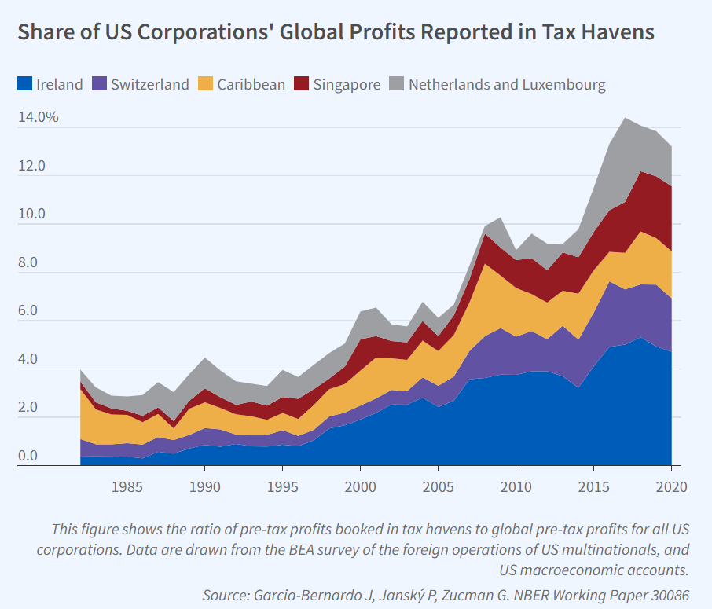
Did TCJA’s Adoption of GILTI change income shifting?
Here’s this from a report
by the Nat’l Bureau of
Economic Research:

Slide 13
This is all part of a global effort
G7 Discussions
Ongoing efforts to enforce transfer-pricing rules
Digital Services Taxes
OECD
Pillar 2 Minimum Tax
Tariffs & Trade Barriers
New GILTI & FDII - Net CFC Tested Income (NCTI) & Foreign-Derived Deduction Eligible Income (FDDEI)

Slide 14
don’t states have their own problems with MNEs?
Use of so-called “80/20 companies” prompted counsel for the MTC to publish two articles:
  “Troubling Tax Behavior Illustrates Need to
  Change State Tax Codes,”
  Brian Hamer, Tax Notes – State, Jan. 30, 2023
  “Pepsi Tax Case Shows Why 80/20 Rules Hurt States,”
  Bruce Fort, Bloomberg Government, Nov. 7, 2023.

Slide 15
MTC Combined filing Models (Joyce & Finnigan)
The MTC combined filing models would include the income and factors of all domestic entities as well as any foreign entities if 20% or more of the entity’s factors, including sales, are domestic.
The models also make WWCR the default (and presumably most equitable) method.
See those models, here: https://www.mtc.gov/uniformity/adopted-uniformity-recommendations/.
Also, the MTC has a model requiring add-back of certain expenses from intercompany transactions.

Slide 16
Pass-through questions

Slide 17
Are there any Pass-through developments?
OBBBA raises the SALT cap and phases out that increase for high-income taxpayers.
What does it mean that the legislation in the House included restrictions on the ability of taxpayers to take deductions for PTE taxes but then those restrictions were removed?

Slide 18
What about Pass-throughs and the global private markets?
As we’ve discussed, private equity is continuing to grow.
PE firms typically hold non-publicly traded assets such as real estate and pass-through operating companies.
Private credit, or debt—where companies borrow from funds rather than banks—is also growing rapidly. But it’s risky.
Some want to be able to offer institutional and individual investors PE holdings through traded funds (like mutual funds).

Slide 19
What about Pass-throughs and the global private markets?
When foreign investors invest in U.S. private equity funds, they often use blocker corporations. While those corporations must report and pay tax on U.S. income, the foreign shareholders do not.
The MTC partnership project has a draft white paper and draft model statute on sourcing the income of investment partnerships—but that applies only to investors taxed as individuals.
How would these blocker corporations be treated for state tax purposes?

Slide 20
What about a simple DST?

Slide 21
Problems with digital Services Taxes
The U.S. government has expressed opposition to foreign DSTs.
And then there’s this from a recent Economist article:
    “As users pose their queries to chatbots rather than conventional search engines, they are given answers, rather than links to follow. The result is that “content” publishers, from news providers and online forums to reference sites such as Wikipedia, are seeing alarming drops in their traffic. As AI changes how people browse, it is altering the economic bargain at the heart of the internet. Human traffic has long been monetised using online advertising; now that traffic is drying up.”

Slide 22
Speaking of Digital products . . .

Slide 23
What are they?
Substitutes for traditional goods and services?
New products that have no traditional analog?
What if it can be reproduced in physical form?
Are they just the products of services?
Software?
(Wait, I thought software was a tangible. But, no, software can also be a service, right? . . . )
Communication?
Does data count?
Do platforms or infrastructure count?
Is it just everything now . . . ?

Slide 24
How will AI change digital products?
Here’s what AI said:
  Hyper-personalization and adaption
  Processes will become more automated
  Interfaces will be enhanced
  Products will simplify decision-making
  Entirely new products and industries could be created

Slide 25
Recent State Enactments
Washington
Maryland
Louisiana

Slide 26
Is it possible to define digital products broadly?
Stay tuned for the report from
the sales tax on digital products
work group.

Slide 27
Other Questions

Slide 28
How will Cuts at the IRS & Loper Bright Affect states?
Shrinkage of IRS staff – common estimates - 25%
Added 10-year tax gap – Yale Budget Lab’s estimate - $2.4 trillion
How may years behind is IRS technology – survey of experts – 25 years
Percentage of federal tax cases now citing Loper Bright to challenge regulations - rough guess – 95%
When will states start to see these effects? ¯\_(ツ)_/¯

Slide 29
Questions?
(No . . . wait . . . we have enough questions . . . we need answers . . .)

