Slide 1

State Taxation of Partnerships –
Status Report
May 21, 2025

Slide 2
Developments – federal budget bill provisions
These developments are still being studied by the MTC and states

Slide 3
House Reconciliation Bill - Section 112018
Changes to Subchapters K and S
Amended IRC 275
New IRC 6659

Slide 4
Changes to Subchapter K and S
Sections 702, 703 and 704 (Subchapter K) and 1366 and 1363 (Subchapter S) would be amended to reflect the limitations under amended section 275.
In a nutshell, PTEs would have to separately state specified taxes for the purpose of applying the limitation at the individual level. They would no longer be able to deduct them from ordinary business income.

Slide 5
Amended IRC Sec. 275
Would limit certain deductions allowed under IRC 164
  Foreign Property Taxes would be disallowed unless used in a trade or business
  “Specified Taxes” would be limited to $30k with a phase out down to $10k once taxpayers reach $400k of modified AGI.

Slide 6
“Specified Taxes”
Any tax described in IRC 164(a), IRC 164(b)(5) [sales taxes] and IRC 216(a) [Cooperative Housing], except for GST taxes in IRC 164(a)(4) and “Excepted Taxes.”
&
Any “Substitute Payment.”

Slide 7
“Excepted Taxes ”
Taxes paid or accrued on account of:
  Foreign income,
  State and local income derived by a “Qualifying Entity” with respect to a trade or business as defined in 199A(d),
  Real or personal property owned when carrying a trade or business or for the production of income,
“Qualifying Entities” are PTEs with at least 75% of gross receipts derived from a qualifying trade or business.

Slide 8
“Excepted Taxes ”
So, apparently, if a PTE records 75% of its gross receipts derived from a trade or business as defined under IRC 199A(d) [except for CPAs and attorneys which are excluded specified service trade or business] then the taxes paid or accrued described under IRC 164, 216, or for the production of income under 212 are not limited.
State PTE taxes seem to generally qualify for the exception.
Now let’s take a look at substitute payments.

Slide 9
“Substitute payments”
Where the limitation under Sec. 275 would impact the effect of state PTE taxes on the federal return of owners.
Substitute payments would be any taxes, except specified taxes, thus including excepted taxes, if under the law of the state imposing it one or more person would be entitled to a specified tax benefit the aggregate dollar of which equals or exceeds 25% of such amount, based on 2 assumptions.

Slide 10
“Substitute payments”
“Specified Tax Benefit” is a benefit allowed against or in reference to a “Specified Tax,” meaning an exclusion or a credit for state tax purposes.
The statute says it is determined with respect to the amount of tentative substitute payment. Based on the JCT example that seems to mean that the substitute payment itself is used as a credit or as a deduction on the owner’s return.
The assumptions regarding the dollar value of the “Specified Tax Benefit” are:
  That all PTE owners are residents of the state imposing the tax, and
  The dollar value of the specified benefit is either the entire amount of the credit or 15% of the exclusion.

Slide 11
Result – With respect to Credits
  When a state uses the distributive share of PTE tax as a tax credit, the specified tax benefit would be 100% of the credit. And since PTE tax payment is the same amount it would be more than 25% of the aggregate value of the PTE Tax payment.
  That seems to mean that PTE taxes that are offset with a credit at the individual owner level would be considered substitute payments subject to the limitation under IRC 275.

Slide 12
Result – With respect to exclusions
  When a state provides an exclusion of all or part of the distributive share of state income, the result seems less clear and would require further clarification.
  Since exclusions are based on distributive share rather than on PTE Tax payments, a narrow reading requiring the use of such payment on the individual’s return as an exclusion would result in PTE tax payments having no specified tax benefit. PTE taxes would not be substitute payments and would not be limited under IRC 275.
  If, the deduction of distributive share of PTE income at the owner’s level is considered a tax benefit “with respect to the payment of PTE tax paid at the PTE level”, then the specified tax benefit would be 15% of all the deductions which is likely to be more than 25% of the PTE tax paid at the entity level. And in this case, the PTE tax would be a substitute payment limited under 275.

Slide 13
New Sec 6659:
Seem to address what is called a state and local allocation mismatches.
Allocations mismatches stem from partnership special allocations, when a partner receives a specified tax (unlimited) deduction, and another partner receives a state credit or exclusion without the deduction.
NEW FEDERAL TAX (penalty?) would be paid by the individual and would equal the highest marginal tax rate in effect in the tax year multiplied by the sum of all allocation mismatches.
However, it is unclear what federal tax benefit can be derived by individual or trust partners from reallocating deductions to other unlimited partners, if they could not take the deduction to start with.

Slide 14
UPDATE on the White Paper
See the version dated 5-19-2025 on the Project Webpage

Slide 15
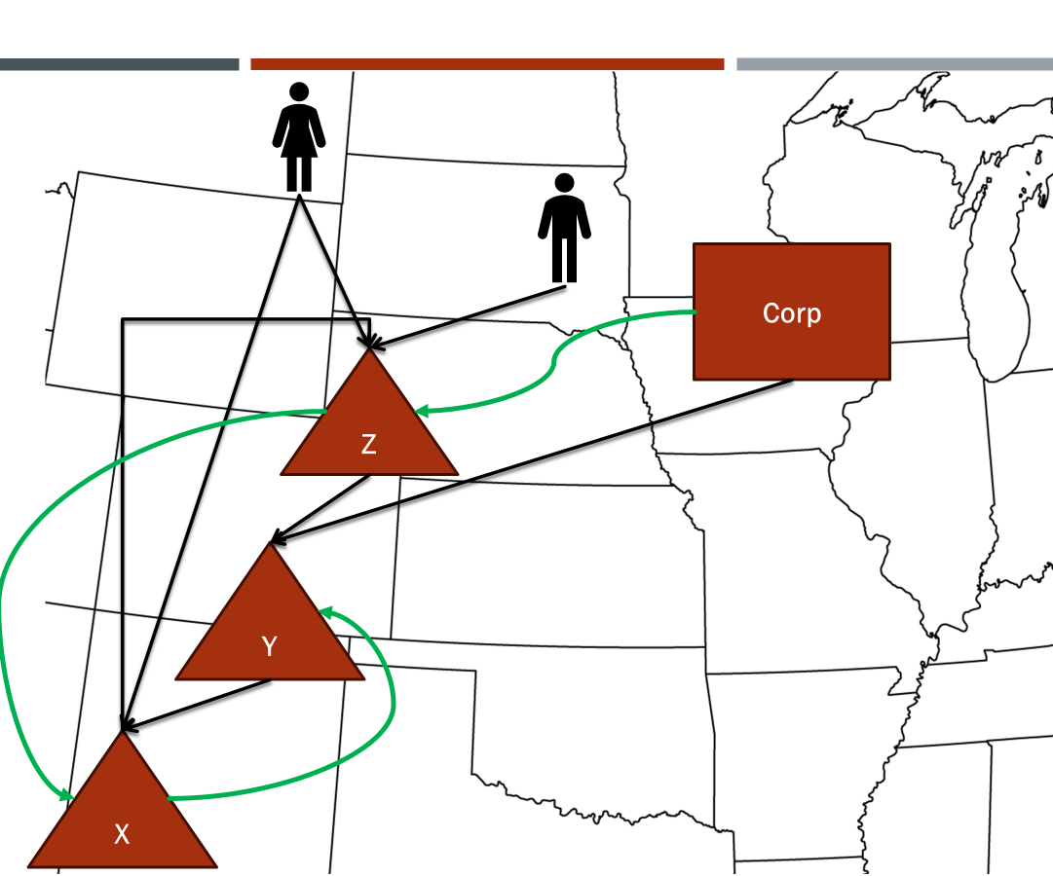
NOTE:
This presentation sets out information from work group discussions, the white paper draft, and multistate research, which are on the project webpage here: partnership project webpage. All input is welcomed.
*Our multistate research should not be relied on as tax advice. For specific questions, please contact your state department of revenue and/or tax advisor.

Slide 16
Partnership Project
Progress To Date
  Comprehensive Issue Outline
  Sourcing Income of Investment Partnerships
    White Paper
    Draft Model
  Sourcing Guaranteed Payments for Services
    White Paper
    Draft Model
  Proposed General Framework –
  State Pass-Through Taxation of Partnerships
  Sourcing in Complex Partnership Structures
    Multistate Research
    White Paper Draft - all input is welcome
  These documents can be found on the project webpage HERE.

Slide 17
White paper approach
  First: Do research on state rules for sourcing where there are corporate partners or complex structures—including intercompany transactions and special allocations. (Section III)
  Second: Summarize the general framework for state sourcing rules to provide context, including – general partnership law, federal tax rules to which states conform, general state sourcing rules – and focus on the issues and implications. (Section I)
  Third: Develop details of a potential approach to address the issues. (Section II)
  Fourth: Take any input during this process from states or the public.
  Fifth: Make general findings and recommendations.

Slide 18
Over-arching Goal of this Process
Proceed in a step-by-step approach to identifying issues and the established law or other context important for addressing the issues.
“Connect the dots” – between the issues or implications of applicable laws or other facts so that states can understand the basis for any proposed solutions.
Provide background and “show our work.”
All this so that we can change course when necessary and, by the time we get to findings and recommendations, there are no “surprises.”

Slide 19
Changes and Updates in 5-19-25 Version
Section I – Context
  Some revisions to the section on Federal Anti-Abuse Provisions
  Some revisions to the section on General State Sourcing Rules for Income of Businesses
  Some revisions and additions to the section on the Importance of the Attribution or “Conduit” Principle
Section II – Proposals for Addressing Issues
  II.D. Other Related-Entity Transactions
    Add-Back Statutes
    Transfer-Pricing Authority
  II. E. Anti-Abuse Rules

Slide 20
Critical Assumptions Based on Work so far:
States use apportionment as the main method of sourcing business income whether earned by corporations, proprietorships, or partnerships, and they use rules of assignment for “nonbusiness” (non-apportionable) income.
In simple partnerships with individual partners, the partnership’s business income is sourced at the partnership level.

Slide 21
Critical Assumptions Based on Work so far:
The first step in applying those rules is determining when income is “apportionable” or “non-apportionable.”
In applying the state sourcing rules specifically to partnerships, the assumption is that this determination is done first at the partnership level.

Slide 22
Critical Assumptions Based on Work so far:
Partnership – Level Sourcing:
  If apportionable, the income can be apportioned using the partnership’s factors.
  If non-apportionable, the income can be sourced based on the partnership’s activity and the nature of the income.
But where there are tiered or corporate partners—the question is how does their relationship to the partnership affect sourcing.

Slide 23
Critical Assumptions Based on Work so far:
Treatment of Item of Income by the Partnership | Treatment of the Distributive Share by the Partner | Result
Non-business (non-apportionable) | Non-business (non-apportionable) | Sourced by applying rules of assignment (allocation) at the partnership level.
Non-business (non-apportionable) | Business (apportionable) | Sourced by applying rules of assignment (allocation) at the partnership level.
Business (apportionable) | Non-business (non-apportionable) | Sourced by apportioning at the partnership level.
Business (apportionable) | Business (apportionable) | Sourced by apportioning at the partnership level unless blended apportionment applies.

Slide 24
Critical Assumptions Based on Work so far:
In other words, the character of the partnership income as apportionable or non-apportionable is determined at the level of the partnership, based on the partnership’s activities, and that character and sourcing result is attributed to the partners—whether individual, corporate, tiered, or other.
The only time this does not determine sourcing is when the partnership would treat the income as apportionable and the partner would also treat its distributive share as apportionable. In that case, blended apportionment might be used.

Slide 25
Update on Blended Apportionment

Slide 26
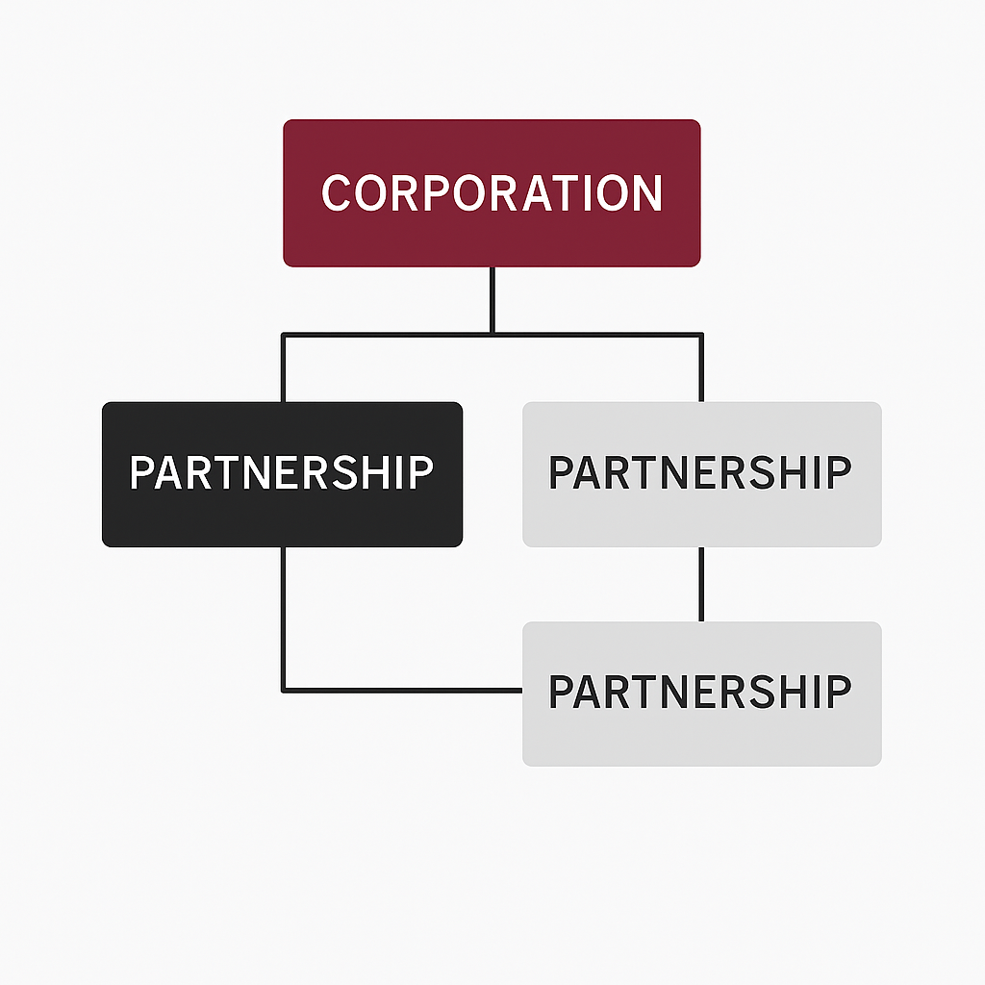


What is blended apportionment?
This concept applies when the partner is a corporation or another partnership.
It is sometimes referred to as “rolling up” the factors.
Under blended apportionment, the partner’s own apportionment factors are combined with its share of the partnership’s apportionment factors. The blended formula is then applied to the partner’s total apportionable income, including its share of the partnership’s apportionable income.
BLEND
BLEND
BLEND

Slide 27
What are the Advantages and Disadvantages of Blended Apportionment?

Slide 28
Advantages of Blended Apportionment
Blended apportionment can help reduce the distortions in income sourcing across states that arise under separate-entity reporting where partners and partnerships are engaged in a unitary business.
It can reflect the economic reality more accurately.
It can allow for the elimination of intercompany transactions from the base and a share of those transactions from the factors.

Slide 29
It can create challenges in reporting tax-related information.
Some states don’t have rules for blended apportionment, and the rules aren’t consistent.
Disadvantages of Blended Apportionment

Slide 30
Who is using blended apportionment?
The majority of states have explicitly adopted some form of blended apportionment for sourcing income when the partner is a corporation.
Alabama, Arizona, California, Connecticut, Delaware, the District of Columbia, Florida, Georgia, Hawaii, Indiana, Idaho, Illinois, Iowa, Kansas, Kentucky, Maine, Maryland, Massachusetts, Michigan, Minnesota, Montana, Nebraska, New Jersey, New York, North Carolina, North Dakota, Ohio, Oregon, Pennsylvania, Rhode Island, Tennessee, Utah, Vermont, Virginia, West Virginia, and Wisconsin.

Slide 31
Who is using blended apportionment?
When the partner is a partnership in another partnership, 12 of the 15 states with sourcing rules for multi-tiered partnerships have explicitly adopted some form of blended apportionment for sourcing income.
The twelve states are Arizona, California, Colorado, Florida, Illinois, Kentucky, Massachusetts, Ohio, Utah, Vermont, West Virginia, and Wisconsin.

Slide 32
Blended Apportionment:
The “How” Issues

Slide 33
“How” Issues with Blended Apportionment
How is the share of the factors to be combined with the partner’s own factors determined?
  General tentative answer – based on the partner’s distributive share of partnership income.
    What if the partner receives special allocations—including special allocations of partnership losses?
      Use absolute values of the total amounts of income (loss) allocated to partners.
Are required allocations of gain or loss—e.g., built-in gain (loss) on contributed assets—sourced differently?

Slide 34
“How” Issues with Blended Apportionment
How are receipts from partner-partnership transactions treated?
  In general—the states that have addressed this issue appear to eliminate those intercompany amounts.
    Are there times when clear 482 or other add-back authority is needed?
Are there other general anti-abuse rules to consider?

Slide 35
Expanded workbook on sourcing Method
The Workbook is intended to:
  Compare separate apportionment vs blended apportionment.
  Provide examples of special allocations and the effect of the absolute value method.
  Compare the effect of both sourcing methods on individuals and corporations.
  Highlight the effects of partnership structure on sourcing and illustrate why sourcing is highly dependent on information transfer between the partnership and its partners.
  Illustrate the effect of each sourcing method on withholding tax.
  Illustrate the effect of intercompany transactions on sourcing.

Slide 36
Expanded workbook on sourcing Method
Assumptions for this workbook will be that all states:
  have adopted some version of UDIPTA to distinguish apportionable income from non-apportionable income.
  use a single sales factor.
  use market sourcing for factor representation.
  must determine some amount of source income at the operating partnership to apply a withholding tax.

Slide 37
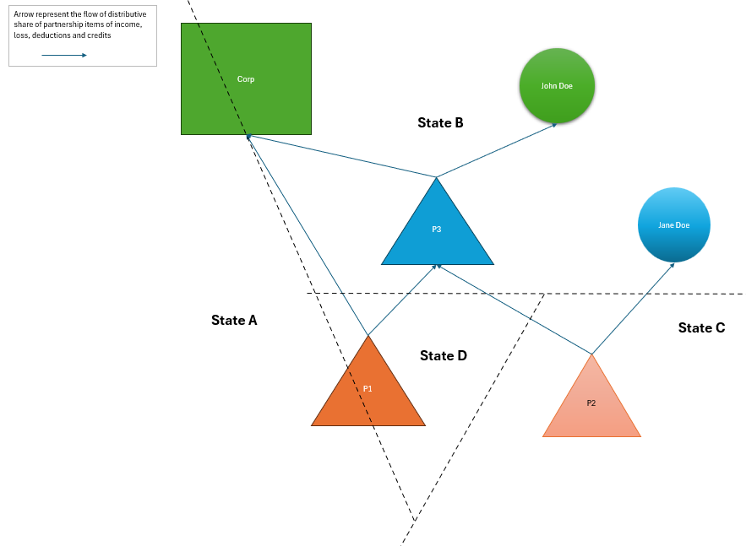
Expanded Workbook on Souring Method
The following structure reflects most possible cases.
Corp and P1 can both be entities operating businesses in at least two states.
The individuals are both residents of B which uses a credit for taxes paid to another state.

Slide 38
Blended Apportionment:
The “When” Issues

Slide 39
When are the states using blended apportionment?
When the partner is a corporation – states vary
  Most expressly limit blended apportionment
    To situations involving a unitary relationship (California, Hawaii, Indiana, Illinois, Maryland, Massachusetts, Michigan, Minnesota, Montana, Nebraska, New Jersey, Vermont, West Virginia, Wisconsin); or
    Where the income is apportionable (Idaho, North Carolina, North Dakota); or
    Where the partnership is a business interest (Alabama – business interest; Arizona – business interest; Iowa – connection with the taxpayer’s regular trade or business operations; Oregon – part of the corporation's overall business operations).
  The remaining blended apportionment states do not explicitly specify when blended apportionment applies.

Slide 40
When are the states using blended apportionment?
When a partnership is a partner in another partnership:
  7 of the 12 states with blended apportionment—California, Colorado, Illinois, Massachusetts, Vermont, West Virginia, and Wisconsin—expressly limit its application to situations involving a unitary relationship.
The remaining blended apportionment states do not explicitly specify when blended apportionment applies.

Slide 41
What does “Unitary” Mean in the context of a partnership?
Some states don’t provide guidance on what “unitary” means for partnerships or blended apportionment.
Some states cross-reference their “unitary” definition for corporate tax which uses tests such as such as functional integration, economies of scale, centralized management, contribution or dependency, and/or flow of value.
Several states have express language disregarding ownership requirements for purposes of the unitary analysis.

Slide 42
Examples of Specific ownership rules for the unitary analysis
45 Ind. Admin. Code 3.1-1-153(b): if the corporate partner's activities and the partnership's activities constitute a unitary business under established standards, disregarding ownership requirements.
Cal. Code Regs. tit. 18, § 25137-1(f): if the partnership's activities and the taxpayer's activities constitute a unitary business under established standards, disregarding ownership requirements.

Slide 43
Examples of Specific ownership rules for the unitary analysis
Matter of the Appeal of: L. Smith, Dkt. No. 20036033 (Cal. Office of Tax Appeals, December 7, 2022).
Critically, Regulation section 25137-1 's instruction that unity is to be determined without regard to ownership requirements also means ''unitary combination does not require that a partner have control of the partnership that is combined." (Appeal of Willamette Industries, Inc., supra; see also Appeal of Albertson's, Inc. (82-SBE-211) 1982 WL 11960 ["lack of control over the partnership business, by itself, does not preclude unitary treatment of a partner and its share of the partnership business"].)

Slide 44
Examples of Specific ownership rules for the unitary analysis
Michigan (Mich. Comp. Laws § 206.663(1))
A flow-through entity is unitary with a taxpayer when that taxpayer owns or controls, directly or indirectly, more than 50% of the ownership interests with voting rights or ownership interests that confer comparable rights to voting rights of the flow-through entity, and that has business activities or operations which result in a flow of value between the taxpayer and the flow-through entity, or between the flow-through entity and another flow-through entity unitary with the taxpayer, or has business activities or operations that are integrated with, are dependent upon, or contribute to each other.

Slide 45
Challenges in applying Traditional unitary tests in the partnership context
A partner’s role in, or control of, the partnership is not necessarily tied to that partner’s ownership share.
Many partnership structures are so complex that identifying common control among related entities can be nearly impossible.
A partner might substantially use its interest in the partnership and the partnership’s intangible assets without the type of “functional integration” or “economies of scale” that were more typical in traditional businesses involving shared physical assets.

Slide 46
How does the attribution principle fit in with the unitary analysis?
A few states have attribution language in their unitary definition stating that any business conducted by a pass-through entity shall be treated as conducted by its members, whether directly held or indirectly held through a series of pass-through entities, to the extent of the member's distributive share of the pass-through entity's income.

Slide 47
Examples of ATTRIBUTION LANGUAGE
Conn. Gen. Stat. § 12-213(a)(32):
“Unitary business” means a single economic enterprise that is made up either of separate parts of a single business entity or of a group of business entities under common ownership, which enterprise is sufficiently interdependent, integrated or inter-related through its activities so as to provide mutual benefit and produce a significant sharing or exchange of value among such entities, or a significant flow of value among the separate parts. For purposes of this chapter, (A) any business conducted by a pass-through entity shall be treated as conducted by its members, whether directly held or indirectly held through a series of pass-through entities, to the extent of the member's distributive share of the pass-through entity's income, regardless of the percentage of the member's ownership interest or its distributive or any other share of pass-through entity income . . .

Slide 48
Examples of attribution language
Vermont Schedule BI-477 Instructions (2024)
The unitary business principle is satisfied if a single economic enterprise exists, which is made up either of separate parts of a single business entity or of a commonly controlled group of business entities that are sufficiently interdependent, integrated, and interrelated through their activities so as to provide a synergy and mutual benefit that produces a sharing or exchange of value among them and a significant flow of value to the separate parts. The unitary business principle can exist for a taxpayer as a result of the taxpayer’s interest in that partnership, whether the interest in that partnership is held directly or indirectly through a series of partnerships or other pass-through entities . . .
Each discrete business undertaken by a lower-tier pass-through is attributable to the filing passthrough. If no unitary business principle exists between these attributed (lower tier) activities and the activities of the filing pass-through entity, the sourcing of income will not change between levels. Income and factors should not be blended, but rather the net income/loss should be reported here.

Slide 49
How does the attribution principle fit in the unitary analysis?
Should unitary business status be automatically attributed to a partner solely based on its partnership interest?
The Court in Virginia Dep’t of Taxation v. FJ Management Inc., No. 0701-23-2 (Va. Ct. App., Nov. 12, 2024) (on appeal) said no.
Or – do partners’ attributes have to be taken into account as well (as they are when determining the ultimate treatment of some items for federal purposes)?

Slide 50
How does the attribution principle fit in the unitary analysis?
What if a presumption of blended apportionment were applied to corporate and partnership partners that could be overridden in certain circumstances—for example, if there is a lack of a unitary relationship or operational function?
If this presumption is rebutted, the taxpayer would instead use the recognizing entity’s apportionment factors to apportion the items without blending the factors.

Slide 51
Questions? Comments?
What's Next?

